Slide 1
YOHHLNet Annual Meeting, Tuesday 13th June 2017 Room 2.14, HEYH Building, Willow Terrace Road, Leeds
Programme:
10.00 – 10.20, Registration & refreshments
Welcome & Apologies – Janet Sampson, YOHHLNet Chair
10.20 – 10.35 YOHHLNet Annual Accounts– Helen Rotherforth, YOHHLNet Treasurer
10.35 – 10.45, YOHHLNet CPD Annual Report – Helen Barlow, YOHHLNet Co-CPD Co-ordinator
10.45 – 11.00, YOHHLNet Annual Report – Janet Sampson, YOHHLNet Chair
Adoption of the Reports and Accounts
11.00 – 11.20, CILIP Yorkshire and the Humber – Samantha Goldsmith, CILIP Y&H Chair
- The work/activities of CILIP Yorkshire and the Humber
11.20- 11.40, #AMillionDecisions – Sarah Hennessy, CILIP HLG Chair and Project Team Member
- An update on the campaign so far
11.40 – 11.55, Questions, discussions
11.55 – 12.00, Closing remarks – Janet Sampson, YOHHLNet Chair
12.00 – 13.00, Buffet lunch and networking

Slide 2
Chair’s Report 2016-17
Key achievements from the last 12 months
Following consultation the name, acronym and logo were decided.
Established our wiki site at http://resources.lihnn.nhs.uk/wiki/Yorkshire_and_Humber_LKS.MainPage.ashx
Following consultation, the constitution was drawn up and is now available on the wiki site
Established the Committee and have been finalising the financial and organisational procedures
Delivered a number of CPD events
Thanks to the CPD Group for all that they do
See the wiki for feedback and presentations from a number of events
Had our official YOHHLNet Launch event in Leeds on 12th December 2016
See the wiki for the presentations from this event
Encouraged applications for bursaries to attend events/conferences
CILIP HLG Conference – 6 places funded by HCLU
LILAC Conference – I place funded by YOHHLNet
Provided financial support to top up the ‘Tools Collection’ – more information to follow
Paid for additional top up for YOHHLNet for the OUP e-book collection
Put out a call for organisations to sign up for membership – more on that later
#YOHHLNET

Slide 3
Benefits of YOHHLNet membership
Better quality Library and Knowledge Services (LKS) through the ongoing sharing of best practice across the region and a shared strategic outlook facilitated by networking events, regional mailing lists and above all the expertise and enthusiasm of all staff across the region
Enhanced access to quality resources through collaborative purchasing, for example topping up the OUP e-handbook collection, and joining up with services in LIHNN and HLN, e.g. MA Healthcare Offer
Increased sector and cross-sector engagement through access to professional updates and sector communications, opportunities for joined up events with LIHNN and HLN, e.g. Mental Health Group
More engaged staff through the sharing of information with peers and strengthening of networks, including special interest groups and communities of practice
Improved staff skills enabled through a wide range of free at the point of access specialist CPD opportunities including training courses, online development, coaching, mentoring and access to a free staff library book collection.
Professional development of all staff by providing support for professional development including funding attendance at conference, opportunities for cross-service coaching and mentoring and encouragement of presenting and writing for publication opportunities
(With thanks to LIHNN and CILIP)
#YOHHLNET

Slide 4
Current YOHHLNet Committee
Janet Sampson | Doncaster and Bassetlaw Teaching Hospitals NHS Foundation Trust
Becky Williams | Bradford District Care NHS Foundation Trust
Helen Rotherforth | Mid Yorkshire NHS Hospitals Trust
Helen Barlow/Katherine France | The Rotherham Foundation Trust
Dom Gilroy | Healthcare Libraries Unit North
Jo Marsden | Sheffield Teaching Hospitals NHS Foundation Trust
Joel Kerry | Leeds Teaching Hospital NHS Foundation Trust
Hazel Brownhill | York Teaching Hospitals NHS Foundation Trust
Maria Jose Simoes | Leeds Community Healthcare NHS Trust
Paul Twiddy | Leeds Teaching Hospital NHS Foundation Trust
Sarah Hennessy | South West Yorkshire Partnership NHS Foundation Trust
Chris Lawton | Northern Lincolnshire and Goole Hospitals NHS Trust
Natasha Craigs | Mid Yorkshire NHS Hospitals Trust
Rocio Rodriguez Lopez | Academic Unit of Health Economics, University of Leeds

Slide 5
Members so far…
Members up to 31st March 2017 and after*: 13 member organisations + 4 member organisations (from 1st April)
Pending: A further 4 member organisations have applied – just waiting for payments to complete
Other possible members: A further 5 member organisations who use our facilities still to join – a number of reasons why not yet happened but will be offering support and encouragement
Delighted that we have members from the health libraries and/or Institute of Science at the Universities of Hull, Leeds and York. It would be great if we could get more – so if you have contacts at any of the other universities in the region let us know.
#YOHHLNET

Slide 6
What we do…
#YOHHLNET
Provide support to the Special Interest Groups
Study days and events
Provide bursary opportunities for all staff
Financial support for the ‘Tools Collection’
Details of Room Booking Opportunities
Assist and/or support consortium purchases

Slide 7
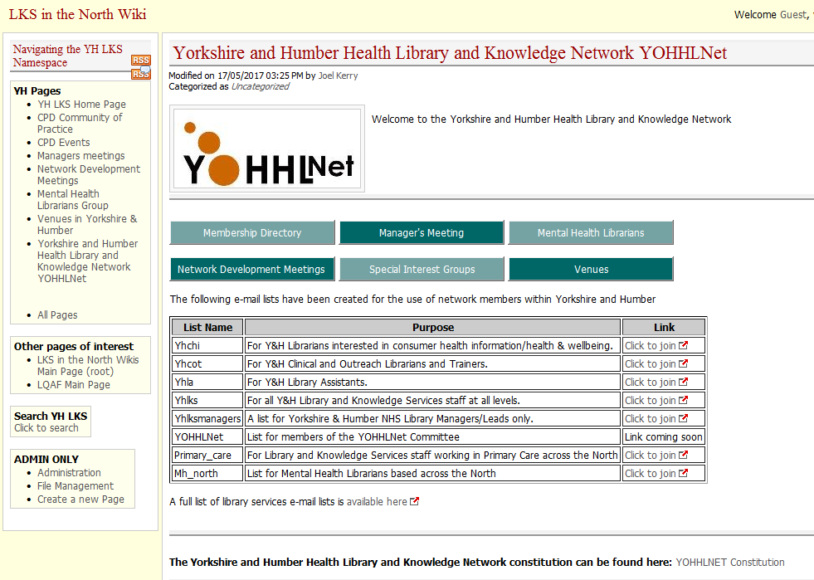
YOHHLNet wiki (1)
Information about our activities and work can be found on the Y & H wiki at: http://resources.lihnn.nhs.uk/wiki/Yorkshire_and_Humber_LKS.MainPage.ashx
#YOHHLNET

Slide 8
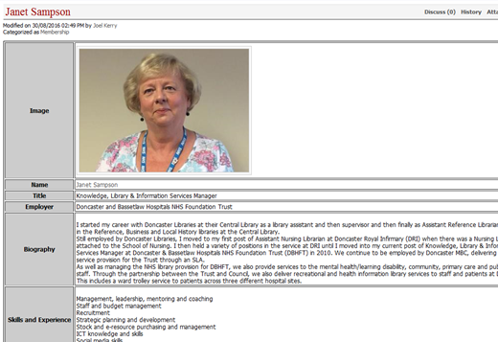
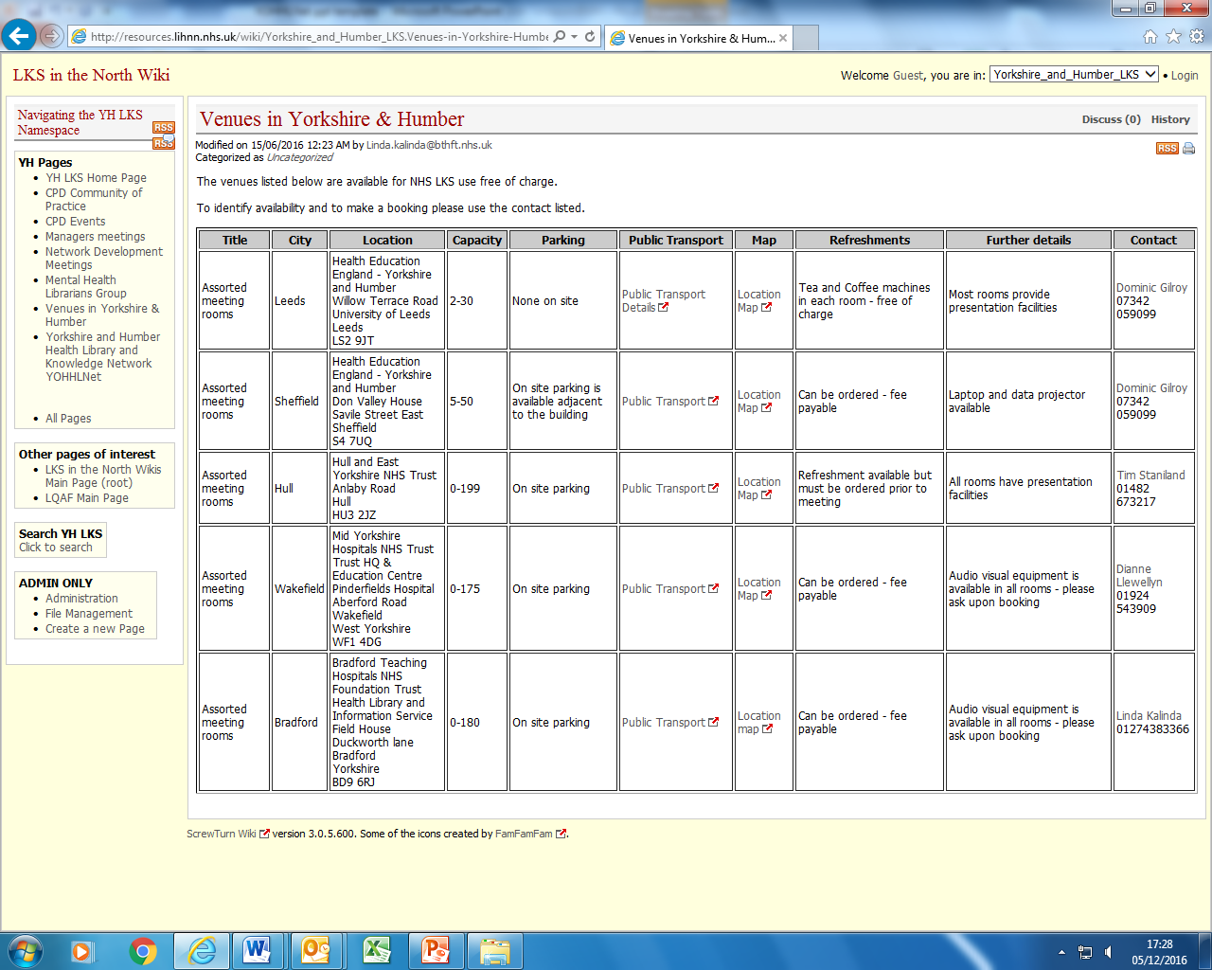
YOHHLNet wiki (2)
You can also find information on the wiki relating to other areas including…
Membership directory:
Room bookings:
#YOHHLNET

Slide 9
Coming next…
Promotion of the ‘Tools Collection’, especially the e-books just purchased
Planning of further CPD events to supplement what may be provided by KFH/HCLU
Based on outcomes of national DNA
Opportunities for further bursary applications
Have already funded 3 places for CILIP Conference 2017
Further opportunities may be available
Explore and formalise support opportunities for Special Interest Groups
Mental Health and Primary Care, Public Health & Commissioning SIGs have updated their Terms of Reference
Offer funding support where needed, subject to available funding
Completion of ‘Welcome Information’ for members
Will be circulated to all member organisations
To include details about mailing lists, wiki, etc.
Inaugural “Annual YOHHLNet Awards” at YOHHLNet Christmas Event
Individual & Team Awards; Leadership; Innovation; Unsung Hero; Engagement
#YOHHLNET

Slide 10
How to Contact Us
You can contact members of the YOHHLNet by contacting any member of the Committee - contact details will be on the wiki shortly and we will re-circulate by the yhlks mailing list again
Or contact the committee in general by e-mailing yohhlnet@gmail.com - is not monitored daily, so if you need something answering urgently please contact the Chair, Secretary or Treasurer direct: Janet Sampson (Chair) - tel.: 01302 642895, email: janet.sampson@dbh.nhs.uk Becky Williams (Secretary) - tel.: 01274 223900, email: rebecca.williams@bdct.nhs.uk Helen Rotherforth (Treasurer) – tel.: 01924 543899, email: helen.rotherforth@midyorks.nhs.uk
#YOHHLNET

