Slide 1
YOHHLNet Annual Meeting, Tuesday 17th July 2018 Room 2.14, HEYH Building, Willow Terrace Road, Leeds
Programme:
10.00 – 10.20, Registration & refreshments
Welcome & Apologies – Janet Sampson, YOHHLNet Chair
10.25 – 10.35 YOHHLNet Annual Accounts– Helen Rotherforth, YOHHLNet Treasurer
10.35 – 10.45 YOHHLNet CPD Annual Report – Helen Barlow, YOHHLNet Co-CPD Co-ordinator
10.45 – 11.00 YOHHLNet Annual Report – Janet Sampson, YOHHLNet Chair
Adoption of the Reports and Accounts
Speakers Programme:
11.00 – 11.15 Leeds Public Health Research Centre – Rebecca Vӓӓnӓnen
11.15- 11.30 Wakefield Public Libraries/Mid Yorkshire NHS Trust – Lynne Holroyd/Helen Rotherforth
11.30 – 11.45 NHS Digital – Caroline Storer
11.45 – 12.00 Leeds Institute of Health Sciences – Judy Wright
Closing remarks – Janet Sampson, YOHHLNet Chair
12.15 – 13.00, Buffet lunch and networking

Slide 2
Chair’s Report 2017-18
Key achievements from the last 12 months
Continued to grow and develop our membership with great support from across the region
Members from NHS, public libraries and the academic sector
Delivered a number of CPD events offering a wide range of development opportunities
Thanks to the CPD Group for all that they do
Many of our own members were involved in delivering a number of events
See the wiki for feedback and presentations from a number of events
Provided support to our YOHHLNet regional groups
Launched ourselves on Social Media!
Encouraged applications for bursaries to attend events/conferences
Held our first Annual Christmas Study Day and launched the annual YOHHLNet awards
#YOHHLNET

Slide 3
Mental Health Group
The YOHHLNet Mental Health Group has invited the HLN Mental Health Library Services to join the group as they are so small in number
Through the revision of Terms of Reference in May 2017, it has been decided that they will meet in person once a year, meet twice a year by tele-conference and meet once a year as the Mental HealthXtra Group with colleagues from LIHNN
Have a Mental Health mailing list that covers the whole of the North as well as contacting YOHHLNet/HLN members locally
Throughout the year, discussed issues around shared learning, best practice and use of e-resources
In 2017, the Mental Health Xtra Group met in Manchester on 18th July
Discussed issues around current awareness, e-resources and demonstrating impact
In 2018 the Mental Health Xtra Group is due to be hosted by YOHHLNet
For further details regards the work of the group check out the YOHHLNet wiki or contact the current Chair of the Group – Becky Williams
#YOHHLNET

Slide 4
Primary Care, Public Health & Commissioning Group
The YOHHLNet PC, PH & Commissioning Group is a small group but also includes members from the acute sector who deliver services to these areas.
The group mirrors the meeting arrangements of the Mental Health Group – in that it will meet in person once a year, meet twice a year by tele-conference and meet once a year as the wider group with colleagues from LIHNN if sufficient interest
Throughout the year, discussed issues around STPs/ACOs, information for patients and the public and use of e-resources
In 2017, the wider Northern Primary Care Group met in Leeds on the 11th October 2018
Financial supported by YOHHLNet with sponsorship from Wolters Kluwer
Presentations from Wolters Kluwer and Public Health England
In 2018, YOHHLNet has agreed to host the joint event again to support colleagues from HLN
For further details regards the work of the group check out the YOHHLNet wiki or contact the current Chair of the Group – Helen Swales
#YOHHLNET

Slide 5
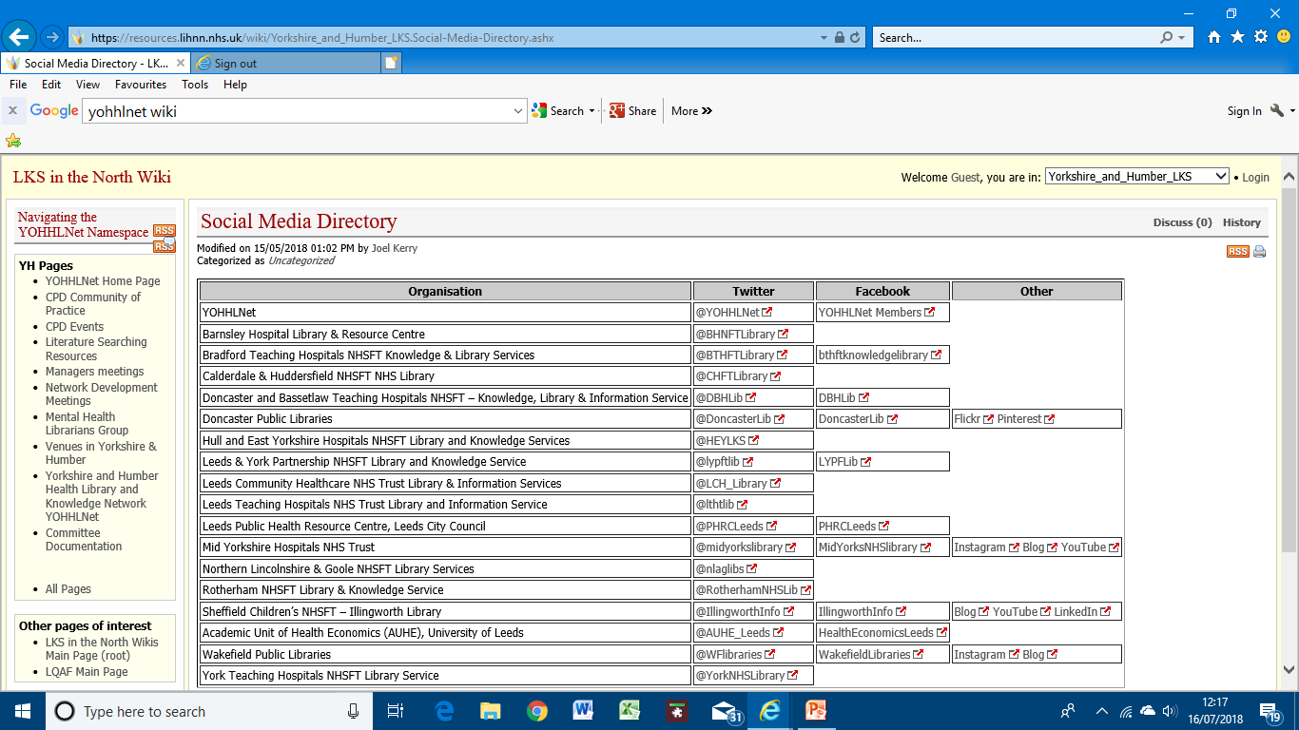
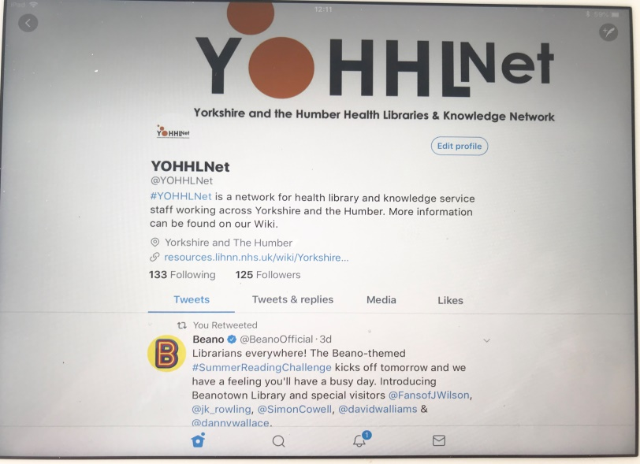
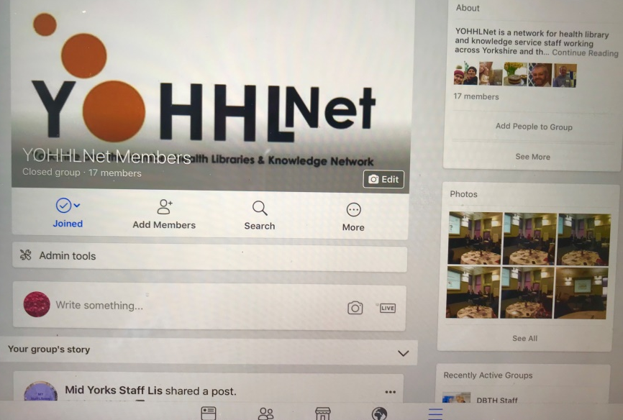
Social Media
In 2017 we launched our Social Media presence to the outside world!
#YOHHLNET

Slide 6
Annual Christmas Study Day, 12th December 2017
YOHHLNet’s first Annual Christmas Study Day and introduced the inaugural YOHHLNet Awards
Was a fantastic day with representation from a wide range of staff.
Superb keynote speaker – Sue Lacey-Bryant, providing an update on Knowledge for Healthcare, highlighting some of the impact submissions from the region.
Great to hear about some of the initiatives happening in the region and some fantastic ideas materialised from the Knowledge Café Session
David Stewart provided an interesting but entertaining (with audience participation!)insight into the journey that the region had made in recent years
Announcement of, and presentations to our YOHHLNet Award winners in the four categories: Moments of Magic; Innovation Award; Engagement Award and Leadership Award. In addition, David Stewart also presented the first Director’s Award to members of the YOHHLNet region
Congratulations to all our winners
Time to relax (and network!) over a lovely festive lunch!
Planning is well under way for our 2018 Christmas Study Day on the
13th December 2018 – so get the date in your diaries!

Slide 7
What we have done in summary
Through YOHHLNETs support of CPD we have provided seven bursaries to allow staff to attend conferences (LILAC, CILIP, ICLC) and hosted/delivered 7 CPD events in the region. Additionally, YOHHLNet members participated in/presented at a number of national and regional events.
Developed many new “firsts” for the region which has helped to establish it as a network to be noticed – active on our social media accounts; social media directory; venues directory; established annual awards to recognise the hard work of individuals and teams across the region, raised issues and addressed problems.
Have provided both advice and financial support to the YOHHLNet Special Interest Groups – helps give them a voice within the region about things they are passionate about and share ideas and developments. A great networking opportunity as well.
#YOHHLNET

Slide 8
What’s next…
Call for new Committee members
Some of the current members are coming to the end of their period of office
As this is the first cycle of change, planning a phased period of change but need some volunteers
Planning of further CPD events to supplement what may be provided by KFH/HCLU
Based on outcomes of national DNA
Opportunities for further bursary applications remain available all year round
Have already funded places for the LILIAC, CILIP HLG and CILIP Conferences 2018 and a UKeIG Study Day
Application form https://resources.lihnn.nhs.uk/wiki/GetFile.aspx?Page=Yorkshire_and_Humber_LKS.CPD-Community-of-Practice&File=YOHHLNet%20Course%20Sponsorship%20Application.doc
Continue to provide support for the YOHHLNet Special Interest Groups
The Mental Health and Primary Care, Public Health & Commissioning SIGs have already started planning for joint events later this year with LIHNN and HLN
Offer funding support where needed, subject to available funding
We will be putting a call out for nominations for the Annual YOHHLNet Awards in the Autumn
We want lost of nominations from all sectors and staff: there is opportunity to nominate both individuals and teams so something for everyone so get your thinking caps on!
#YOHHLNET

Slide 9
How to contact Us
We want to hear from you…
If there is anything that you would like YOHHLNet to consider doing to support you in your work or professional development, or
If you have any brilliant ideas, innovations or light bulb moments that would help the network then please let us know – we would love to hear from you.
You can contact members of the YOHHLNet by contacting any member of the Committee (details on the Wiki site) or contact:
Chair, Secretary or Treasurer direct: Janet Sampson (Chair) - 01302 642895, janet.sampson1@nhs.net Becky Williams (Secretary) - 01274 223900, rebecca.williams@bdct.nhs.uk Helen Rotherforth (Treasurer) – 01924 543899, helen.rotherforth@midyorks.nhs.uk
#YOHHLNET

Slide 10
Benefits of YOHHLNet membership
Better quality Library and Knowledge Services (LKS) through the ongoing sharing of best practice across the region and a shared strategic outlook facilitated by networking events, regional mailing lists and above all the expertise and enthusiasm of all staff across the region
Enhanced access to quality resources through collaborative purchasing, for example topping up the OUP e-handbook collection, and joining up with services in LIHNN and HLN, e.g. MA Healthcare Offer
Increased sector and cross-sector engagement through access to professional updates and sector communications, opportunities for joined up events with LIHNN and HLN, e.g. Mental Health Group
More engaged staff through the sharing of information with peers and strengthening of networks, including special interest groups and communities of practice
Improved staff skills enabled through a wide range of free at the point of access specialist CPD opportunities including training courses, online development, coaching, mentoring and access to a free staff library book collection.
Professional development of all staff by providing support for professional development including funding attendance at conference, opportunities for cross-service coaching and mentoring and encouragement of presenting and writing for publication opportunities
(With thanks to LIHNN and CILIP)
#YOHHLNET

