Slide 1
YoHHLNet
12th December 2019

Slide 3
Jayne

Slide 4
Dom

Slide 5
?

Slide 6
HEE LKSL North team
1st Floor, Regatta Place | Brunswick Business Park | Summers Road | Liverpool | L3 4BL
Health Education England
3rd Floor | 3 Piccadilly Place | Manchester | M1 3BN
Health Education England
G11, Willow Terrace
Leeds
LS2 9JT
David Stewart
Health Education England
1st Floor
Regatta Place
Brunswick Business Park
Liverpool L3 4BL

Slide 8
Resource Discovery
Watch out for all of these
Point of care tool – BMJ Best Practice
A resource discovery tool
Regional library management systems

Slide 9
Quality Improvement Outcomes Framework
All NHS organisations enable their workforce to freely access proactive library and knowledge services that meet organisational priorities within the framework of Knowledge for Healthcare.
All NHS decision making is underpinned by high quality evidence and knowledge mobilised by skilled library and knowledge specialists.
Library and knowledge specialists identify the knowledge and evidence needs of the workforce in order to deliver effective and proactive services.
All NHS organisations receive library and knowledge services provided by teams with the right skill mix to deliver on organisational and Knowledge for Healthcare priorities.
Library and knowledge specialists improve the quality of library and knowledge services using evidence from research, innovation and good practice.
Library and knowledge specialists demonstrate that their services make a positive impact on healthcare.
Notes:
DG
Next three slides provide an overview of the outcomes and the structure of the framework – chosen outcome 5 to demonstrate as it uses evidence from research
The overarching aim of the outcomes is that NHS organisations and the healthcare workforce deliver an evidence-based national health service by accessing high quality, customer focused knowledge and evidence services enabled by the expertise of healthcare library and knowledge specialists.
(Read out each of the outcomes):JUST READ OUT THE OUTCOME,DON’T ADD ANY OTHER INFORMATION
Outcome 1 (Read)
Outcome 2 (Read)
Outcome 3 (Read)
Outcome 4 (Read)
Outcome 5 (Read)
Outcome 6 (Read)
You will notice that some of these outcomes (for example Outcome 5) are the largely the remit of the library and knowledge staff while others require ongoing interaction between the organisation and its library and knowledge service (for example Outcome 2)
This reflects that fact that the Outcomes Framework is something which belongs to the organisation and not solely the Library and Knowledge Service, and can be used to develop and improve the organisation’s approach to, and use of, library and knowledge specialists in addition to its use within and by the Library and Knowledge Service for improvement.

Slide 10
Public and patients information
We have a draft paragraph in the draft People Plan!
Train the trainer sessions completed around the country – but may be more!
Work on a 15-minute session for staff inductions
Developing e-learning in partnership with Scotland
Using geodata to focus interventions on areas with low information literacy levels

Slide 11
Mobilising evidence and knowledge
Knowvember – hope it went well!
https://kfh.libraryservices.nhs.uk/knowvember19-how-to-get-involved/
New postcard set: AI and Fishbowl added

Slide 12
Workforce development 1
Senior leadership programme next year
Talking to NHS Leadership Academy about the Rosalind Franklin programme
National CPD Team – programme of events:
Plan on page
Story telling
Exploring inclusion, equality and diversity

Slide 13
Workforce development 2
Development Needs Survey – closed 30 November 2019
Recommended staff ratios

Slide 14
Research
Return on investment: scoping work completed
Re-launch of HEALER as a community of practice for health LKS research
Publication of the Wirral research
Work-stream developing a driver diagram

Slide 15
Communications
Two new Briefings: 1st and 15th of the month
Blog: http://kfh.libraryservices.nhs.uk/
Advent calendar: Illuminating Quality Outcomes

Slide 16
Knowledge for Healthcare - refresh
Plan to publish new version early 2021
Work has begun
Survey of surveys – January 2020

Slide 17
In other news...
New health module in the MMU masters programme – started September 2019
Exploring the idea of an e-learning course in KM – market research
A new “concordat” to share purchasing of e-resources: HEE, CQC, NICE and PHE all signed up...

Slide 18
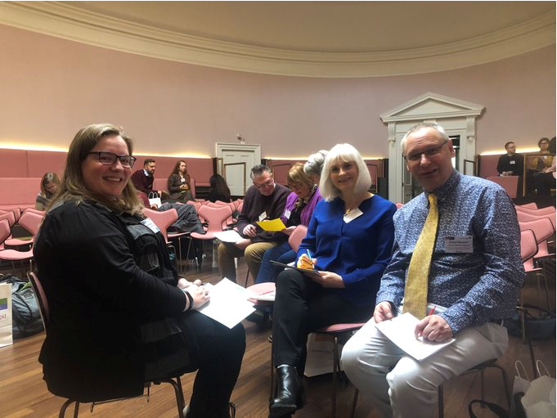

Slide 20
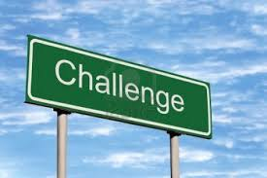

Slide 21
Any questions

