Slide 1
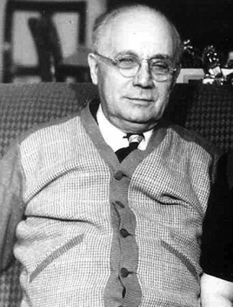
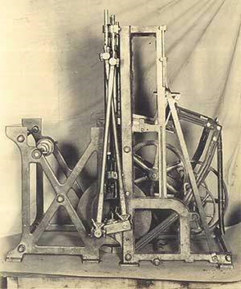
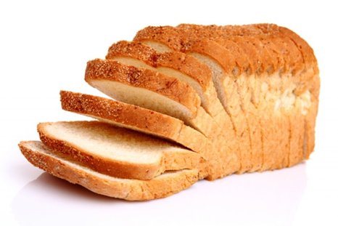
Otto Rohwedder
Notes:
Thanks to Paul Lord for this one…
Who is this? Otto Rohwedder. Okay, what is this? Bread slicing machine. Otto came up with the idea for a bread slicing machine in 1912. This is now considered the benchmark innovation in modern history, that thing against which all other ideas are measured.

Slide 2
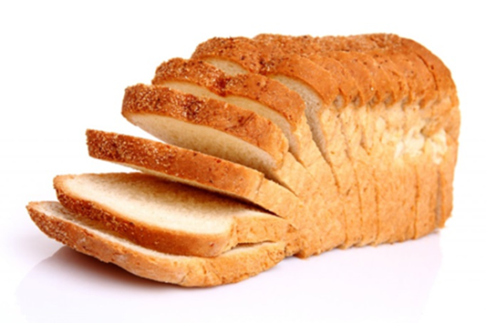
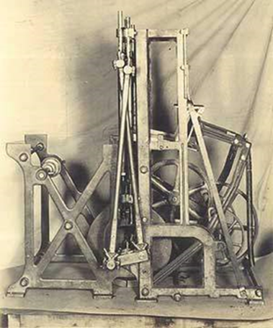
How long did it take for sliced bread to take off?
One year
Five years
Fifteen years
Fifty years

Slide 3
How long did it take for sliced bread to take off?
One year
Five years
Fifteen years
Fifty years
Notes:
So, when we say that new treatment X is the best thing since sliced bread, we cannot assume that it will get into practice rapidly.
Average of 17 years for evidence into routine practice

Slide 4
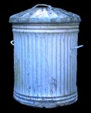
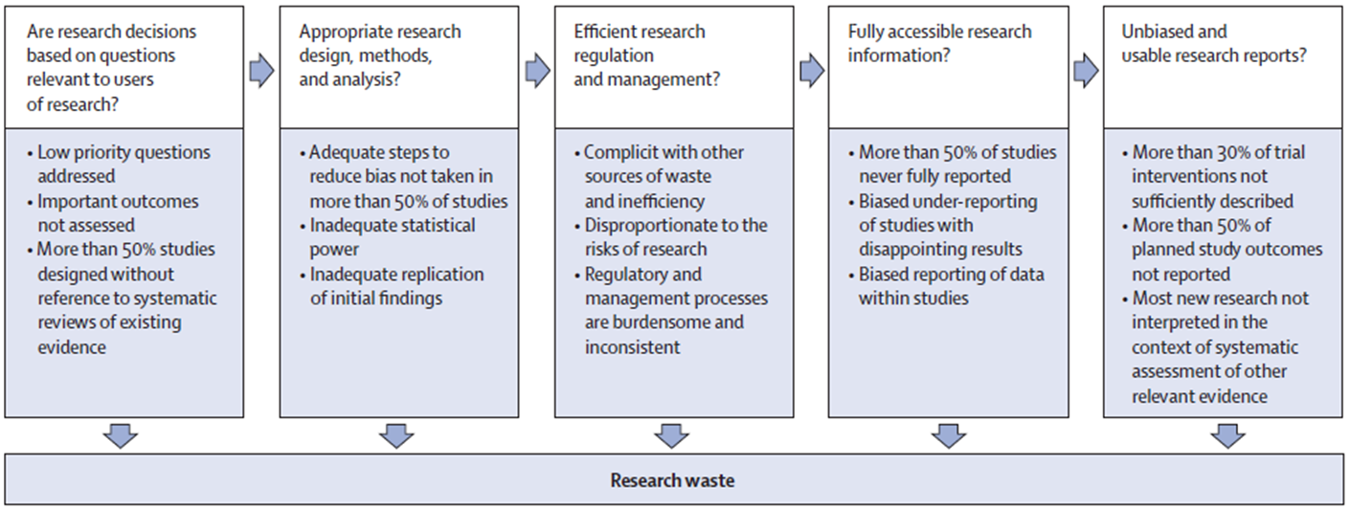
Avoidable research waste
Chalmers I, Glasziou P; Lancet 2009; 374: 86–89
MacLeod et al. Lancet 2014; 383: S0140-6736(13)62329-6

Slide 5
How much health research is wasted?
19% 37% 63% 85%

Slide 6
How much health research is wasted?
19% 37% 63% 85%

Slide 7


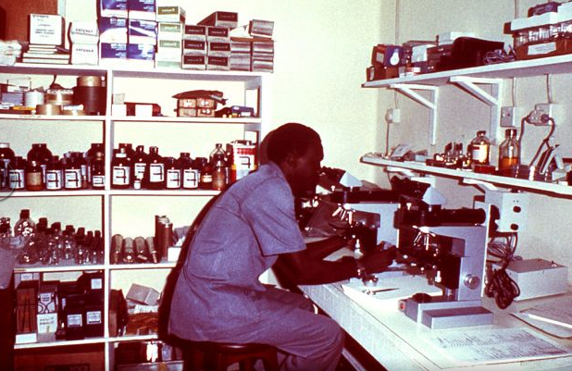
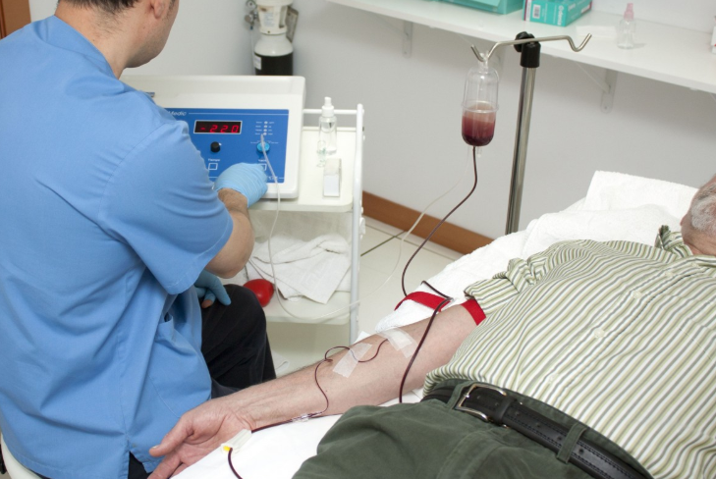

Slide 8
Implementation research: from bookcase to bedside
Robbie Foy
Notes:
Acknowledge focus on implementation / QI research – but common themes with broader research and service improvement

Slide 9
What is implementation research?
… the study of methods to promote the systematic uptake of research findings and other evidence-based practices into routine practice and, hence, to improve the quality and safety of health care
Foy R, Eccles M, Grimshaw J. Fam Pract 2001:18;353-5
Notes:
Other disguises, e.g. quality improvement, KT, patient safety

Slide 10
Why do we need implementation research?

Slide 11
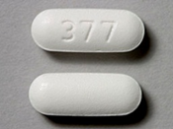
Prescribing of opioids for chronic, non-cancer pain in general practice
Foy et al. BMJ Open 2016;6:e010276.

Slide 12
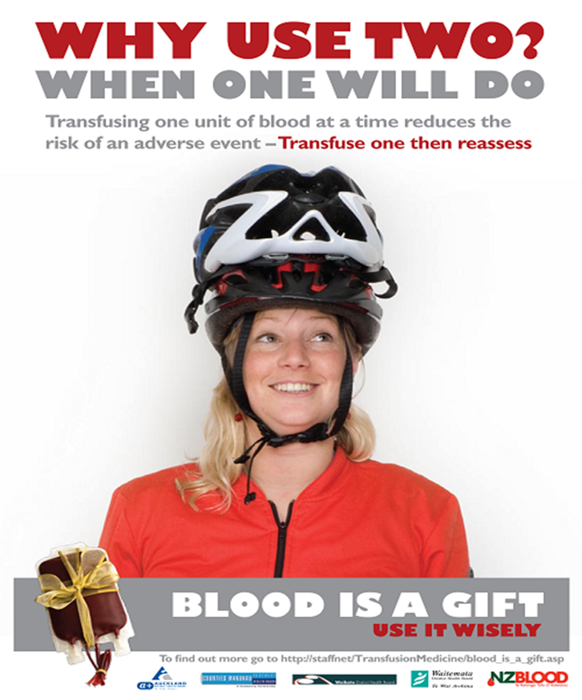
What proportion of blood transfusions given are probably unnecessary?
5%
10%
20%
40%

Slide 13
What proportion of blood transfusions given are probably unnecessary?
5%
10%
20%
40%

Slide 14
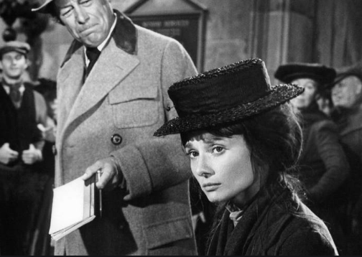
Why don’t people do what we tell them?

Slide 15
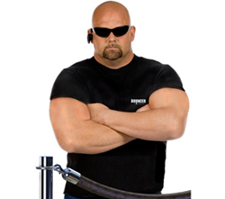
Why don’t people do what we tell them?

Slide 16
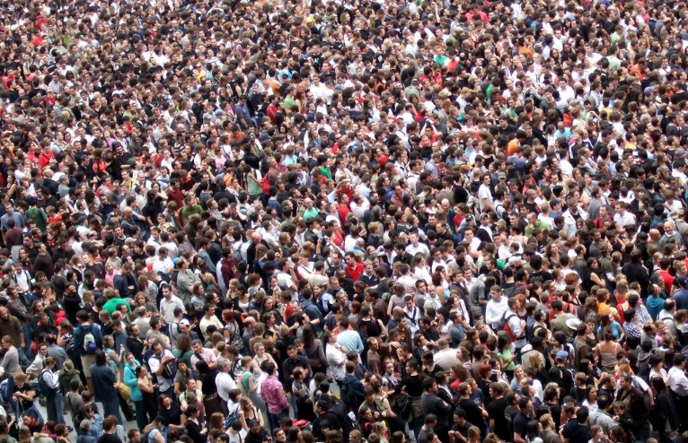
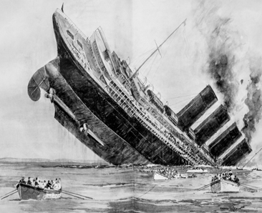

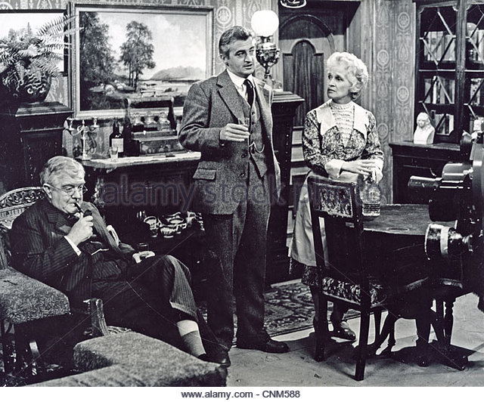


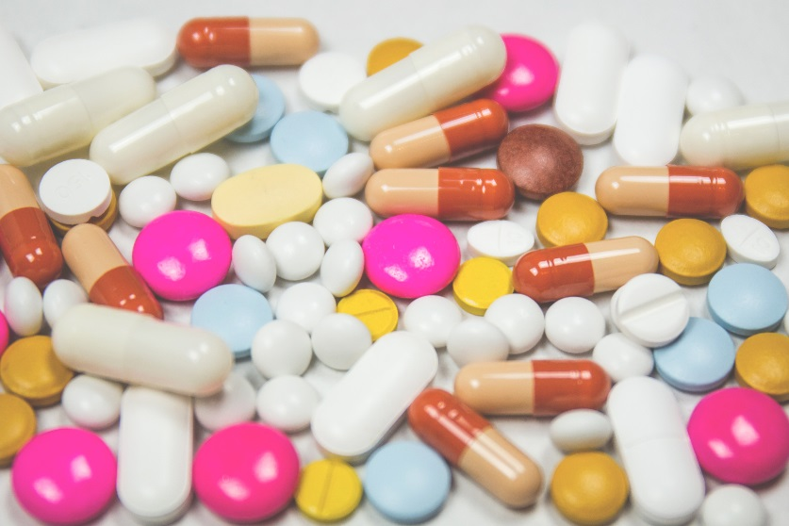
Notes:
The jewel in the crown
Multi-morbidities (23% primary care patients; 82% aged 85 years or over)
Multiplying top-down priorities / guidelines (over 100 relevant to GP)
Multiple bottom-up priorities (2.5 problems per 11.9 minutes)
Multiplying demand
Multiple ‘re-disorganisation’

Slide 17
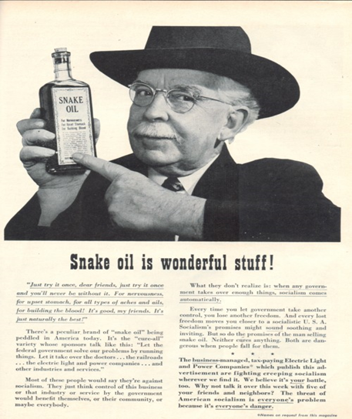
What did we hope to achieve?
A guideline implementation package for general practice which…
Fits in with ways of working and resources available
Has been rigorously tested in ‘real world’ conditions
Improves population healthcare and outcomes
Produces an acceptable return on time, money and effort
Can be adapted to a range of ‘high impact’ clinical priorities…

Slide 18

Foy R, Willis T, Alderson S, Bregantini D, Carder P, Clamp S, Collinson M, Farrin A, Glidewell L, Hartley S, Heyhoe J, Holland M, Hulme C, Heudtlass P, Hunter C, Ingleson E, Lawton R, Louch G, Johnson S, McEachan R, Meads D, Petty D, Rathfelder M, Richardson J, Rushforth B, Schmitt L, Vargas-Palacios A, Stokes T, Ward V, West R, Watt I

Slide 19


Acknowledgement
This presentation summarises independent research funded by the National Institute for Health Research (NIHR) under its Programme Grants for Applied Research programme (Grant Reference Number RP-PG-1209-10040)
The views expressed are those of the authors and not necessarily those of the NHS, the NIHR or the Department of Health

Slide 20
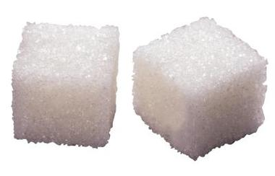


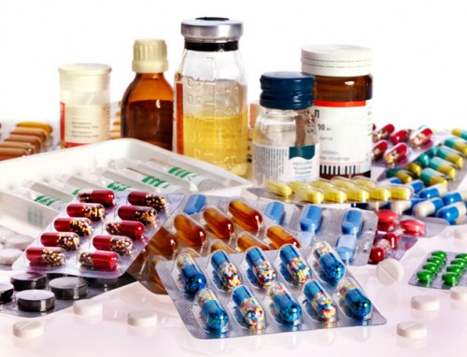
We identified ‘high impact’ recommendations
Diabetes control
Blood pressure control
Anticoagulation in atrial fibrillation
Risky prescribing
Rushforth et al. BMC Family Practice 2015; 16:156

Slide 21
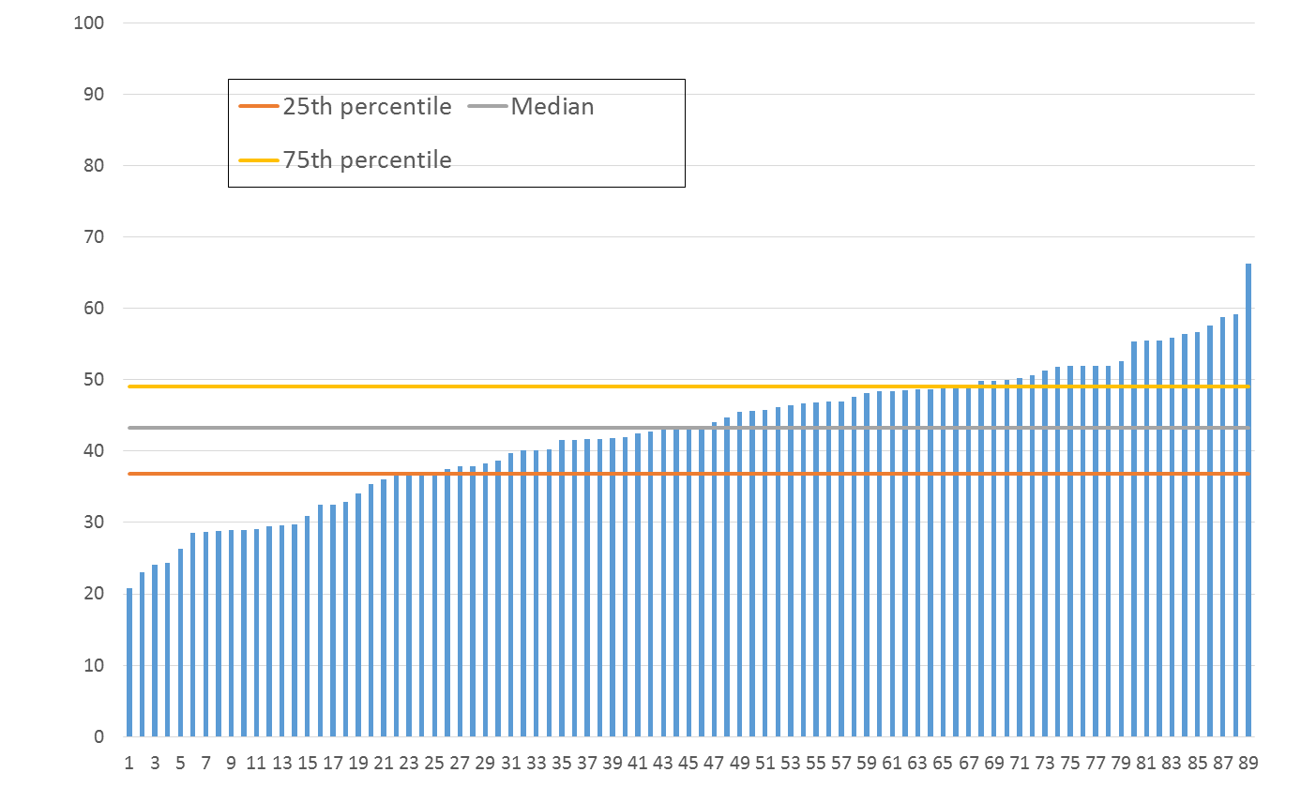
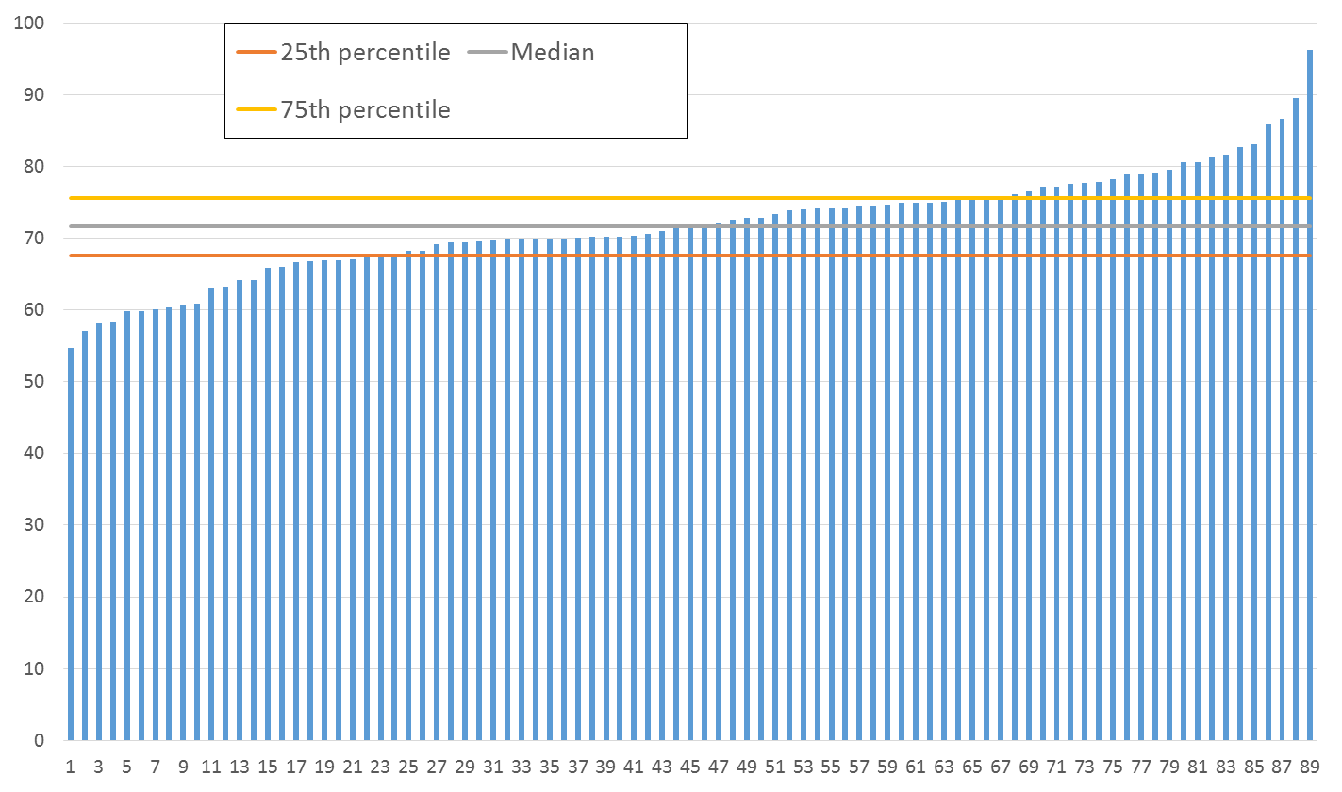
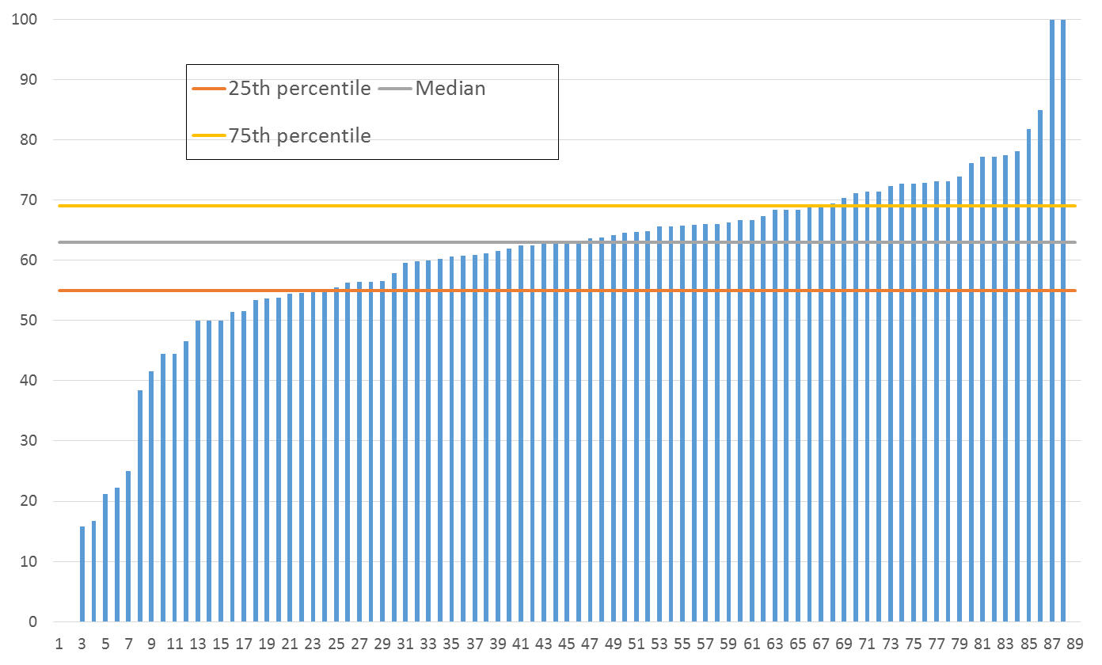
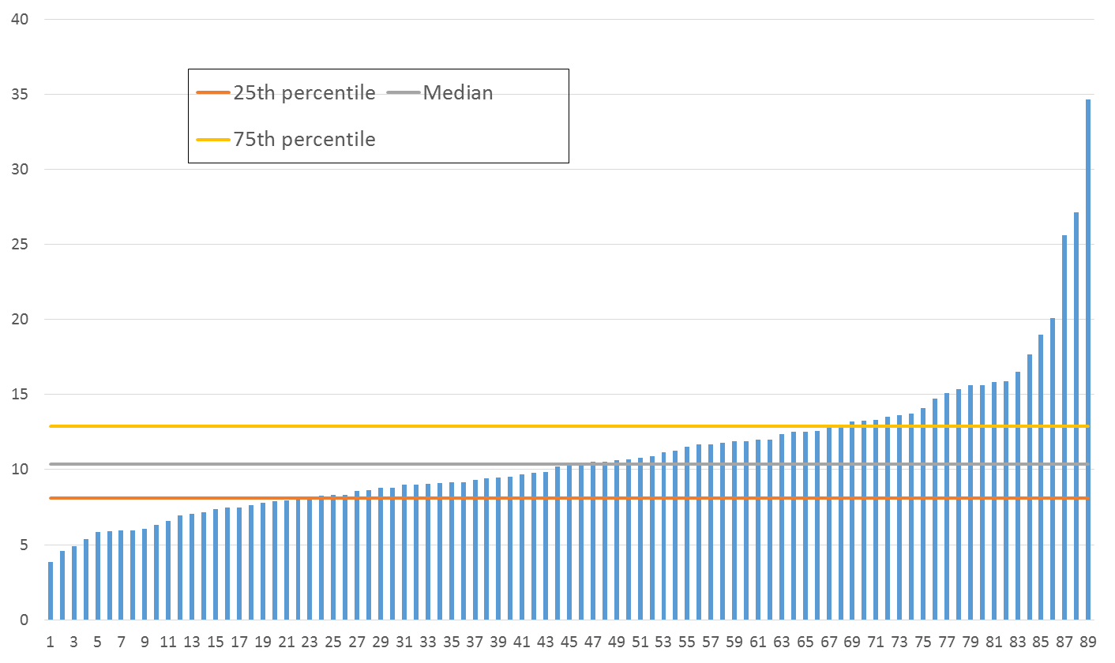
We analysed adherence to ‘high impact’ indicators
Diabetes control
Blood pressure control
Anticoagulation in atrial fibrillation
Risky prescribing
Willis et al. PLoS ONE 2017;12: e0177949

Slide 22

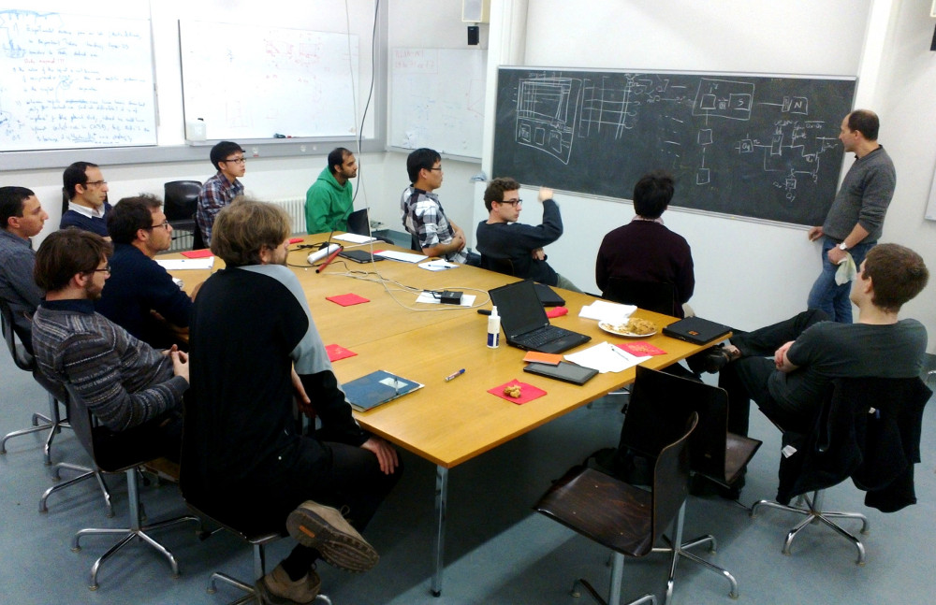


We developed an adaptable implementation package
Interviews
Consensus
Evidence
Theory
Lawton et al. Implementation Science 2016; 11:113
Notes:
Interviews: with health professionals
Expert panel: patients, commissioners, clinicians
Evidence: evidence-based interventions widely used
Theory: Guided by current ideas about influences on behaviour – outlines key barriers/enablers to performing behaviour. Embed these within established interventions.

Slide 23
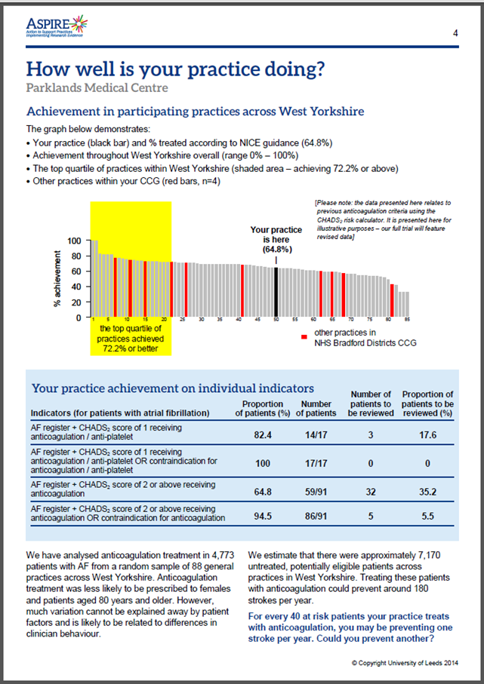

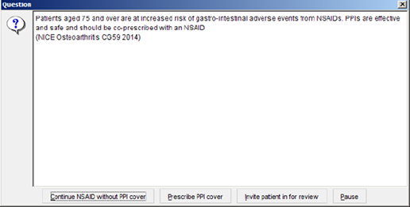
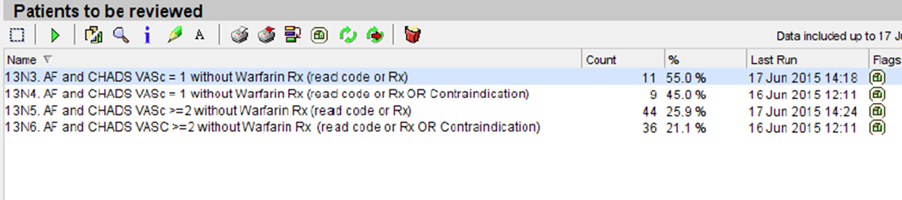
Persuasive messaging
Peer comparison
Problem solving
Goal setting
Action planning
Reinforcement
Glidewell et al. Implementation Science 2018;13:32

Slide 24

We did a rigorous ‘real world’ trial
Willis et al. Implementation Science 2016;11:25
Notes:
We put our implementation package to the toughest test by doing a pair of randomised trials. We used ‘opt out’ recruitment of practices to help ensure that our practices were as typical as possible and not only those interested in research. We used routinely collected, anonymised patient data to assess outcomes. We used quite a sophisticated design to ensure that we had multiple controls – and could therefore be more confident that any effects we found were because of the implementation package and not only (say) because practices might know they were taking part in an experiment.

Slide 25
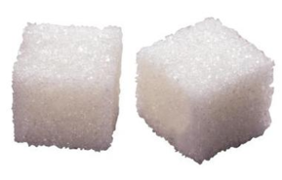
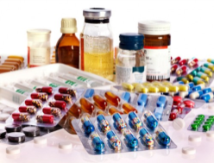

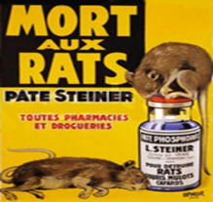

Adapted implementation package | 40 practices | 40 practices
Diabetes control | Intervention | Control
Risky prescribing | Control | Intervention
Adapted implementation package | 32 practices | 32 practices
Blood pressure control | Intervention | Control
Anticoagulation in atrial fibrillation | Control | Intervention
Notes:
Opt out recruitment
Routine data at 11 months

Slide 26

We did an economic evaluation
Notes:
To assess value for money

Slide 27
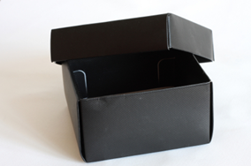
We did a process evaluation

Slide 28
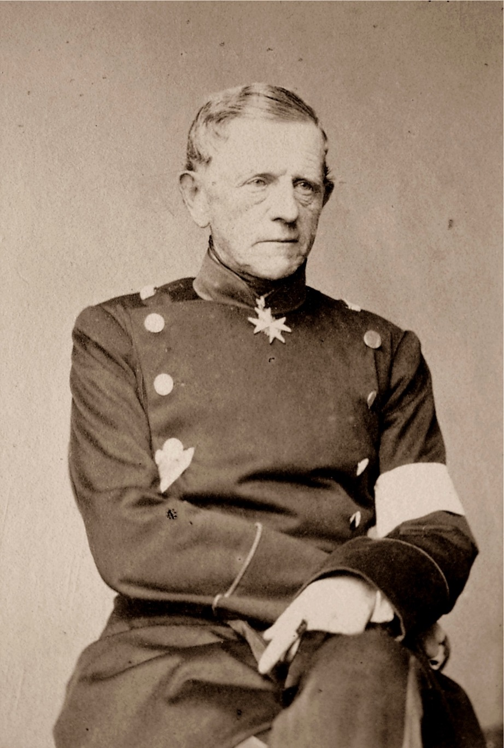
Field Marshall Helmuth Karl Bernhard Graf von Moltke
Notes:
Field Marshall Helmuth Karl Bernhard Graf von Moltke (26 October 1800 – 24 April 1891) was Chief of Staff of the Prussian General Staff from 1857 to 1871 and then of the Great General Staff (GGS) from 1871 to 1888

Slide 29
What worked?
Diabetes control
Blood pressure control
Anticoagulation in atrial fibrillation
Risky prescribing

Slide 30
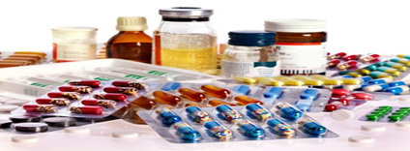
Risky prescribing
Control 6.0%
Intervention 4.9%
Odds ratio 0.81 (97.5% CI 0.67 to 0.99)
Once confounders adjusted for, the odds of a patient achieving outcome in intervention practices was 18.5% lower compared with a patient with same characteristics in control practices

Slide 31
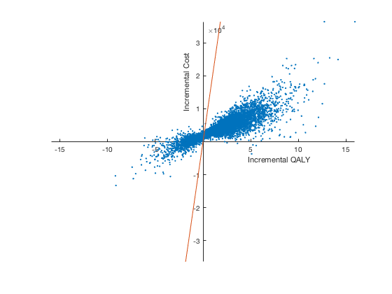
More expensive and more effective than usual practice
Incremental cost effectiveness ratio of £2,337
Over 75% of simulations conducted for probabilistic sensitivity analysis indicated cost-effectiveness
Risky
prescribing

Slide 32
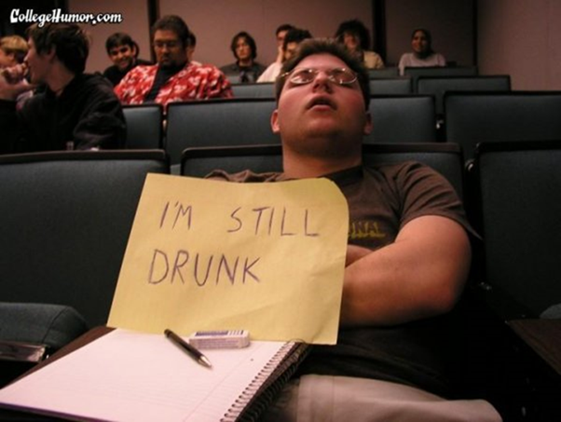
Let’s pause…

Slide 33
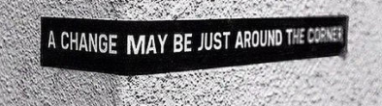
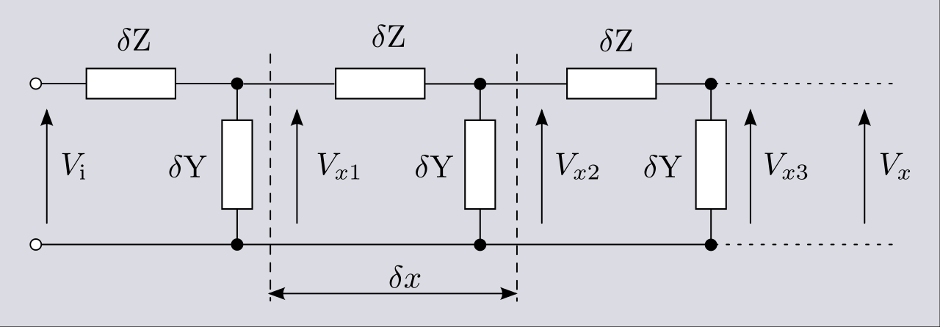


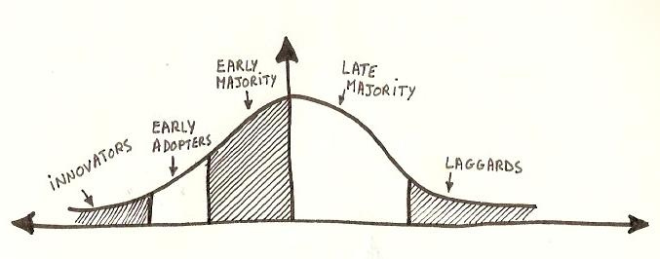
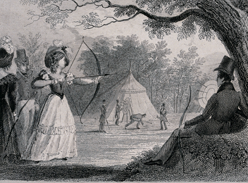
Latency
Voltage drop
Prompts
Targeted behaviour
Wrong target
Stampede

Slide 34
Latency
Voltage drop
Prompts
Targeted behaviour
Wrong target
Stampede

Slide 35
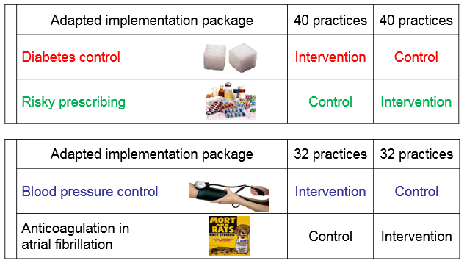
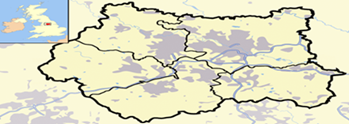
What have we learned?
Iteration
Rigour
Scale
Pragmatism
Notes:
UBA’s would have been difficult to interpret with any confidence; 200 practices and 65000 patients

Slide 36
OpenPrescribing.com adjusted multi-level linear model: opioid prescription analysis
£900,000
Intervention start
Intervention finish
Blue = aggregated control CCGs
Purple = aggregated intervention CCGs

Slide 37
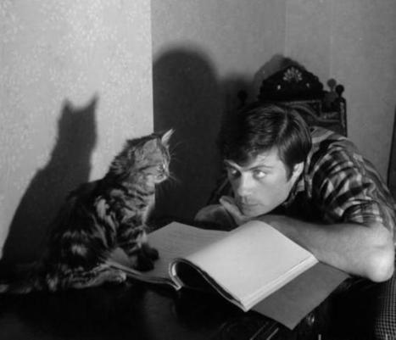
Additional reading
Grimshaw JM, Eccles MP, Lavis JN, Hill SJ, Squires J. Knowledge translation of research findings. Implementation Science 2012; 7: 50
Grol R. Beliefs and evidence in changing clinical practice. BMJ 1997; 315:418-421
Auerbach AD, Landefeld CS, Shojania KG. The tension between needing to improve care and knowing how to do it. NEJM 2007;357:608-13

Slide 38
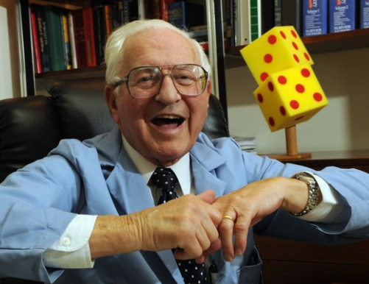
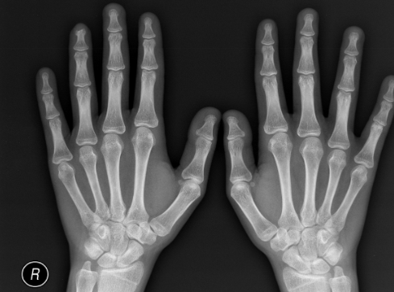
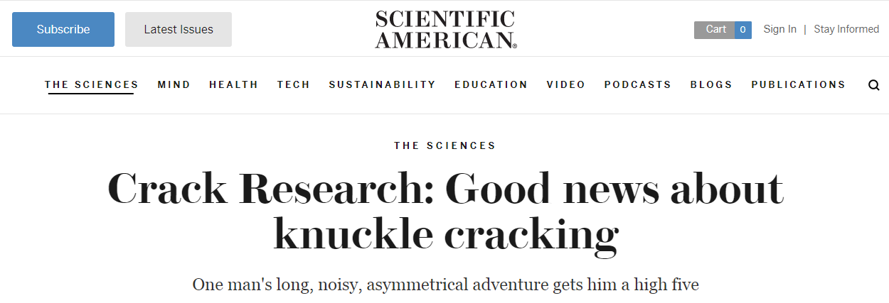
Donald L Unger
Notes:
Donald L Unger; Ig Nobel Prize 2009

