Slide 1

Library & Knowledge Service Managers Meeting
17th March 2020
Manchester

Slide 2
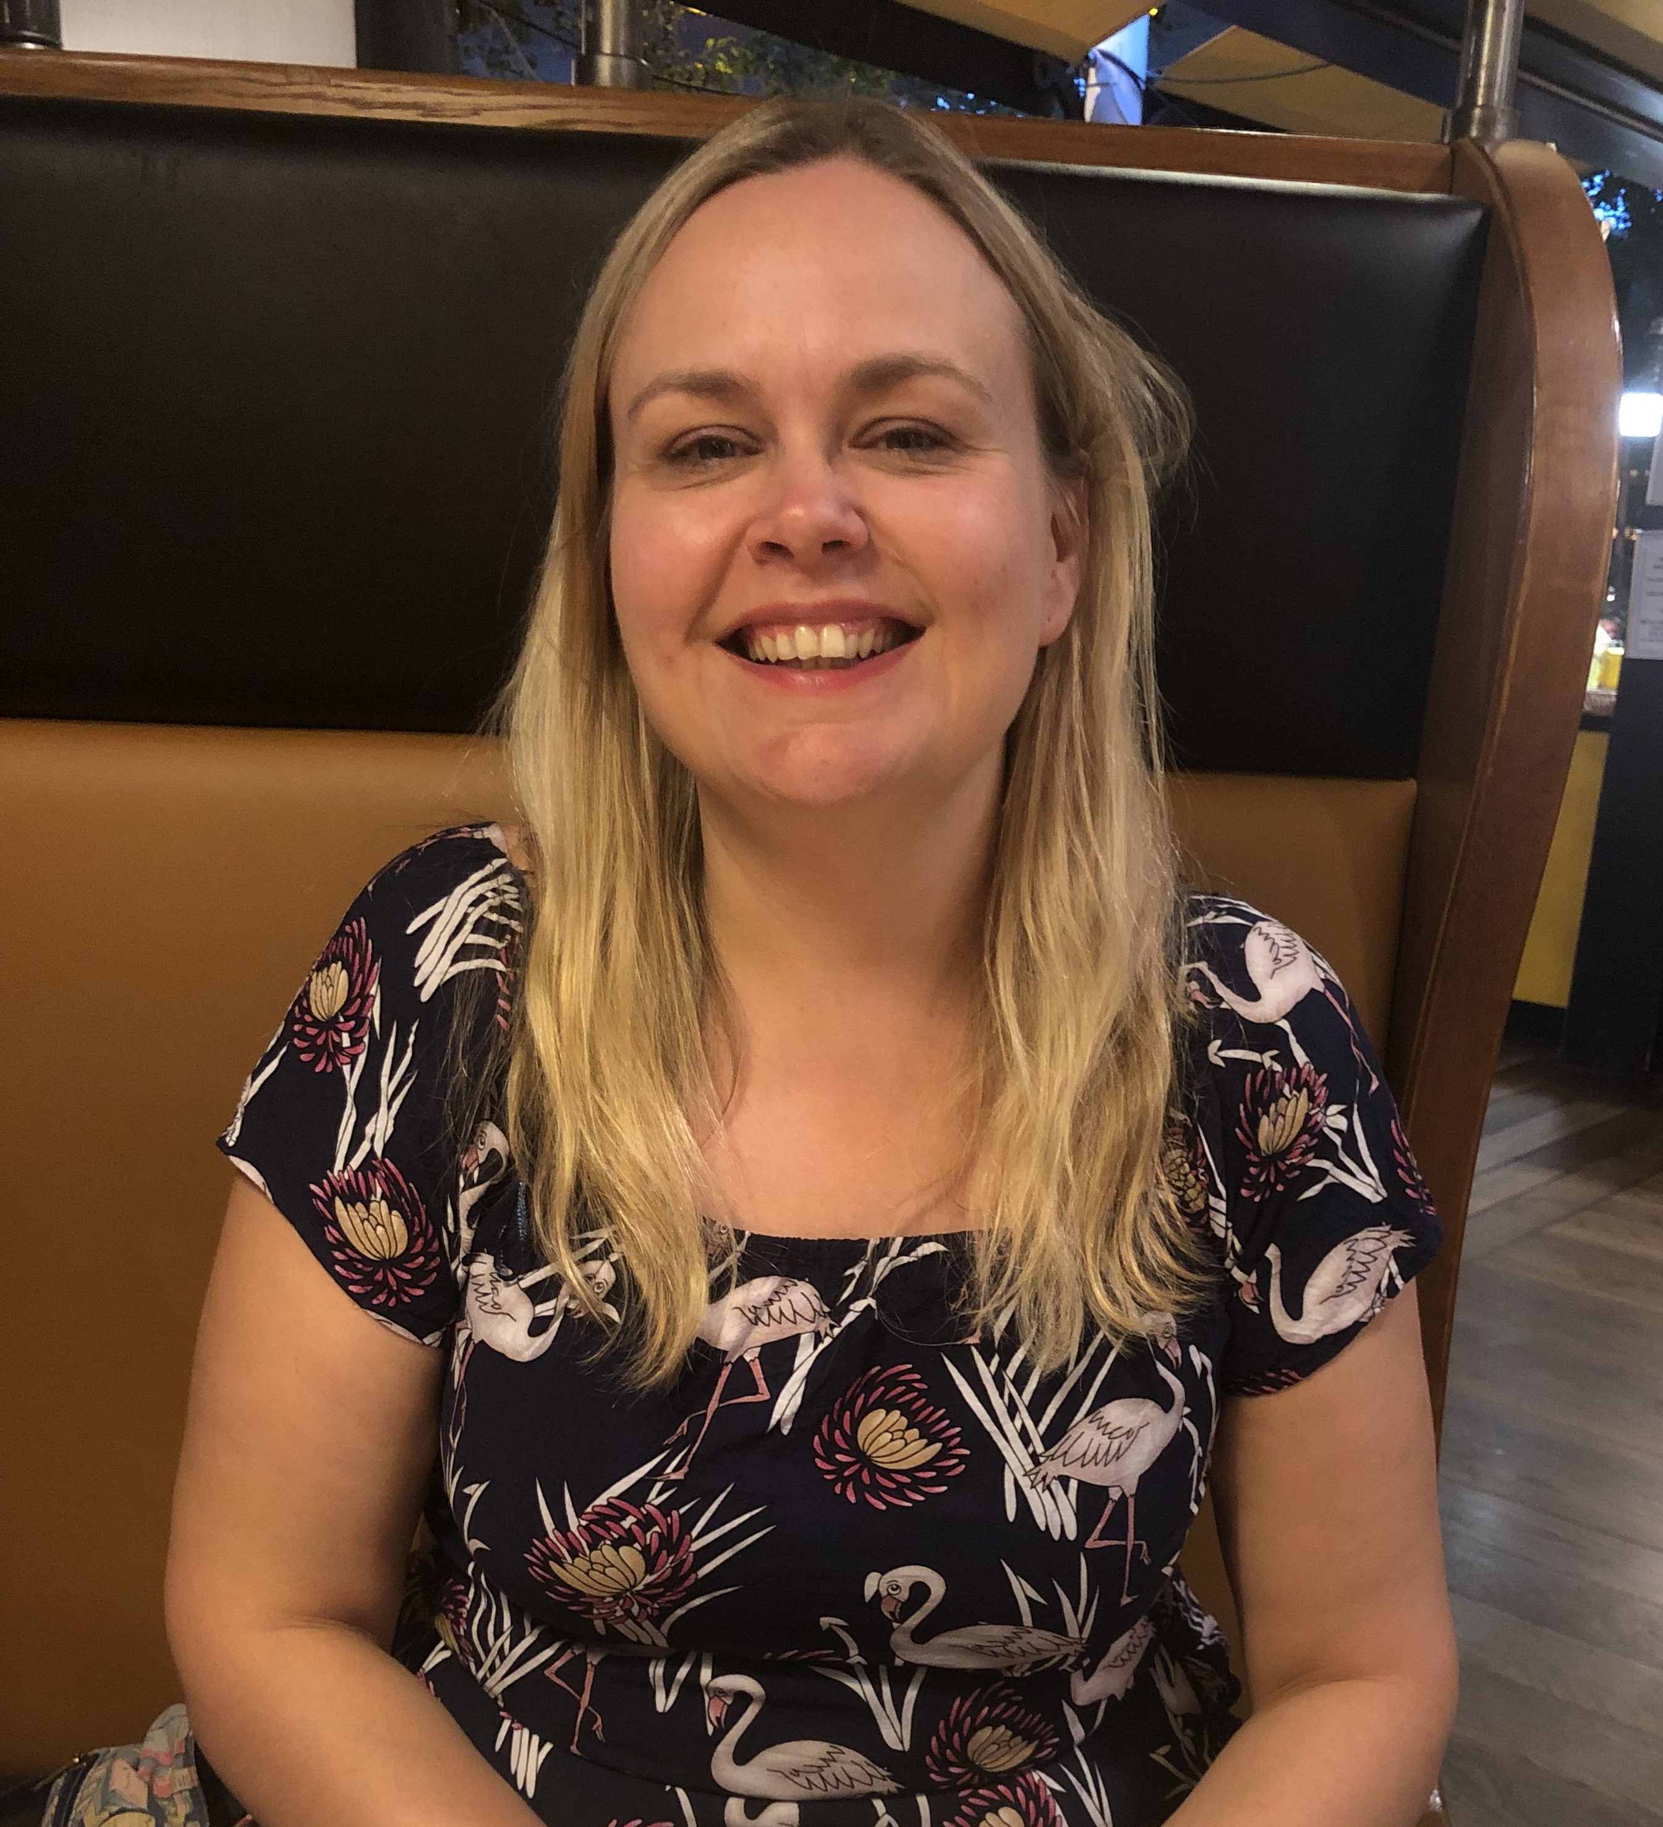
Welcome to Becky Williams
Library and Knowledge Services
Development Manager
Based in Leeds

Slide 3

Knowledge for Healthcare – Refresh 2020
Refresh – not re-write
Vision, principles and design criteria will stay the same
Survey of surveys
Writing over the summer
Publication towards end of 2020

Slide 4

HEE Policy on Recommended Ratio of Qualified LKS Staff to NHS Staff - Wte
HEE recommends that those NHS organisations with staffing ratios in the region of the current average of 1 qualified librarian to 1,730 healthcare staff strive to achieve an improved ratio of at least 1:1,250 qualified librarians or knowledge specialists per WTE healthcare staff
Notes:
Initially it was agreed during purdah and we were not permitted to publish it.
Given the delay we reviewed this post election and decided, as leads, to opt for a soft launch. This should be in our minutes.
So we got it onto the HEE page and I wrote to managers so they can use it - while awaiting our new comms support, who will be able to combine this with announcement of the online version of the self assessment tool pertinent for Exec teams.
Meanwhile we have put the KM roadshows in place, again an opportunity to explore the online self assessment tool, so perhaps the announcement should follow those?

Slide 5
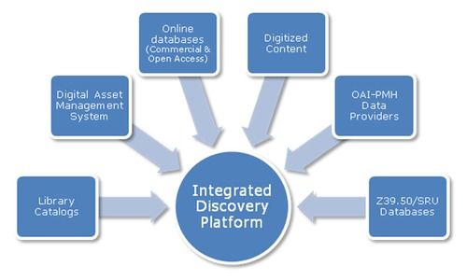
A National Resource Discovery system – it’s really happening
To provide NHS staff with a single, coherent national gateway to their trusted library and knowledge service, connecting them seamlessly to quality resources, services and support tailored to their needs
HEE will invest around £350,000 pa
over the next three years

Slide 6

How Many?
Nationally: One to Seven?
HEE has committed to an investment of c£520,000 over three – to five years to implement

Slide 7
2019 Development Needs Survey
Over 650 responses

Slide 8

National and Regional CPD Programme 2020 - 2021
New national CPD budget
£190,000 to cover national and regional events
21 May 2020 Knowledge Management Roadshow Leeds
Library Managers meetings:
  7 July 2020 Newcastle
  17 November 2020 Leeds

Slide 9

Senior Leadership programme will run September 2020 – May 2021
15 places – recruiting soon
Fully funded except travel
Workshops and action learning sets will be in Birmingham
Mid-career programme – we are still exploring options

Slide 10

New national bursaries scheme
£15,000

Slide 11


&

Slide 12

Library and Knowledge Services Tariff
Proposals still on the table
Part of the DHSC’s Tariff Working Group
programme for 2020

Slide 13

Briefings: 1st and 15th of each month
Blog: https://kfh.libraryservices.nhs.uk/
Email lists: national and north
Meetings: may be more virtual this year!
Make sure you are signed up!

Slide 14

HLISD
Please keep this up to date
Our new staff are finding
it very difficult to identity you
and your team members

Slide 15


Slide 16
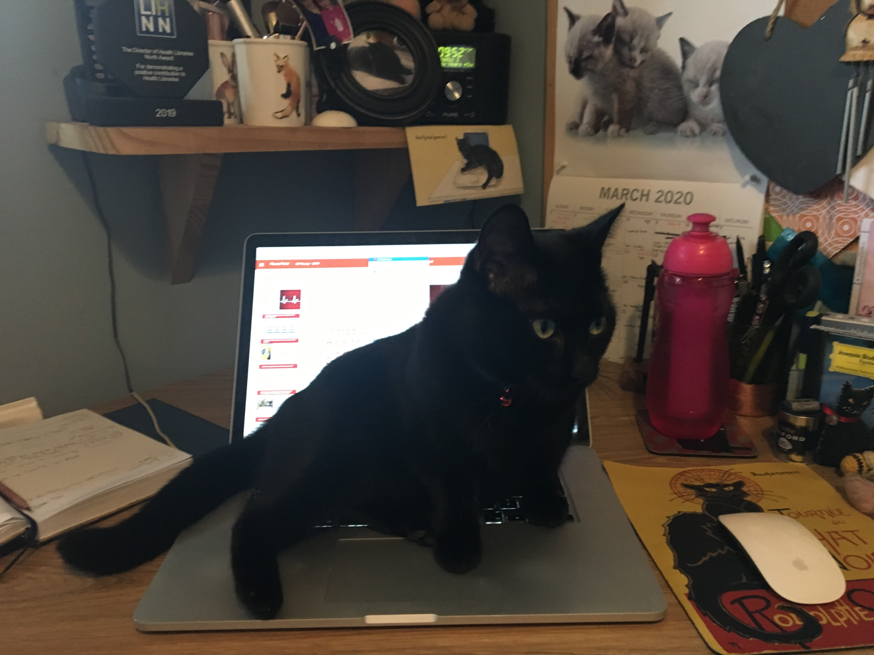
HEE LKS North Team now working from home.
Contact details at https://www.lksnorth.nhs.uk/hee-lks-north/hee-library-and-knowledge-services-north-team-members-and-roles/

Slide 17

Revised Deadlines
Stats Part 1: 30 April 2020
Stats Part 2: deferred until October 2020
Quality and Improvement Outcomes Framework: deferred until Summer 2021

Slide 18


