Slide 1

Library and Knowledge Services Managers
North
7th July 2020
David Stewart

Slide 2
Covid: supporting LKS teams
KfH blog
Covid-19 search bank
  https://kfh.libraryservices.nhs.uk/covid-19-coronavirus/for-lks-staff/literature-searches/
Covid-19 bulletins collaboration
  https://kfh.libraryservices.nhs.uk/covid-19-coronavirus/for-lks-staff/covid-19-current-awareness/
E-resources
CPD
Resilience training
Facilitating virtual meetings training
Action Learning Sets
Planned activities
  Social distancing posters
  Space policy
Notes:
Points to mention:
Search bank – 172 searches submitted of which 144 have been published. Anecdotal feedback suggests it has been extremely popular and a formal evaluation is planned
Bank of sample bulletins – do get in touch with creators if you want to cascade any of these locally. The potential for further collaboration on the production of all current awareness offers, but especially bulletins, has led to a project to promote CASH as a platform for reducing duplication especially in the time spent scanning sources
E-resources – Many of the free offers of e-resources have now ended and usage is being evaluated to inform negotiations with suppliers. Remind colleagues about the Kortext e-book project: HEE investing in regional collections of e-books with a credit model for local purchase of resources.
Resilience training – good response – committed to putting on as many sessions as necessary for everyone to make the most of these
Virtual meetings training – more dates coming
Action Learning Sets – proved very popular and more cohorts will be offered
Posters to promote social distancing in libraries are being produced and will be disseminated to all sites
[Space policy – see the next slide]

Slide 3
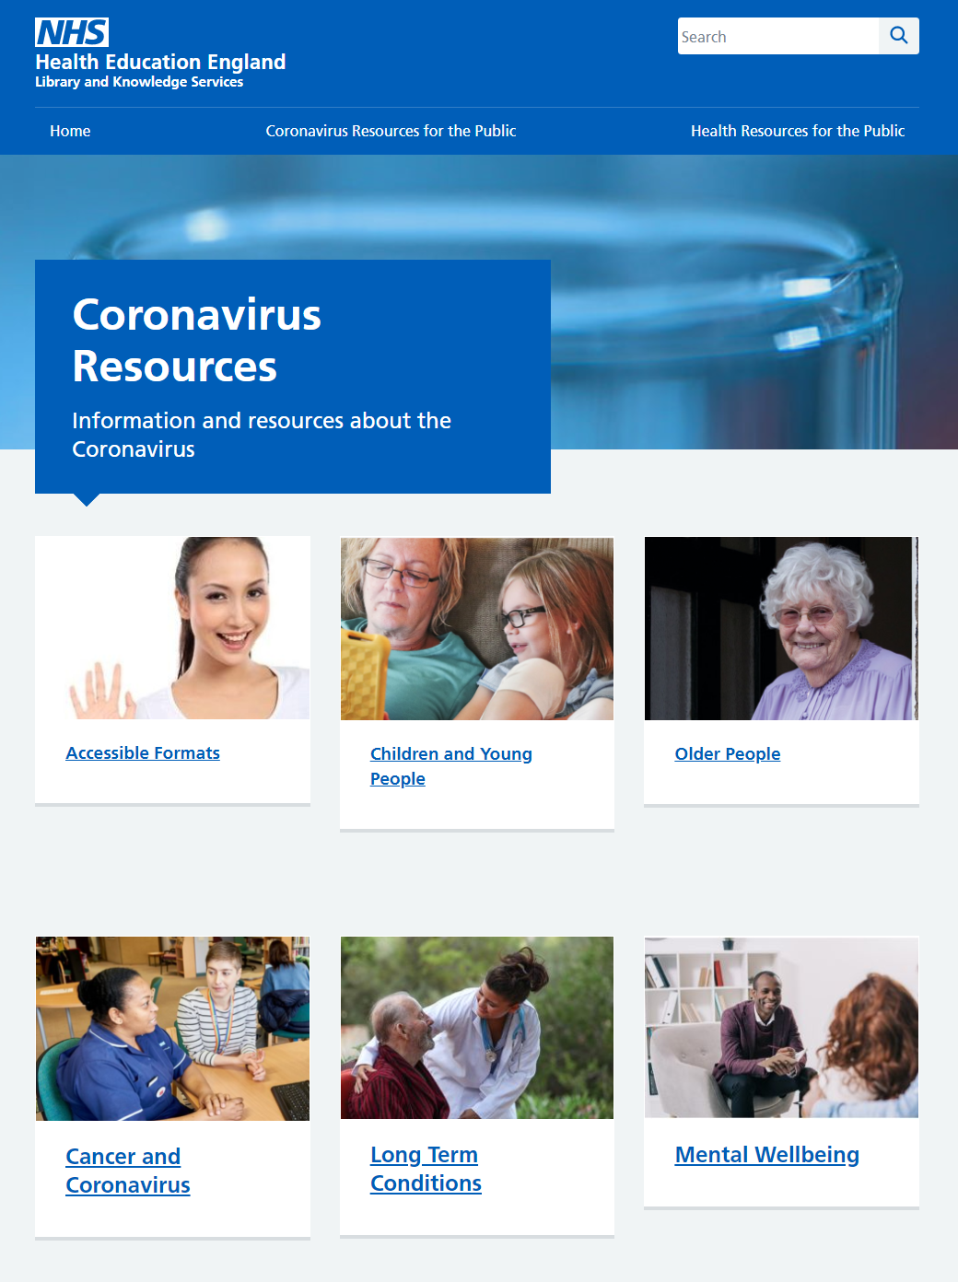
Covid: supporting patients and the public​
New content added:
  Mental Wellbeing
  Long Term Conditions
Coming soon:
  Carers
  Looking After Yourself
Signposting trusted information for patient/public groups, and in accessible formats​
https://library.nhs.uk/coronavirus-resources/
Notes:
The covid information section of library.nhs.uk has had over 21k visitors in May and June. New sections have been added on Mental Wellbeing and Long Term Conditions and Carers and Looking After Yourself will be launched soon.

Slide 4
Covid: supporting the Nightingale Hospitals
Library and Knowledge Services have been involved in delivering evidence and resources to staff at the regional Nightingale Hospitals
Formed a community of practice with weekly – now monthly - online meetings to share experiences and provide mutual support
  Able to work at speed to respond to the situation
  Make the most of shared knowledge: what works, what to avoid
Participants will be capturing and sharing highlights of the experience through vlogs
Notes:
Nightingale Hospitals are hosted by existing Trusts (eg London = Barts Health, Birmingham = University Hospitals, Birmingham). The librarians at these Trusts were all pro-active in embedding access to evidence and resource in the offers for the Nightingale sites:
Enabling on-site access to e-resources, focusing on BMJ Best Practice and Royal Marsden Manual
Administering Athens accounts for new members of the workforce
Signposting tailored support through intranets and LibGuides
Influencing for BMJ Best Practice to be integrated into electronic health records
Community of practice – facilitated by Sue Robertson and Dom Gilroy
Met weekly for short, snappy catch-ups to share experiences and provide mutual support
(Now meeting monthly to ensure preparedness for the next phase)
Beneficial for all involved – a model for long-term collaboration across the networks?
Able to work at speed to deliver tailored services
Making the most of shared knowledge and experience – what works, what to avoid, how to influence colleagues etc
Support from peers working with similar challenges
Experiences of those involved are now being captured in vlogs which will be published soon.

Slide 5
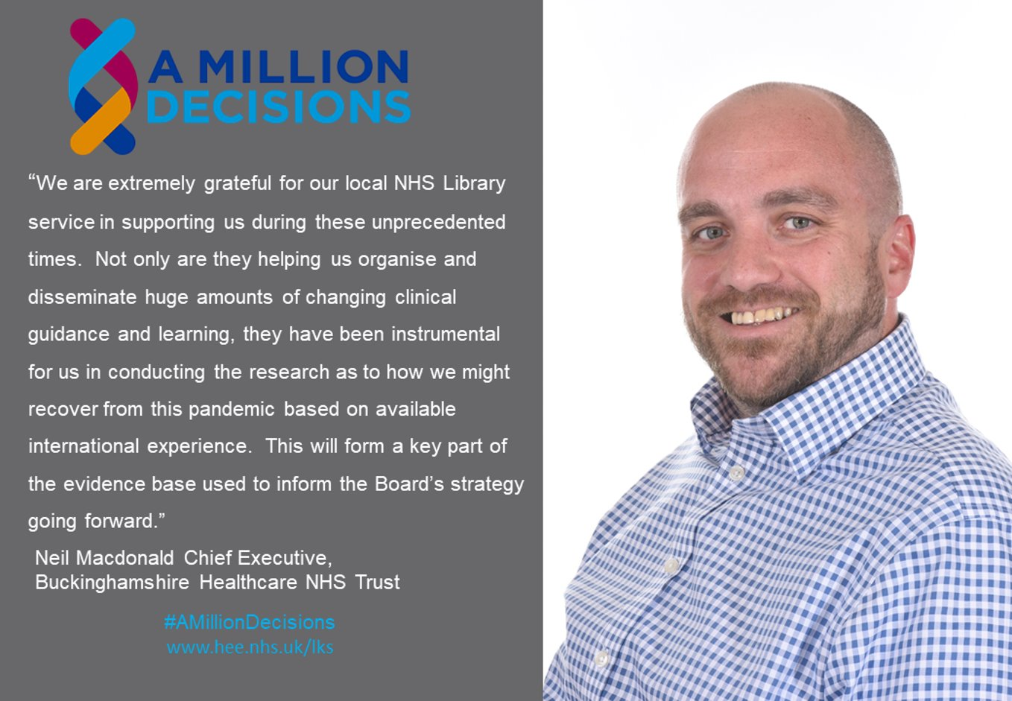

https://www.hee.nhs.uk/coronavirus-covid-19/coronavirus-covid-19-overview
Notes:
Led by Sarah Lewis, a team of librarians produced a synthesised toolkit of resources for Trusts recovering from their initial pandemic responses. The resource includes recovery planning, capacity and long-term impacts, workforce wellbeing, learning lessons, organisational resilience and innovation
The CEO, Neil McDonald, circulated the report onwards to fellow CEOs. The librarians involved were recognised for their contribution by HEE's acting CEO, Wendy Reid, and the full report was approval by HEE Gold Command for publication on HEE's website (link included).
Patrick Mitchell, HEE's Director of Innovation and Transformation, said: “NHS Library and Knowledge Services are a vital digital service during these challenging times. We’ve seen and supported some great examples of collaborative working through the reach of library services. This toolkit to support NHS trusts during the recovery phase of the COVID-19 pandemic was developed from a search requested on recovery by the Chief Executive of Buckinghamshire Healthcare NHS Trust, which has since been shared with 46 other trusts.”

Slide 6
Covid: impact on our services and staff
Have you impacted on your Trust's Covid-19 Response through:
  Evidence searches
  Bulletins, etc.
      Please Contact: dominic.gilroy@hee.nhs.uk
We are planning to ask you about your skills:
  how have they be useful in any temporary roles?
  What new skills have you learned?

Slide 7
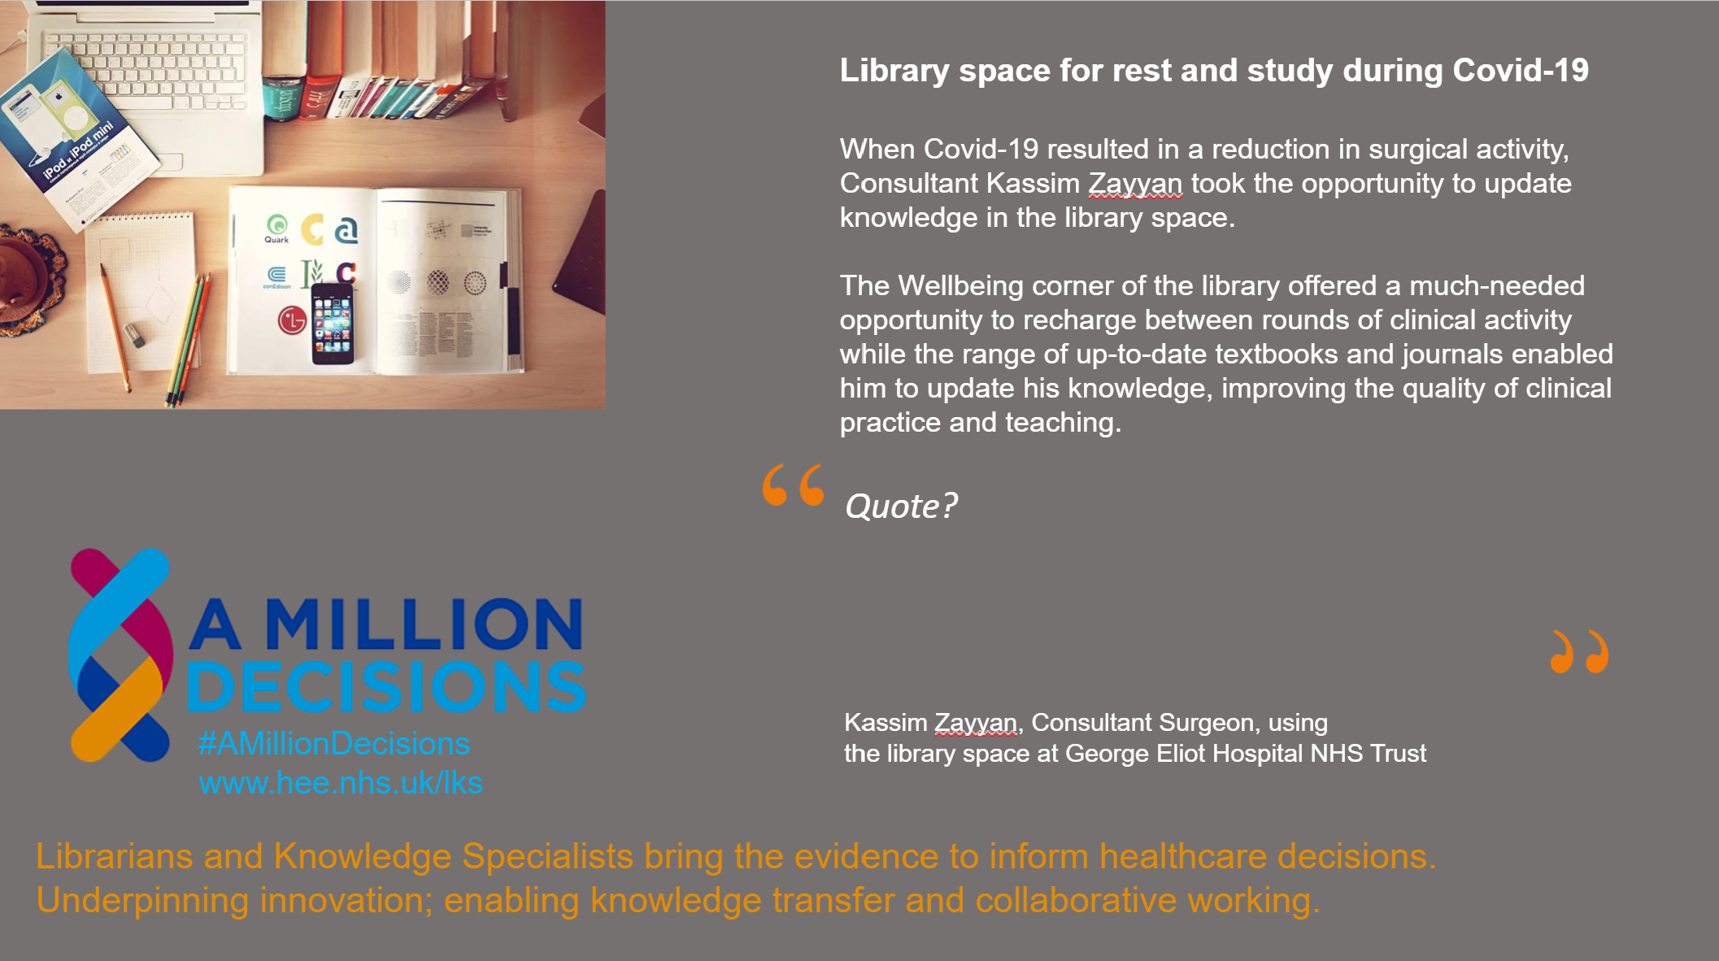
HEE Policy on library space – coming this year
Notes:
The importance of the library space as a refuge and to support learning and development has been highlighted in many organisations over the past several months. Case studies are being collected (like this one which is a work in progress but we will share it when finished!).
We're conscious that other services have been challenged about the use of their library space, some of which has been repurposed. A policy on library space, highlighting its importance to the workforce, is in development to support managers with making the case in future.
Meanwhile, don't forget the resources on the blog about adapting the workplace and arranging physical spaces to facilitate social distancing.

Slide 8

Resource Discovery 1 – National Discovery System
Procurement started June 2020
Implementation starts November 2020
Roll out starts September 2021
Phased over 3-5 years
  Core functionality for all users to existing e-resources
  Phased integration with library management systems and repositories
Engagement with you and end-users throughout
Notes:
We've spent the last couple of months refining a robust set of procurement documents including a procurement plan, specification and evaluation framework. The document set will be published in the next few days. During the procurement, we're limited about what we can say publicly but a number of library service managers are included in the evaluation panel to represent the needs of the networks. We expect to be able to announce the successful applicant in October and then to start implementation in November.
We're looking at a phased implementation from 2021 with a national platform offering access to e-resources and, at the same time, full integration with one regions LMS and full service offer.
We're already planning lots of opportunities for you and your teams to feed into this implementation programme.

Slide 9

Resource Discovery - 2
Library Management Systems – plan is to have two in the North:
  Capital and revenue costs paid for by HEE
  Plus system admin costs via SLA with Trusts
HDAS – feedback currently being evaluated for further discussion
Notes:
We are planning to start the project for the northern LMS systems later in the year
Similar projects are already ongoing in some other regions
HDAS - the feedback is currently being evaluated and the Knowledge for Healthcare Board will need to make a decision in due course. It is a proving very difficult to try and find a way forward. We will be in touch as soon as we can with further news.

Slide 10

Resource Discovery - 3
DawsonEra – e-book aggregator has gone into administration
Kortext have offered to take your content onto their platform
Contact Nadine Prowse:
  nadinep@kortext.com
  0771 281 3877
HEE will provide £50,000 to create a Kortext collection for the north – further details will follow soon

Slide 11

Health Literacy and Patient Information
Health Information Week: 6 – 12 July 2020
BMJ BP and HEE delivered a session on Health Literacy and Patient Information
The new COVID-19 patients’ site will publish:
Looking after Yourself
Carers
Notes:
Health Information Week will look a little different this year
There are 2 main themes:
Finding information you can trust
Physical and mental wellbeing
Highlight 2 things: BMJ BP showcasing patient resources and how they can be used for shared decision making – clinicians – recorded
HIW Website includes branding and publicity resources
We would like to find out whether people have been able to get involved at all in Health Information Week?
Could you give us a tick if you have been involved in any way – big or small – and a cross if you just haven’t been able to this year?
Review responses
Please feel free to use chat to give us a flavour of what is happening?

Slide 12

Workforce Planning and Development - 1
Working with CILIP on:
  Options appraisal for a HEE led Learning Academy
  Revised PKSB and guidance note for staff in health libraries
  CILIP review of the impact of technology on our profession – due April 2021

Slide 13
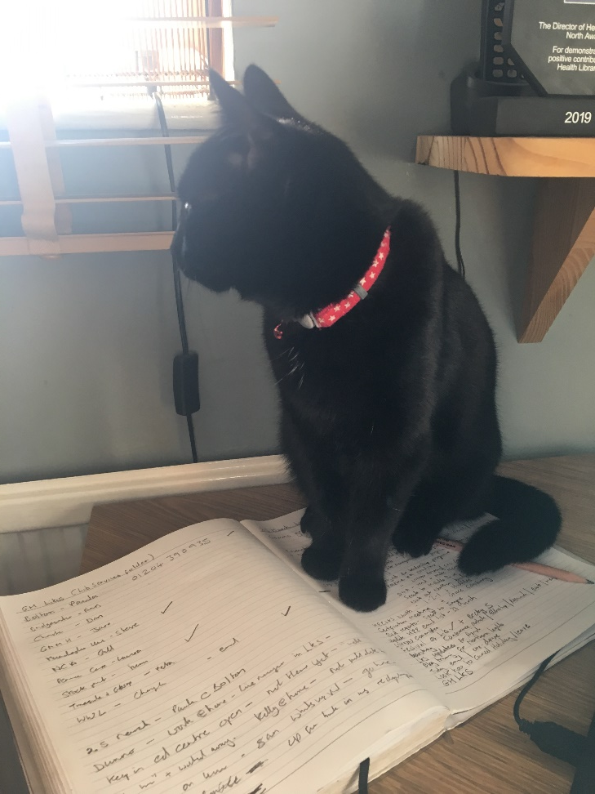
Workforce Planning and Development - 2
CPD:
  Virtual offer - currently offering courses on critical appraisal, facilitating meetings and training, and resilience
  Library Carpentry proposal
  CPD group planning future events
Costing Training
- Introduction to Costing & Hourly Rate Calculator Sessions available now
- Process Costing Session available soon

Slide 14

Workforce Planning and Development - 3
Early days:
  Working with the HEE Health Science School and Manchester University on digital skills modules and possibly certificate
  New careers pages on NHS careers that help young people understand opportunities in our profession

Slide 15

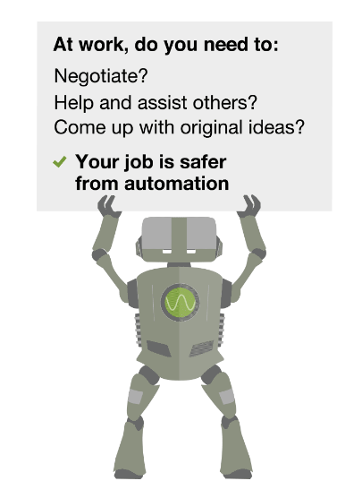
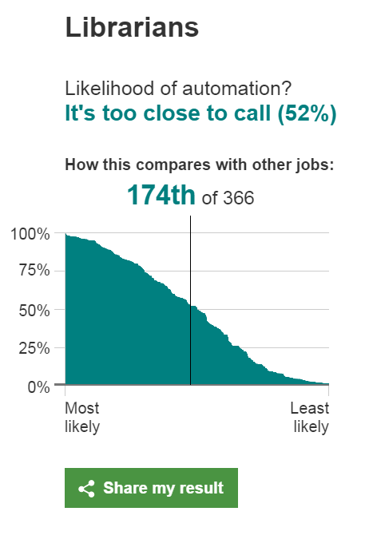
Will a robot take our jobs?
Notes:
The question on your lips now might be Will a robot take my job?
According to a study by researchers at Oxford University and Deloitte - c35% of jobs in the UK are at high risk of automation over next 20 years.
Sophisticated algorithms are challenging a number of office and administrative support roles.
So What is the likelihood that our work could be automated within the next two decades?

Slide 16


Paraprofessional Role Development
Notes:
Changing workforce profile
Fewer administrative posts
More clinical and embedded librarians delivering on Knowledge Mobilisation, Health Literacy, and Outreach/Clinical/Embedded Librarian priorities will be required
How do we upskill some of our paraprofessionals to take on these roles
Pyramids are history but diamonds are forever

Slide 17

LKS Tariff
We are still working on this!
Revised paper to be considered later this year
New Primary Care Tariff: an opportunity to see if we can get a percentage of this to support LKS

Slide 18
Quality and impact
Part one statistics – 100% return for the North – thankyou
Part two statistics – Due for collection with deadline of October 30th 2020
Library Quality and Improvement Outcomes Framework – new date for the baseline assessment return is 30 June 2021

Slide 19
Impact of embedded librarians
Research from the Wirral published
Impact of an embedded librarian in
critical care
Return on investment
https://kfh.libraryservices.nhs.uk/wp-content/uploads/2020/06/WUTH-critical-care-research-report-Jan-2020.pdf

Slide 20

Stay in touch
Let us know if you have:
New staff in post
Staff leaving

Slide 21

Communications
KfH Briefings
Monthly manager meeting updates
E-mail Lists
      - northlks@lksnorth.nhs.uk
      - lksmanagers-north@lksnorth.nhs.uk
      - lksmanagersengland@libraryservices.nhs.uk

Slide 22


