Slide 1

A web-based tool connecting people with evidence
Ben Skinner
Head of Library and Knowledge Services
Brighton and Sussex University Hospitals NHS Trust

Slide 2
Session aims
Overview of KnowledgeShare
  What is the context?
  What is it for?
  Brief demonstration

Slide 3
Core library and knowledge services
Streamlining • Collaboration • Accessibility
Member
Contact Details
Information Skills Teaching
Interests for Evidence Updates
Evidence Searches
Notes:
As the same time as we were developing KnowledgeShare we also developed separate systems for literature searching and teaching.
The literature search database allows us to log a search request including information on what is needed, assign the search to a librarian, record what was done to satisfy the request, generate a standard report and finally record evaluation of the search and report on activity.
The teaching database allows us to set up a teaching session, book people on, communicate with participants, manage a waiting-list, generate certificates of attendance, record evaluation and report.
Eventually we realised that we should bring these systems together! The result was that I can now call up a particular consultant and see at a glance what their interests are, what current awareness we’ve sent, what searches they’ve requested and what teaching they have been on.
The final step was to turn this into an online system.
One advantage of this is that different LKS teams can license it and collaborate through it. You add your library members but we continue to add the resources and so your members benefit from the work we are doing. They still appear to receive the email notification from you, so the personal contact is maintained.
Another advantage is that we can share literature search work more widely. Instead of only benefiting one or two colleagues, a literature search you do can now be shared (as part of current awareness) with any other NHS colleagues that have the same interests.
For members, the advantage is that they will be able to log in and update their professional interests, see what the latest resources are that match those interests, request a search, see previous searches, see other people’s searches, book on training, evaluate searching or training online, etc.
Finally, there is also the possibility for them to connect and network with colleagues in other parts of the country based on shared professional interests or a shared interest in a literature search topic.

Slide 4
Evidence Updates
Personalised, targeted evidence updates
Records members’ professional interests
Matches people to resources
Emails short updates
Notes:
Aim to avoid the “blanket” approach to current awareness
Want to send members individual, personalised emails based on their specific professional interests
For example, a colorectal cancer surgeon working in a hospital has very different interests to a hospice nurse working in the community (even though they’re both in the area of “cancer”). So they get different notifications, with some overlap.
Created Access database to record and categorise members according to their interests. Also add information resources and categorise these. The system matches the two.

Slide 5










































What do we tell people about?

Slide 6
Flexible current awareness
Personalised evidence updates
OR
Bulletins on any combination of topics
OR
Journal table-of-contents alerts

Slide 7


Brighton and Sussex
Library and Knowledge Service
Your Library and Knowledge Service
Members’ Interests
Information Resources
(Optional)
Information Resources
Bulletins
Evidence Searches
Information Skills Teaching
Personalised Updates
Tables of Contents
Your members
Notes:
The online KnowledgeShare system has been designed and built to achieve all these goals
The diagram on this slide, if taken step-by-step, illustrates fairly clearly how the system works.
Blue arrows indicate a communication between your LKS and your members
Blue text indicates work that you have to do.
Green text indicates work that Brighton and Sussex, or the system itself, does.
As you can see, it is possible for individual LKS teams to add information resources for the purposes of current awareness, but it’s not essential. You may want to add local pathways or events, or you might want to add a particular journal that covers a topic you feel is under-represented. The more LKS teams that do this, the more collaborative it becomes, although we want to be careful not to add so much that people are overwhelmed.
The system allows members to receive current awareness in three different ways:
1. The personalised updates already described
2. Journal table of contents alerts (like Zetoc except that they appear to come from their local librarian)
3. Newsletters that LKS staff create based on any combination of topics they like.

Slide 8
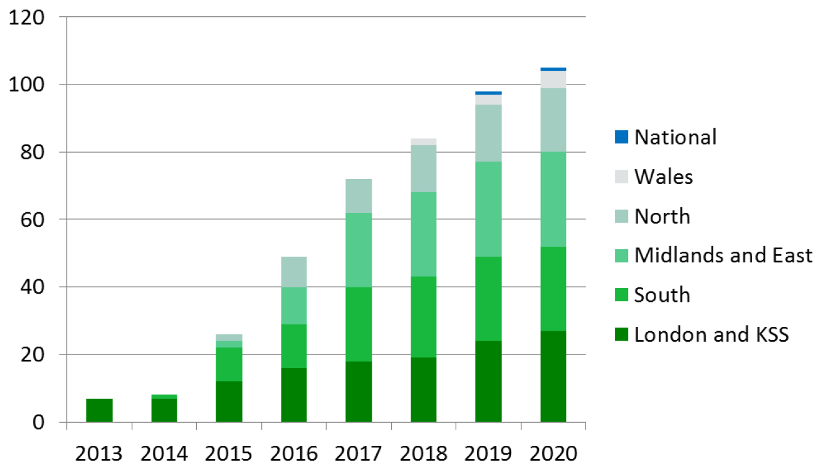
Subscribing LKS teams

Slide 9
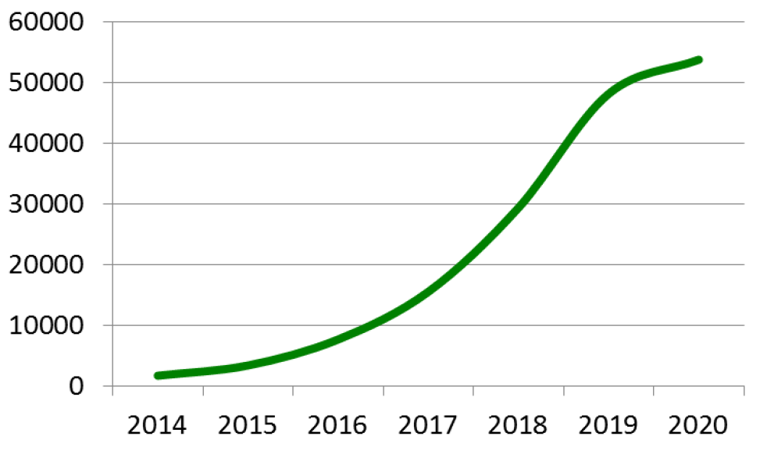
Members added to KnowledgeShare (cumulative)

Slide 10
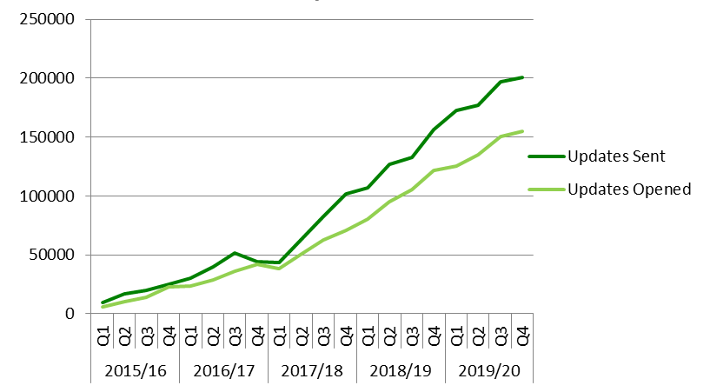
Evidence updates sent and opened

Slide 11
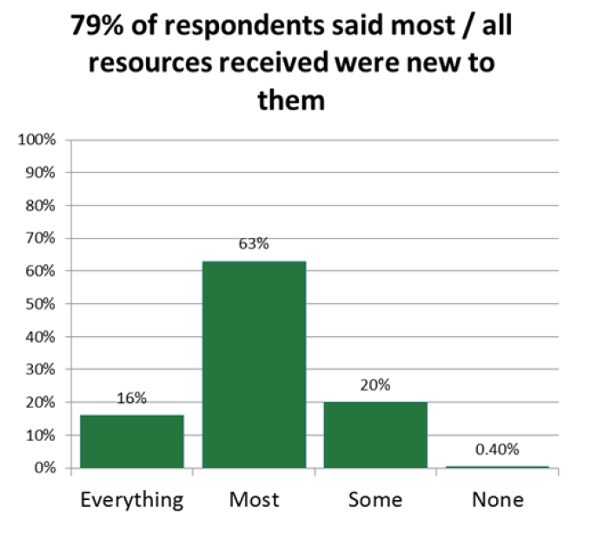
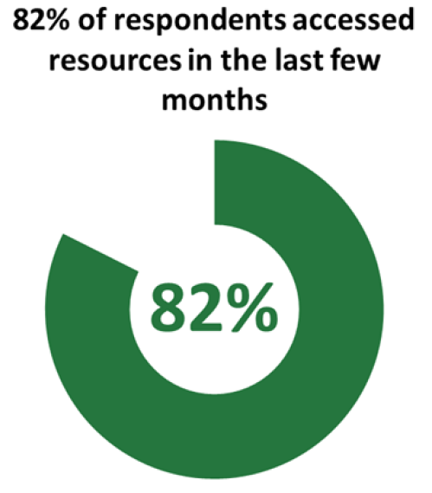
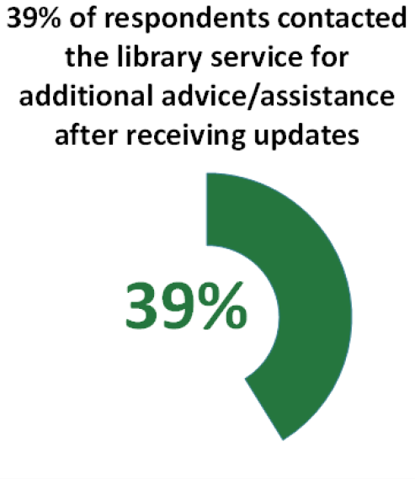
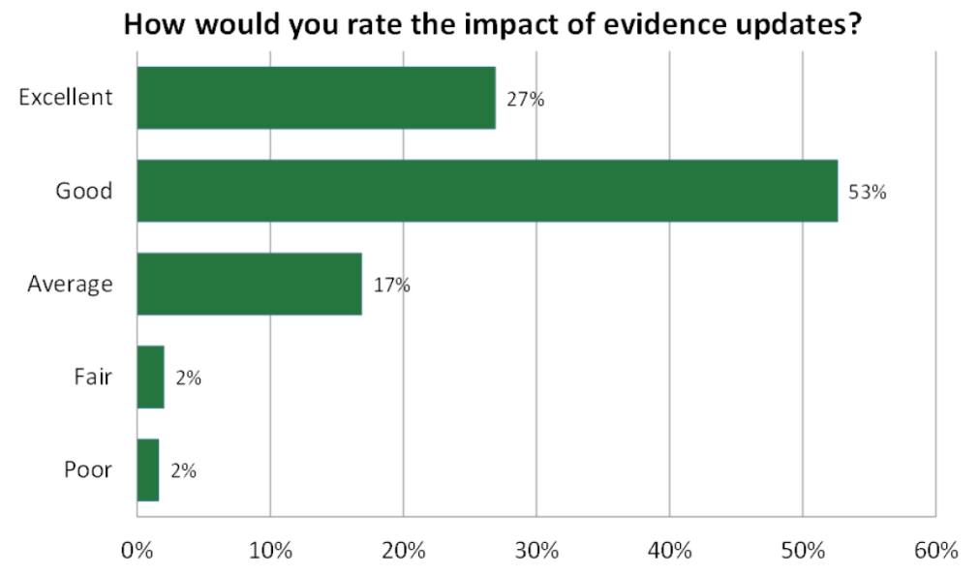
Evaluation

Slide 12
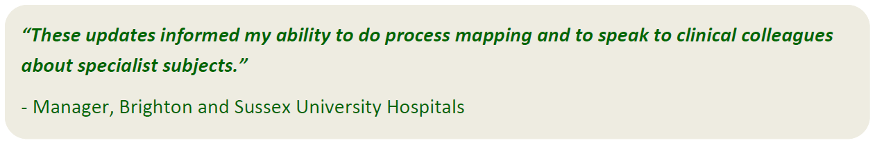
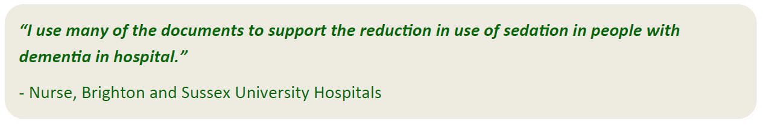
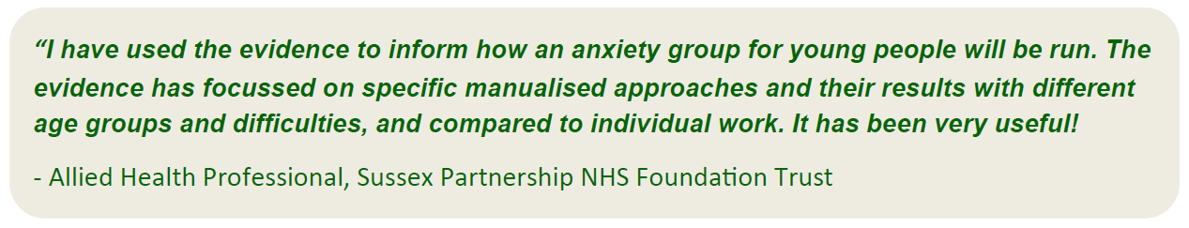
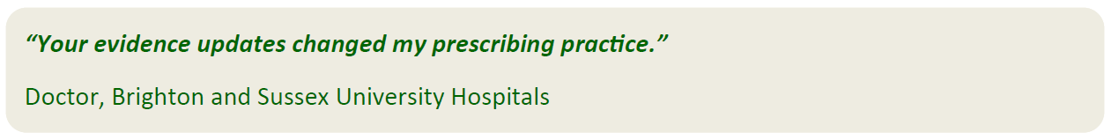
Responses

Slide 13
KNOWLEDGESHARE DEMO
Link

Slide 14
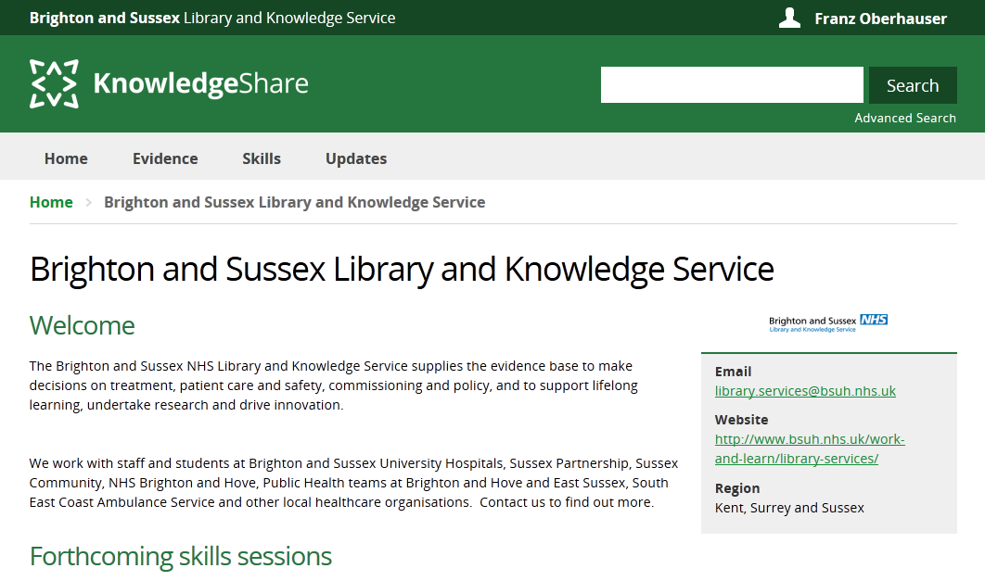


Slide 15
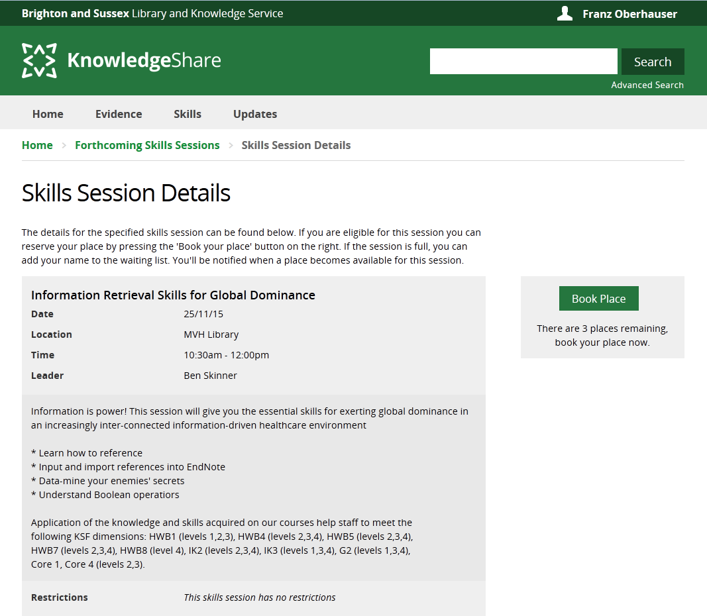

Slide 16
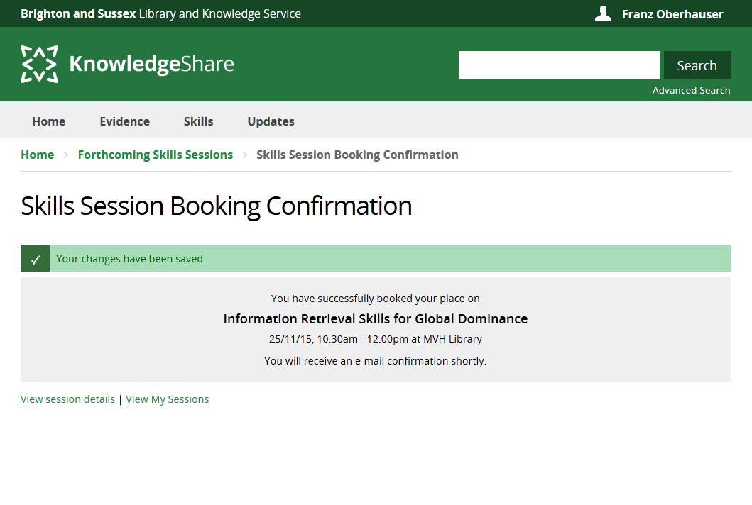

Slide 17
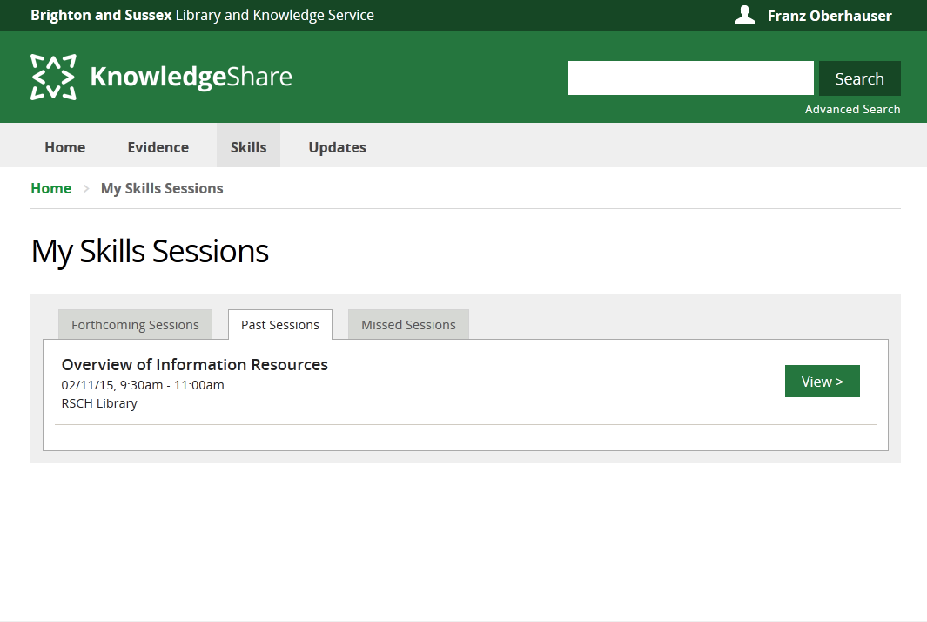

Slide 18
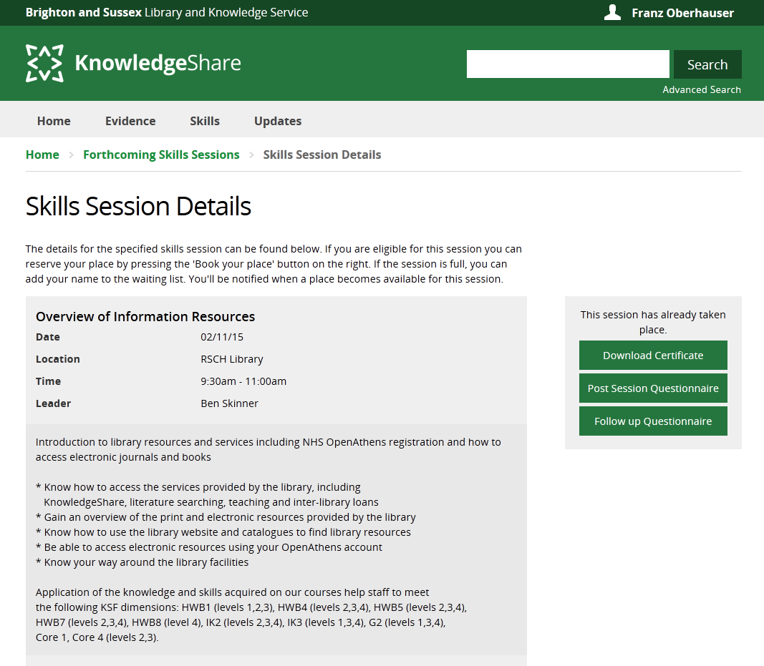

Slide 19
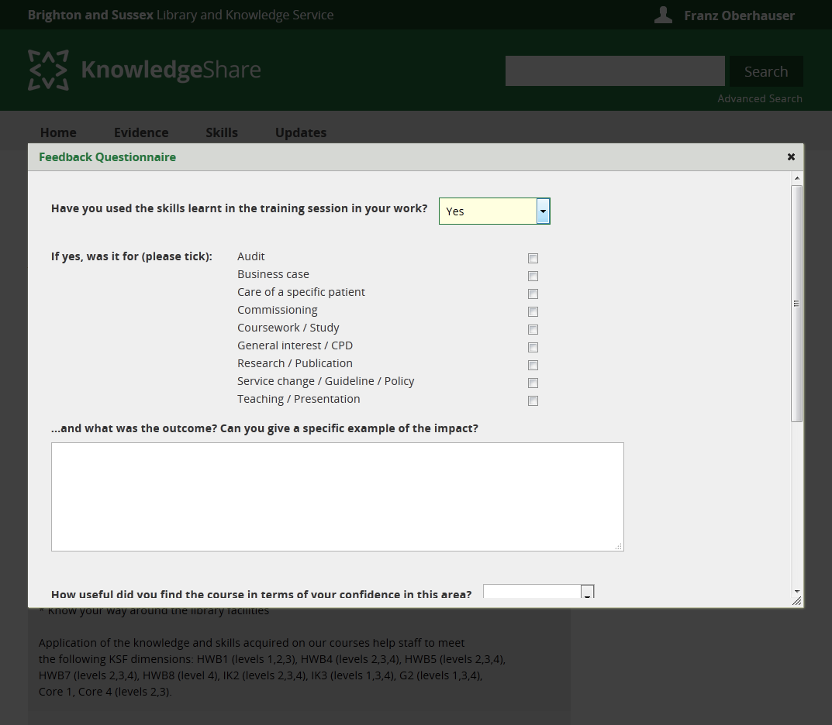

Slide 20
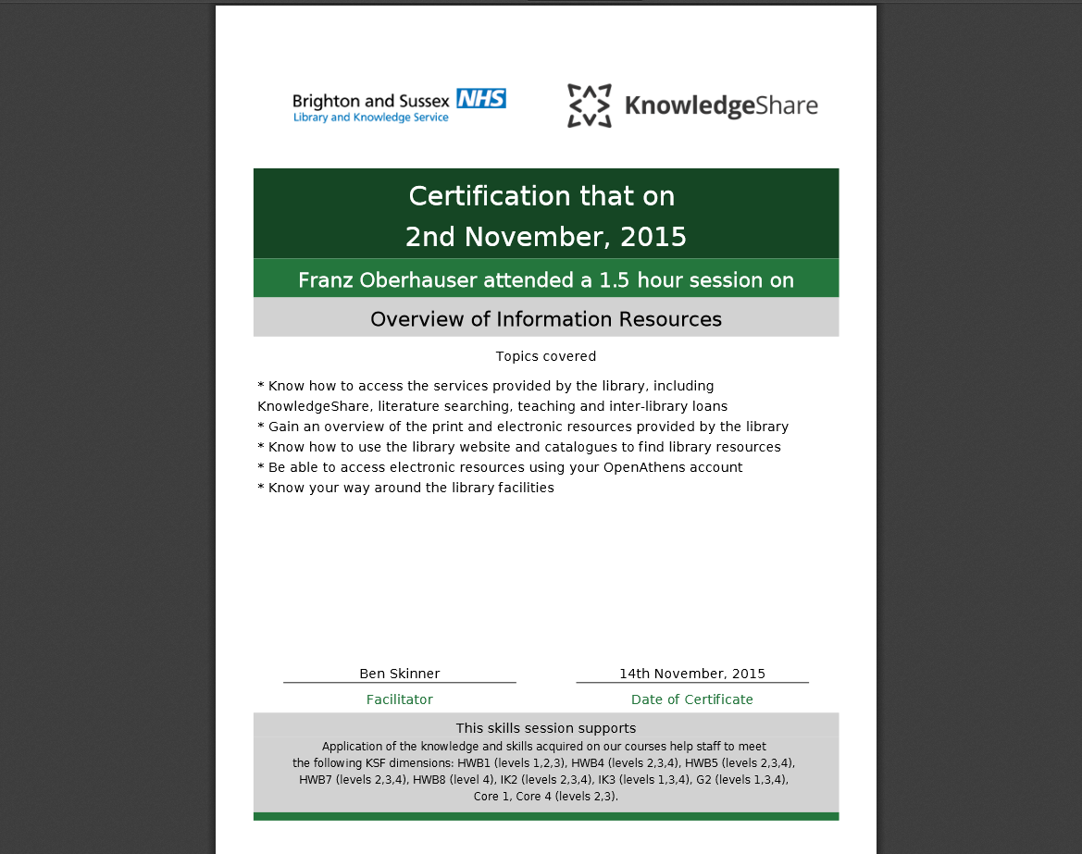

Slide 22
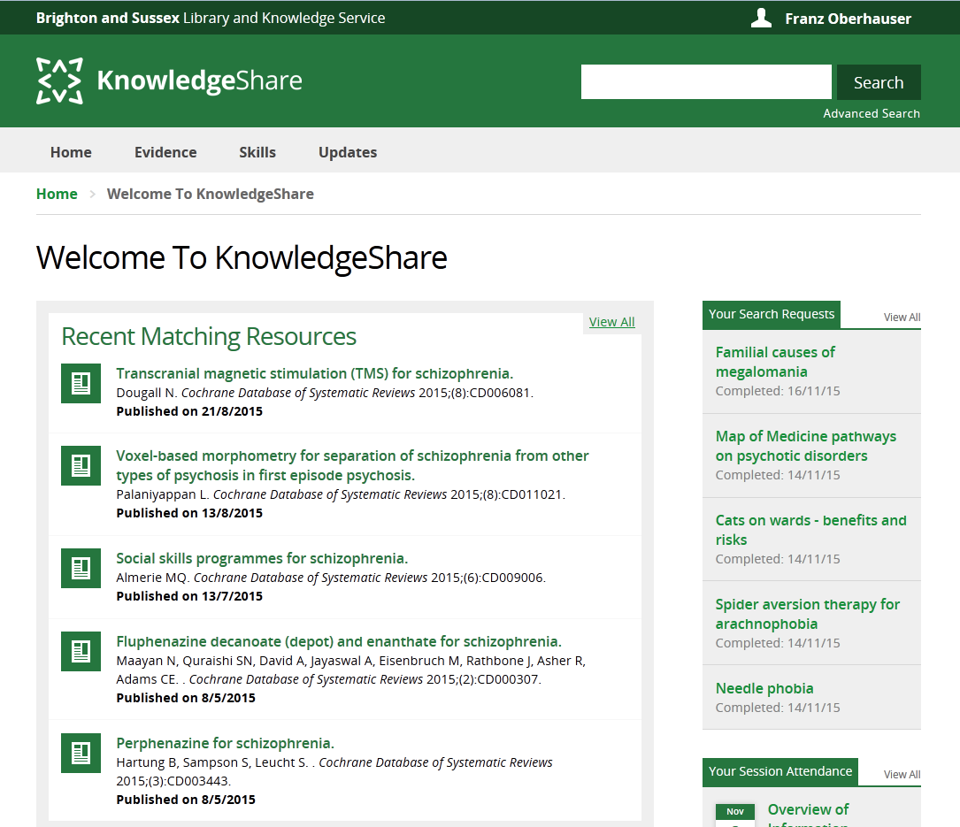

Slide 23
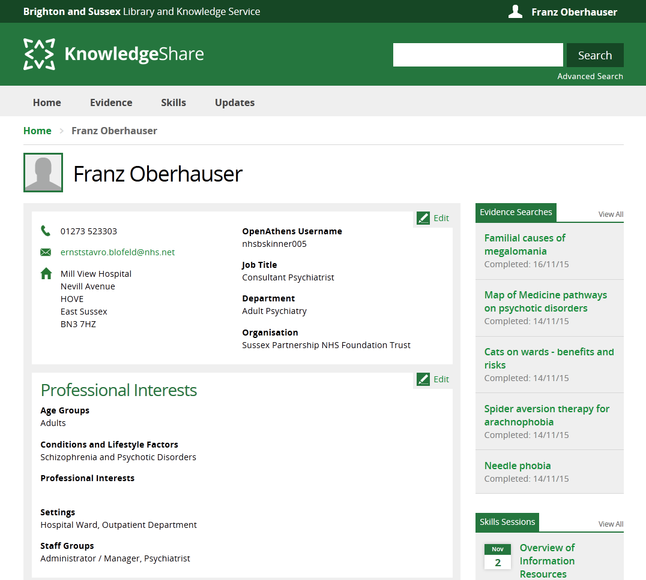

Slide 24
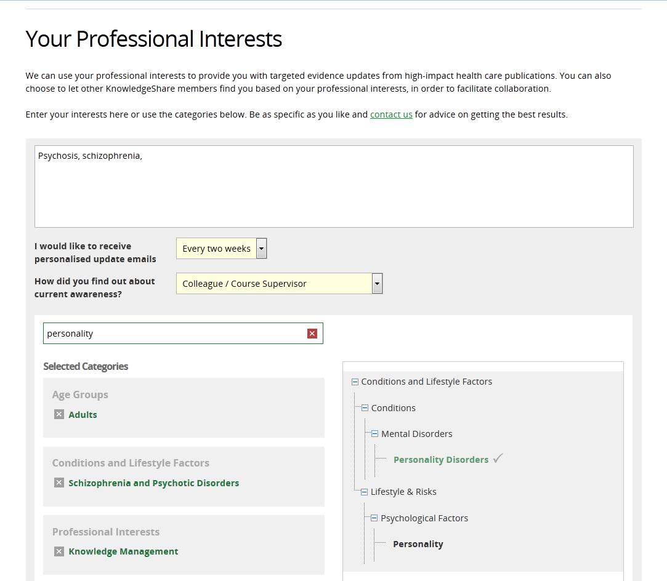

Slide 25
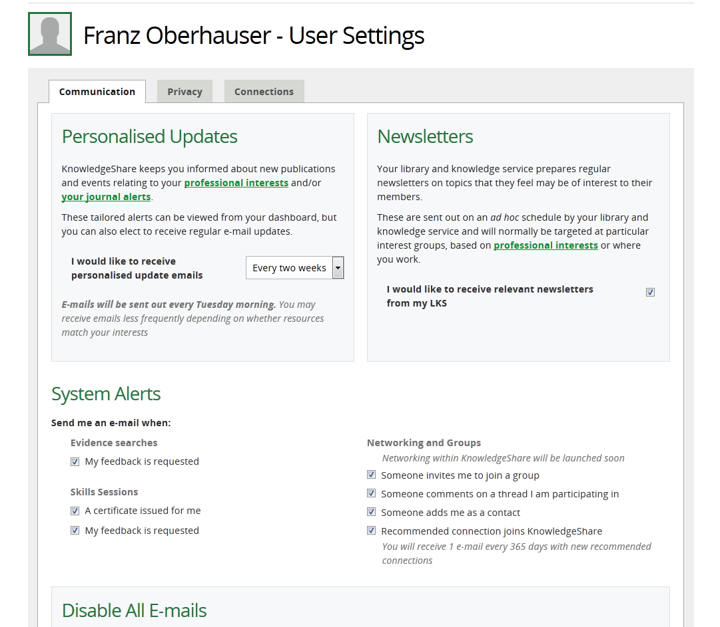

Slide 26
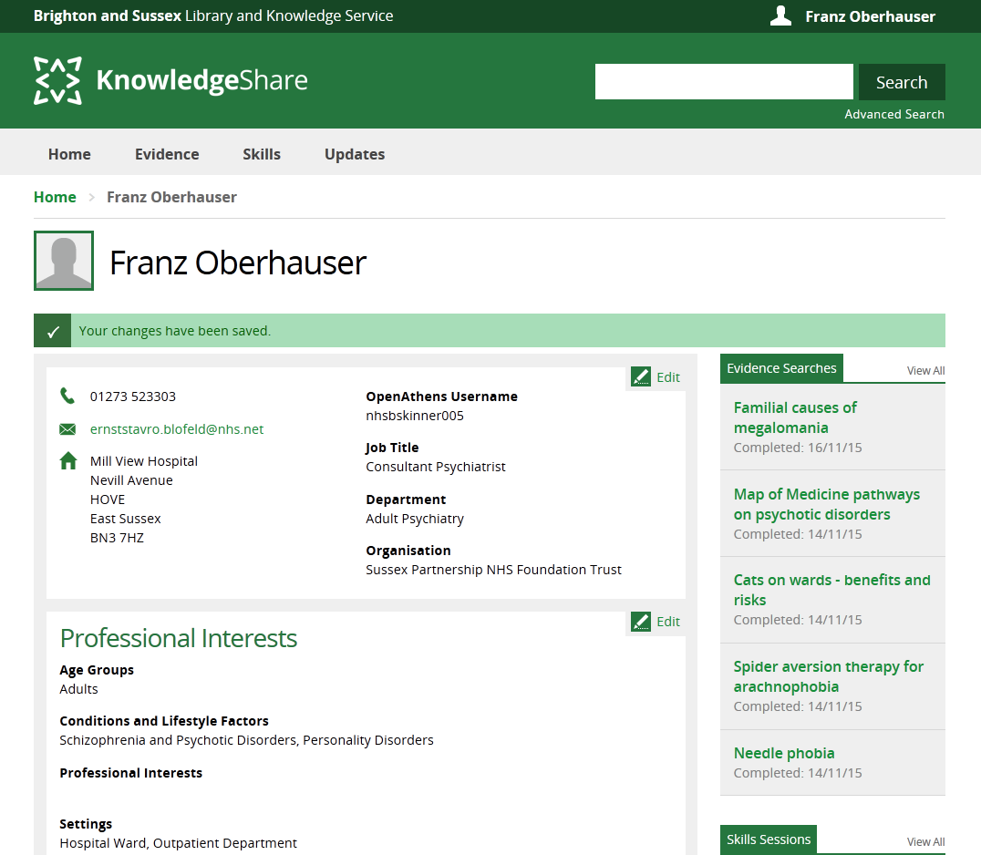

Slide 27
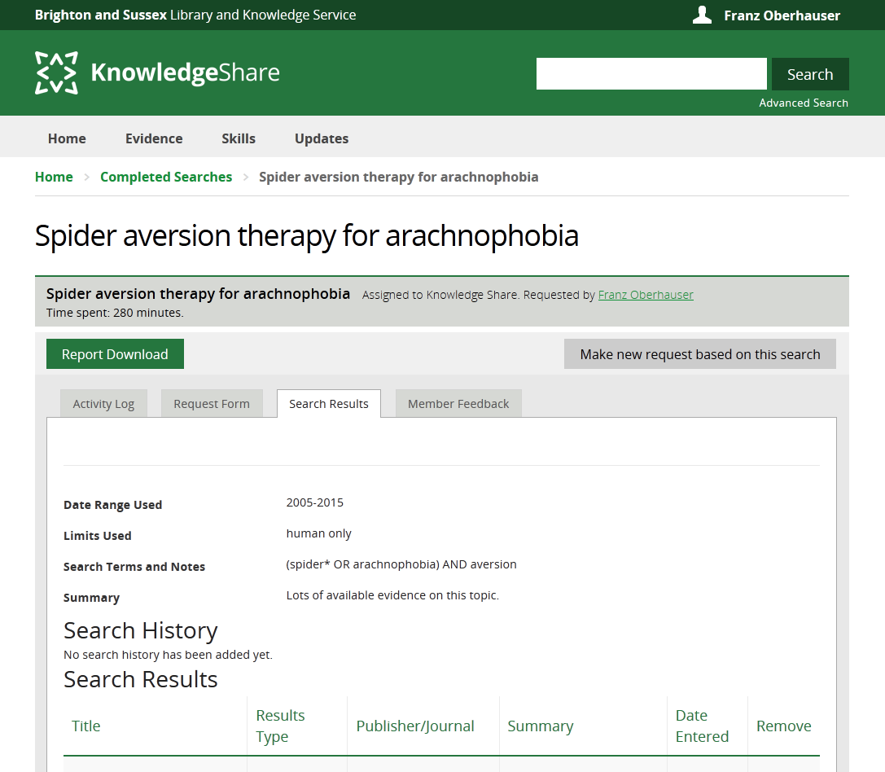
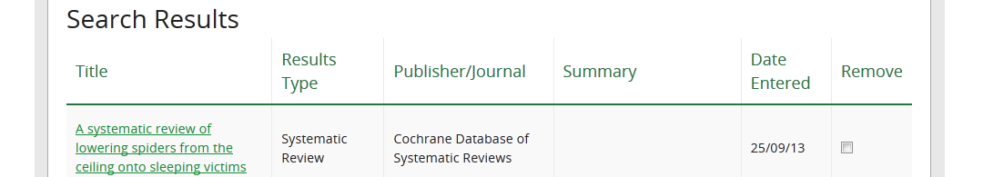

Slide 28
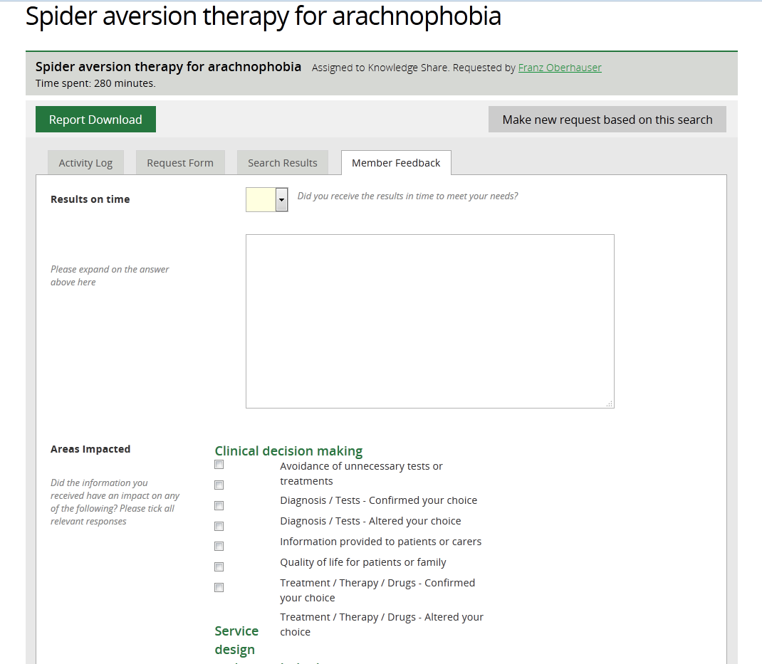

Slide 29
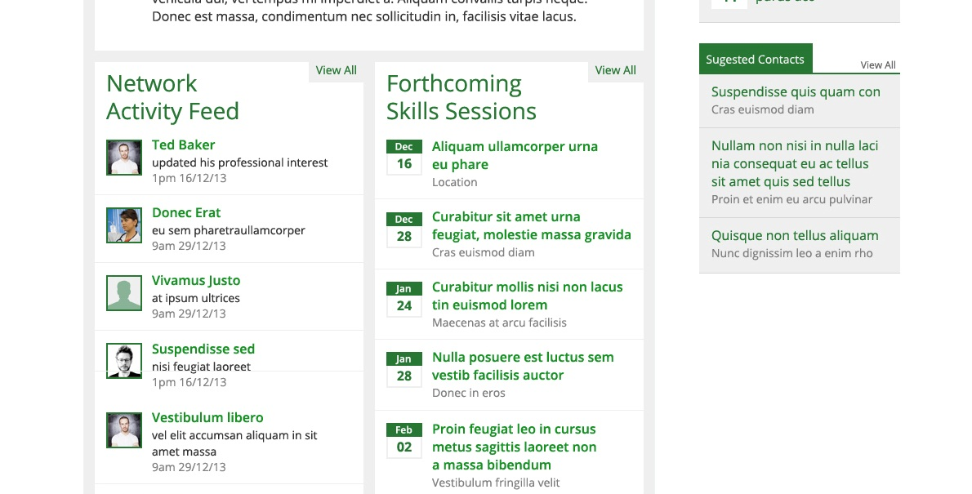


Slide 30

Created by: | Ben Skinner
 | ben.skinner@nhs.net
Provided by:
 | www.bsuh.nhs.uk
Built by:
 | www.maldaba.co.uk

