Slide 1
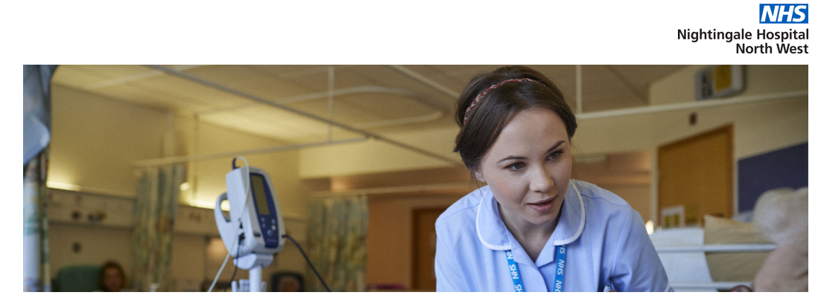
My experiences of working at the NHS Nightingale NW Hospital during COVID 19
Steve Glover, Head of Library Services
Manchester University NHS Foundation Trust

Slide 2
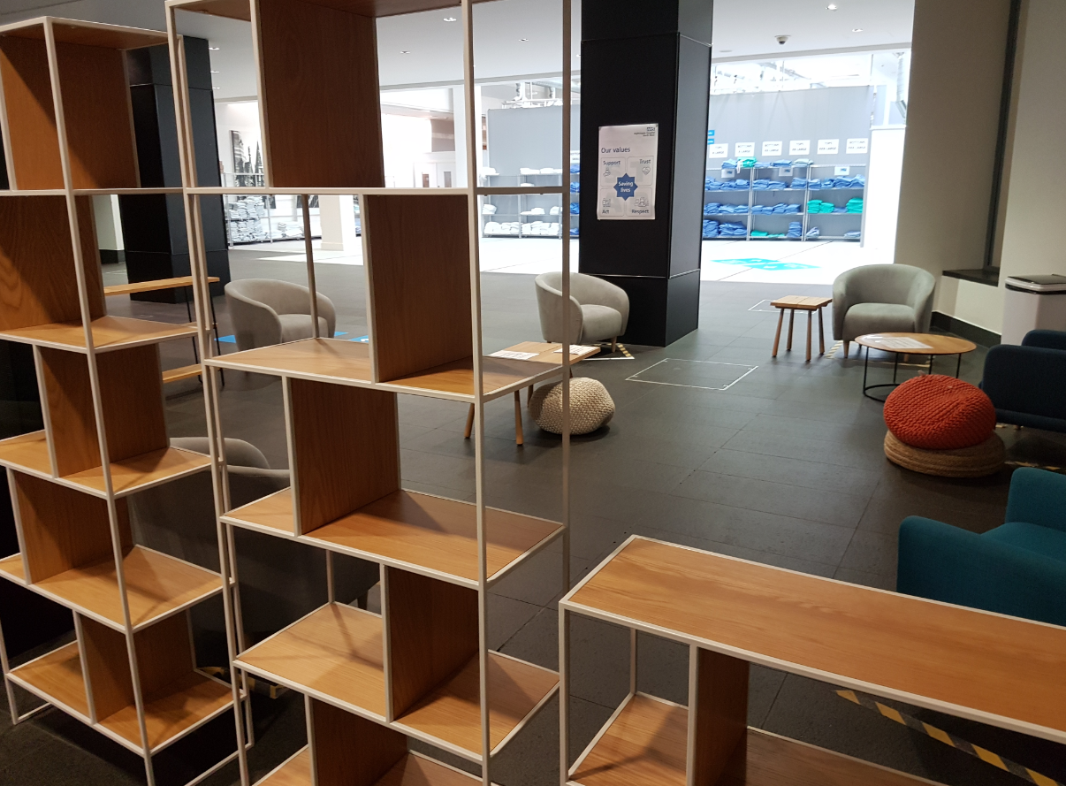
NHS Nightingale North West
Step down patients …. 5 days post ICU & swabbing COVID +ve
Field Hospital: no complex underlaying conditions
Referrals from 25 north west hospitals from Cheshire to Cumbria
18 Wards – 36 beds per ward in a Nightingale lay out
650 Bed capacity if needed
https://www.youtube.com/watch?v=qlaV3ivJ4mU&feature=youtu.be

Slide 3
My role
I volunteered in early April when a call came out for staff
Induction at The Etihad Stadium over Easter weekend
I was one of four MFT library staff to work at the Nightingale
Following induction we had “aspirational interviews” on Easter Sunday to determine which roles we could best make a contribution
I was given the role of Duty Operations Manager

Slide 4
Duty Operations Manager
Based in the Operations Room
Bed Manager, NWAS Operations Admissions & Discharges, Medic Liaison, Nursing Liaison, Duty Manager
Bed capacity live state screen
Manage referrals through triage to accept or reject status working with medics, nursing, pharmacy, AHP, MH, & safeguarding teams
Work with NWAS top arrange transport
Manage the Bed Manager and Ops admin team
Run the 9am and 4pm capacity meetings

Slide 5
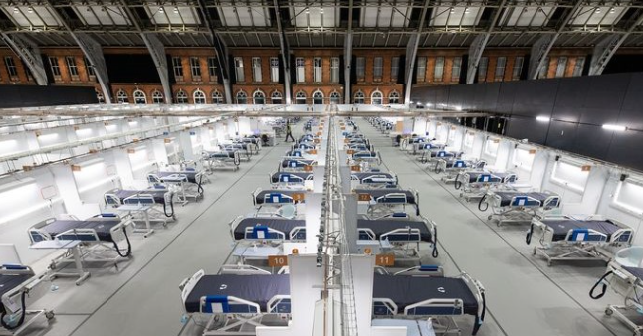
Experiences gained ……..
Working in an Ops room environment
Working with multi-professional clinicians
Multi agency systems
Working with NWAS controllers
Bed management and capacity decisions
Expect the unexpected

Slide 6
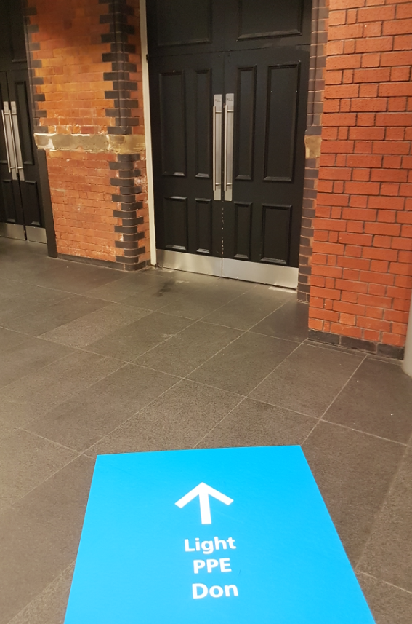
Operations admin team (“Ops”)
From Door to discharge
Admissions – PAS - paperwork
Patient flow (attend daily board round)
Discharge to residence
Liaise with local hubs for packages of care
Arrange discharge with NWAS
Daily multi-professional team meeting around flow and discharge

Slide 7
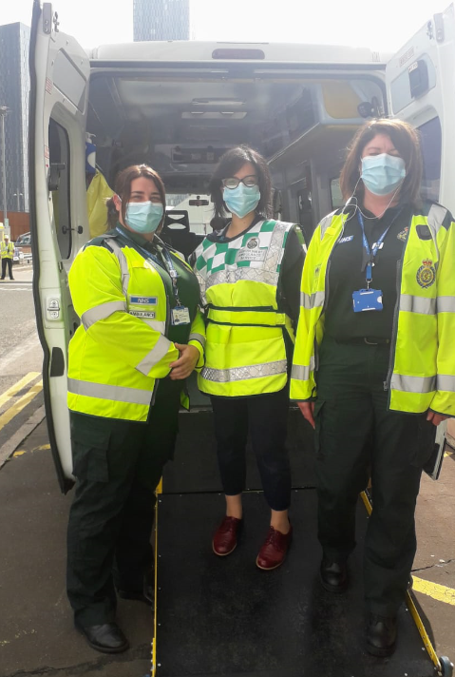
MFT Library staff at The Nightingale
Laura Russell – arrived on day one and worked with the set-up team prior to opening
Becky Walsh – Patient flow team from admissions to discharge (weekends)
Asma Ahmed – Patient flow team from admissions to discharge
Working with clinicians
Working on PAS & clinical systems
Learning about discharge

Slide 8
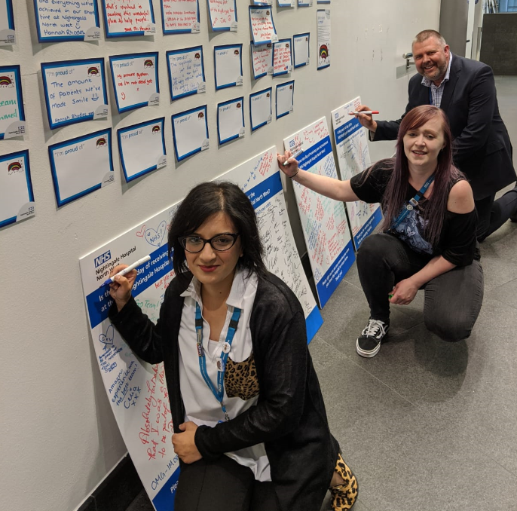
Signing out on our last day

