Slide 1
Current Awareness: collaboration across the community?
Samantha Gavaghan
Lucy Reid
With Marie Hickman, Doug Knock and John Barbrook

Slide 2
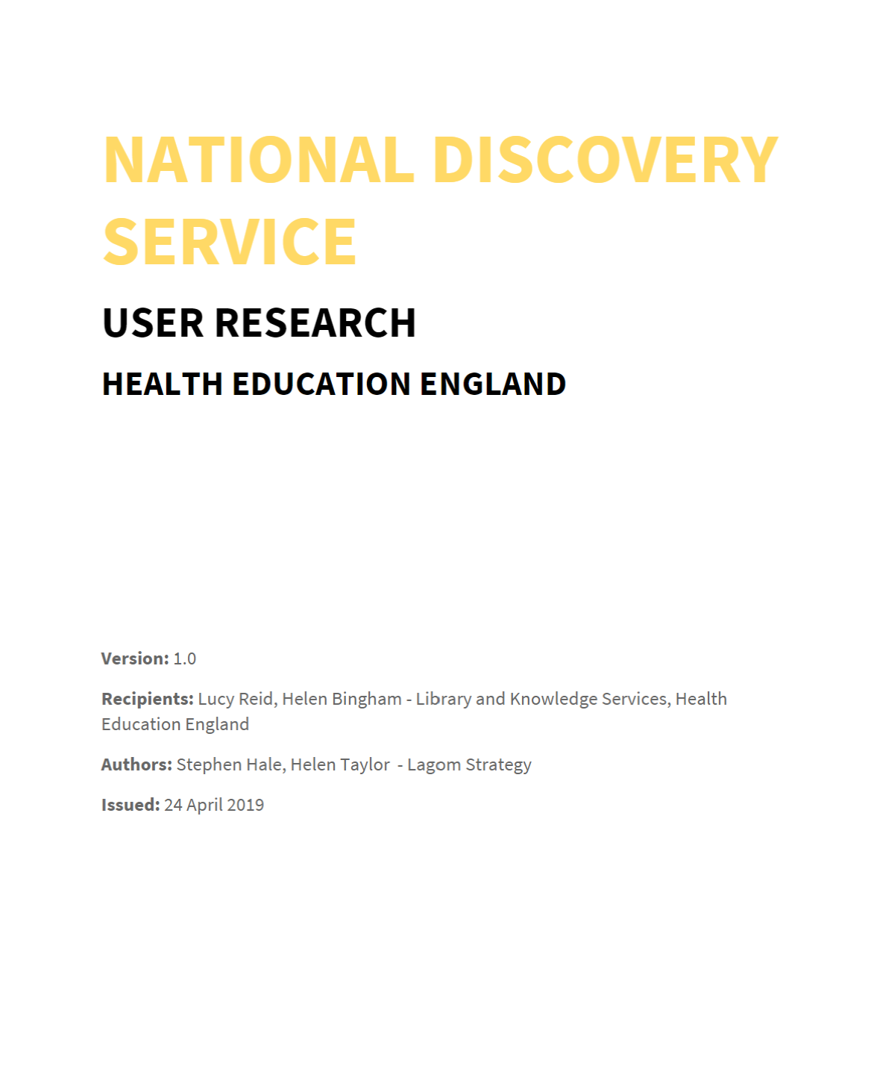
Background and introduction
Introduction
Why is current awareness important?
NHS long term plan – horizon scanning
KfH - “Quick and easy access to evidence”
Lagom end user research - 2019
Helping to embed research/evidence into practice
Marketing and promotion of LKS
Saving time for library users
What is current awareness?
Wide range of definitions but it includes:
KnowledgeShare and other alerting products
Social media alerts
Tables of contents
Bulletins
Notes:
Quote from LTP: 3.116. We will speed up the pipeline for developing innovations in the NHS, so that
proven and affordable innovations get to patients faster. We will create a simpler, clearer
system for medtech and digital that will apply across England. This will include a new advisory
service for innovators, linked to the Academic Health Science Networks (AHSNs). We will
bring together in one place all ‘horizon-scanning’ activities. And we will simplify health-related
national innovation programmes, backing those that are most successful under a single multistakeholder
governance structure.

Slide 3
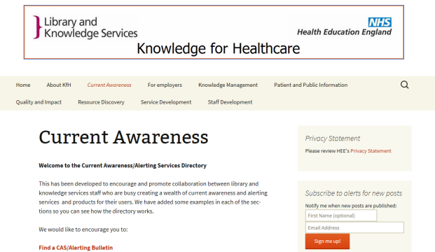
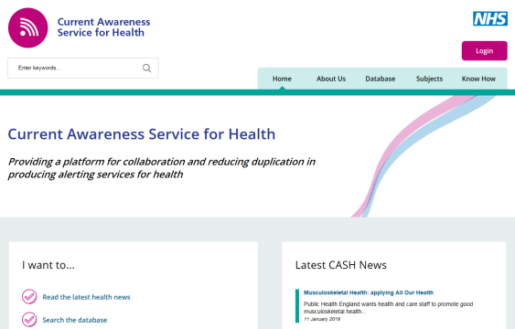
Background and introduction
Health Education England – Leadership Academy Knowledge for Healthcare Senior Leaders Development Programme
April 2018 – January 2019
Our project
The original brief was to:
“critically evaluate and build on the work of the former Current Awareness Task and Finish Group”
KfH task and finish group – final report and recommendations 2016
Aim: Increase collaboration to 80% of NHS LKS
Blog page created
Guidelines produced
CASH portal redeveloped

Slide 4
What we set out to do
Focus on the production of current awareness bulletins
Aim to identify
good practice for sharing and redistributing bulletins
barriers for libraries not sharing and reusing them
In order to
suggest improvements to the knowledge for healthcare site to facilitate sharing and redistributing bulletins
review and produce more robust guidelines to enable library services to produce high quality bulletins or libraries to share them more
Notes:
Focus on Bulletins – time-intensive production process, popular with library staff and their users, but we knew that there was little analysis of the reach impact of bulletins and sensed that there was a lot of duplication in the system.
We revisited previous project(s) to look for what had worked and what didn’t work so well
Literature search of previous research.

Slide 5
What we needed to find out
1. Do you produce your own current awareness bulletins, circulate bulletins produced by other services or both?
2. What characterises a high quality bulletin? Are there any that you’d recommend as exemplary?
3. How are you evaluating your current awareness bulletins? Do you look at usage, reach or impact? What are your findings?
4. How much time do you spend in an average week on your current awareness bulletins?
5. Have you used the Knowledge for Healthcare current awareness bulletin guidelines and bulletin repository?
6. The principle behind the guidelines and repository is to facilitate collaboration and reduce duplication in bulletin production. Whether you’re a creator or distributor of bulletins, what would help colleagues to “do once and share”?
Notes:
We decided to concentrate on 6 questions

Slide 6
Methods
Twitter Chat
Tuesday 18th September 2018
Interviews
13 interviews
Case Studies
2 case studies
Reviewed technology
This work has continued since the end of the original project and new learning from the covid-19 bulletins group has been added
Notes:
Twitter Chat 18th september – lucy lead the twitter chat on behalf of the group – whilst the rest of us lurked in the background 21 people joined in
13 interviews
2 case studies with the current awareness community respected authors
Technology issues across trusts - not all trusts allow equal access to technology – interesting issues with GDPR and google analytics

Slide 7
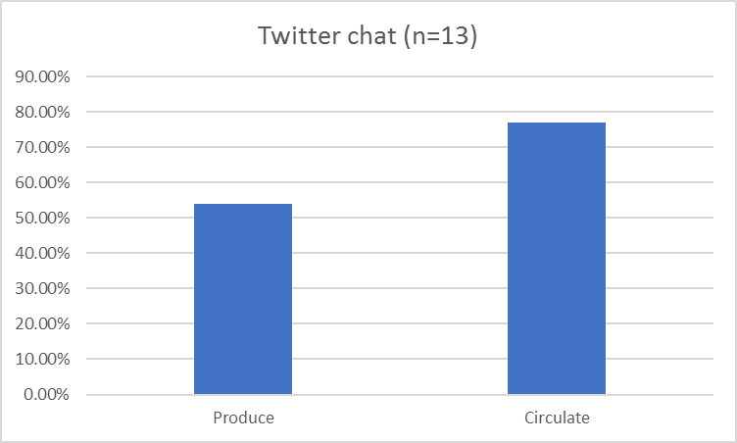
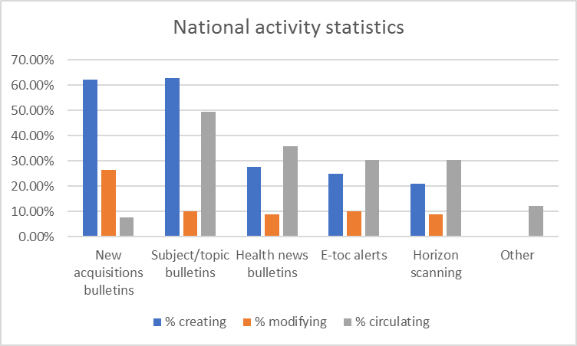
What did we learn?
1. There are still lots of people creating bulletins

Slide 8
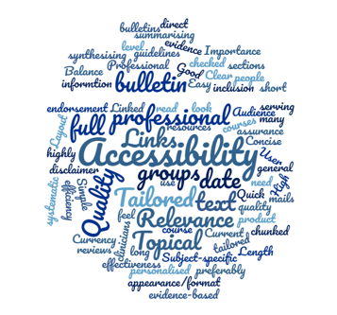
2. There is wide variation in what people consider to be effective for current awareness bulletins

Slide 9
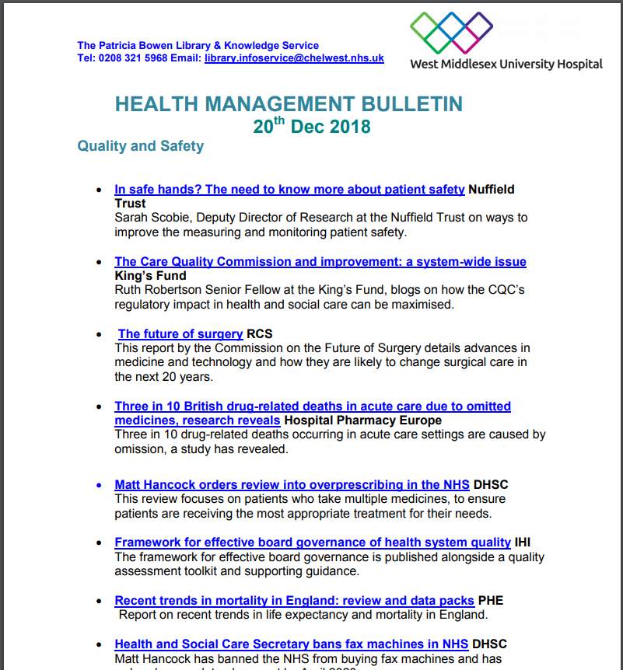
2. And a wide variety of styles, formats and content coverage

Slide 10
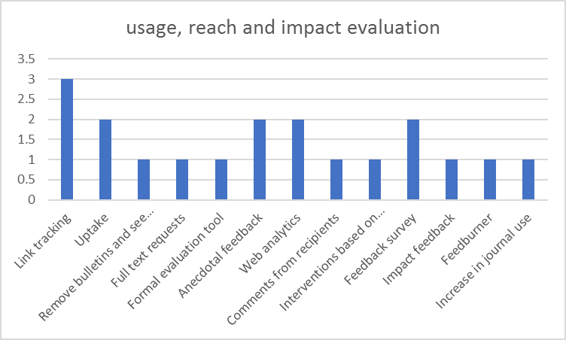
3-4. Much more work is needed to assess the reach, impact and cost effectiveness of current awareness bulletins
Current evaluation tools
How long do people spend on their bulletins?
30-45 minutes per day
30 minutes - 1 hour per bulletin
1 hour per bulletin
2 days per quarter
2 hours/week for two staff
3-4 hours
6-8 hours per month
10 hours
as long as it takes

Slide 11
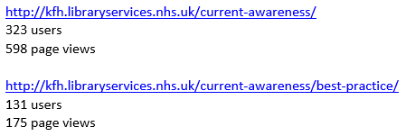
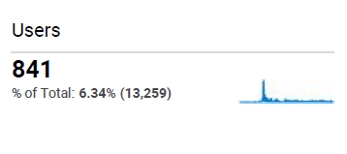
5-6. Those who had used the KfH current awareness content found it useful but it needs to be more robust, easier to use and promoted more widely
Suggestions for improvements
Editorial oversight for the repository (quality assurance with feedback to those whose bulletins are rejected)
Including a "spec" for each bulletin (audience, scope, source etc)
Promotion of the repository
Identifying one provider/lead for each topic
Templates
Toolkit
Good practice guidance including on technology to measure use
Include generic resources for libraries to then add in local material
Specialist bulletins are most useful to “do once and share”
Contact details and links to their websites/products
Branding – national plus local for marketing purposes
People are quite “protective” of their work – so need to get over that hurdle!
Central repository – knowing what is out there
User data (1/9/17-17/5/18)
Notes:
Only 17 bulletins listed
Only 1 collaborator
Only 6 schemes
Many of the links are out of date
We fell into some of the same traps with the Covid-19 current awareness page as well.

Slide 12
Bottlenecks and pain-points
Acknowledgement of sources, contributions, authorship, finances
Availability of resources such as staff and time
Variation in products and in schedules
Tracking uptake, including blocking of cookies, IT infrastructure variation and localisation of click through links (e.g. Bit.ly)
Notes:
Trackability and Streamlining
Acknowledgements. Many Current awareness bulletins are shared widely, however with the caveat that they are acknowledged. Librarians are academics at heart, so would be willing to contribute to current awareness activities where a formalised methodology for acknowledgement and highlighting best practice exists. The possible fear of plagiarism may be a possible issue to collaborations
Also and issue could be where services felt that they should be paid or financed for time spent. ‘Why do others outside of my organisation benefit from my work approach?’
Staff Availability. The resource utilization of Current Awareness differs greatly between libraries, with some locations having dedicated staff while others having no staff and relying on automated current awareness such as KnowledgeShare or HDAS alerts.
The products used differ, and are used mainly due to local use cases. There are a number of well regarded CA activity using standard bulletins, basic CA activity via social networking and the automated systems such as KnowledgeShare. This leads to little homogeneity across the Current Awareness ‘ecosystem’ so may be a significant barrier to further collaboration
Current Awareness Schedules also differ, with weekly or monthly activity. This is understandable given the different activity between topics, with, for example, cardiology as a topic generating much more new evidence that less prolific subjects such as podiatry. By standardising with greater collaboration, it is possible that users may become dissatisfied with a reduction in Current Awareness.
Tracking Cookies and identifiable bit.ly links. These are an issue, give the manual nature of the creation of trackable links and no automated system s other than KnowledgeShare able to create custom links automatically. Some current awareness bulletins show extensive tracking via bit.ly links and are able to evidence high usage, whilst others may only evidence that the bulletin ‘was opened’.

Slide 13
Where did we get to at the end of the project?
Recommendations
Review functionality of existing services – controlled study
Do any resources / services have the capacity to deliver high quality, tailored current awareness bulletins covering all subject matter?
Either
Review the business model for existing service providers
Collaborate to achieve sustainable product development to meet end-users’ needs
Or
Enhance editorial guidance, quality assurance and technical infrastructure of HEE LKS current awareness web presence to support “do once and share” delivery of bulletins
Produce guidelines and recommendations for evaluating bulletins and capturing impact
In all cases:
Promote use of all current awareness resources through HEE LKS web presence
Establish mechanisms for monitoring and evaluation to demonstrate reach and impact

Slide 14
Community of Practice
Kick-off event – November 2019
Presentations from bulletin producers: PHE, Kings Fund, RCSEng, Oxford Health, CASH, KnowledgeShare, NHSES
Workshop sessions: defining good quality bulletins, measuring value and impact, priorities for the group
Map who’s doing what
Awareness and use of the repository
“Be more Scotland”
Return on investment (value and impact)

Slide 15
Covid-19 current awareness group – applying our learning?
Call out for people involved in producing Covid bulletins
Blog-site used to signpost resources and sample bulletins
Similar patterns of variation: themes, formats, distribution methods and schedules
Who’s scanning what sources?

Slide 16
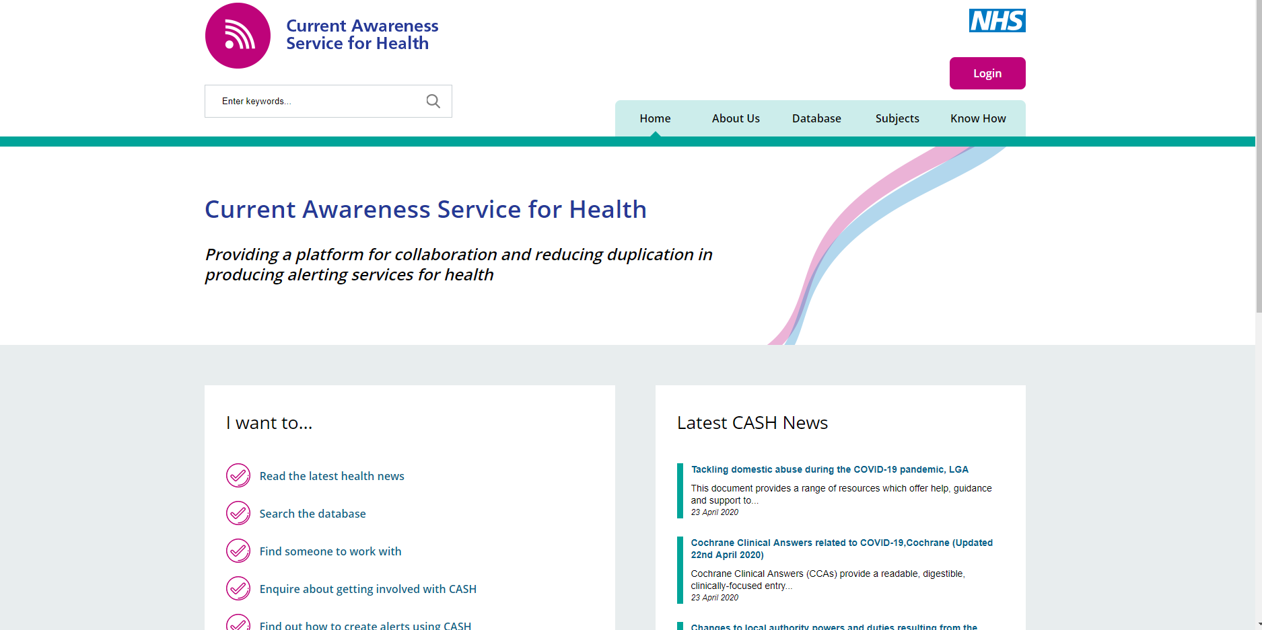
Current Awareness Service for Health
http://cash.libraryservices.nhs.uk/
Notes:
CASH is available from the NHS library and knowledge services website or the link above.
The site was built using the EasySite CMS and what I am going to demonstrate is by no means the finished product it can have additional directories and pages added.
Just before COVID-19 hit we were reviewing the pages and many pages are not maintained.
The content focuses is on reports, policy and guidance rather than journal articles although there are always exceptions. At SFH we produce a Sepsis bulletin which usually has articles as that it was the customer requested.
So CASH is very much about providing a flexible platform to enable LKS to deliver timely alerts to their customers.

Slide 17
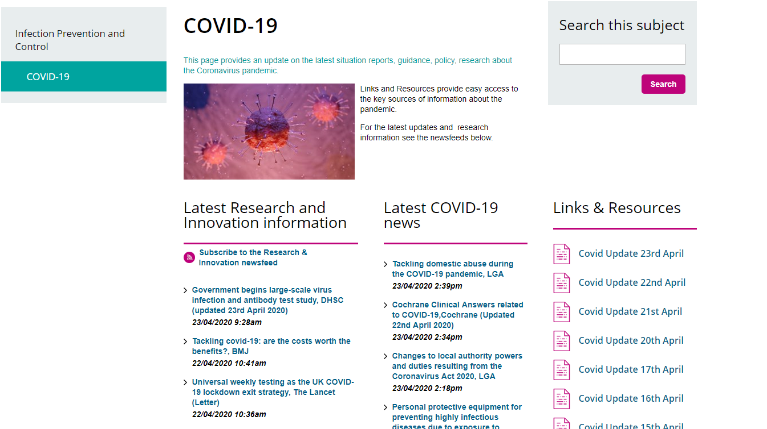
COVID-19 Page
Existing categories and newsfeeds
Sources checked twice daily
Notes:
For speed and ease this page was created using existing categories and newsfeed
The first is for research articles and we are only adding those which are UK and may be of immediate interest.
The second is the feed used to produce the daily COVID-19 bulletin delivered at 8.00 am the following morning.
This is also uploaded as a word document.
Note we have also put the time entered so you know when a source was last checked.
We discussed having different bulletins for different audiences but decided that as it was daily it was easy to scan.
So I’ve started at the end of the process – let’s go back to the beginning…

Slide 18
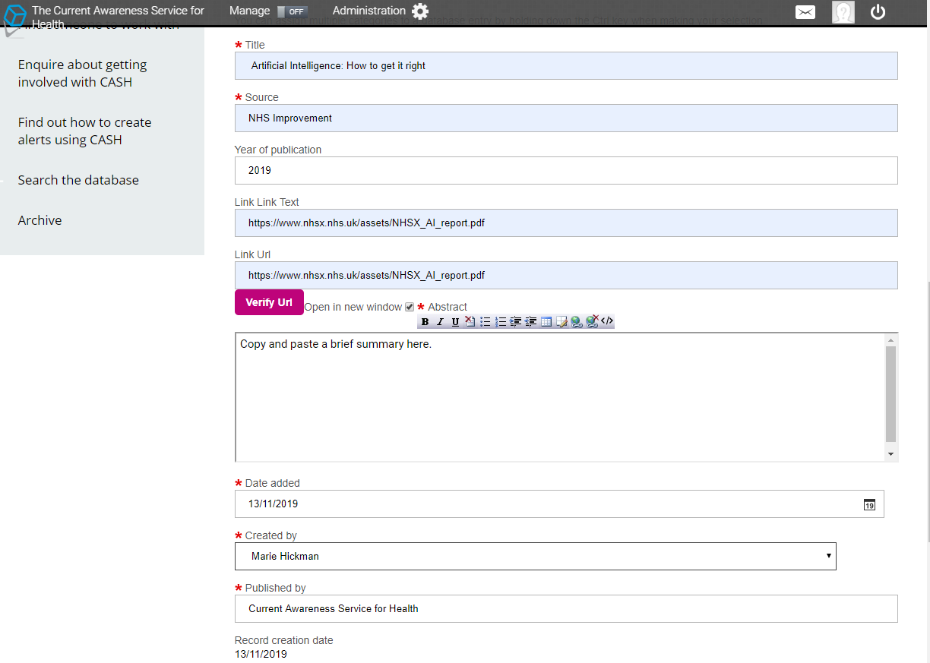
Database entry form
Database is hub of the service
Sources checked twice daily
Very quick to enter items
Quality sources
Grey literature
Key research articles
Notes:
The data entry form makes it very quick to enter an item.
You can select more than one category or tag e.g. Infection control & primary care & quality and transformation and STPs.
If you are producing your own bulletins consider using CASH to automate the process and share content with other LKS too.
DEMO
NB ADD CATEGORY.
Record is immediately visible. There are some duplicate entries, but these can be edited before the bulletin is produced.
The record is also searchable – so you can find Children & Young People and Infection Control and pull out everything entered today.

Slide 19
Output formats
Know How pages to share best practice
Customisable bulletins containing news and other information direct from CASH e.g. MailChimp
Newsfeeds
End-users
Easy to embed on webpages e.g. Trust internet
Facebook page
Other internet services e.g. ProtoPage, NetVibes
Notes:
Past feedback was that LKS did not know how to use CASH.
The Know How pages contain information to help including how to set up a Mailchimp bulletin using a newsfeed from CASH.
One of the massive benefits of using the database as a repository is that you can use the newsfeeds to produce local bulletins on a regular basis Examples e.g. PCN News, Infection Prevention and Control Bulletin, Sepsis etc.
Can use multiple newsfeeds, but needs to be set up by CASH Administrator. Single newsfeed is easy.

Slide 20
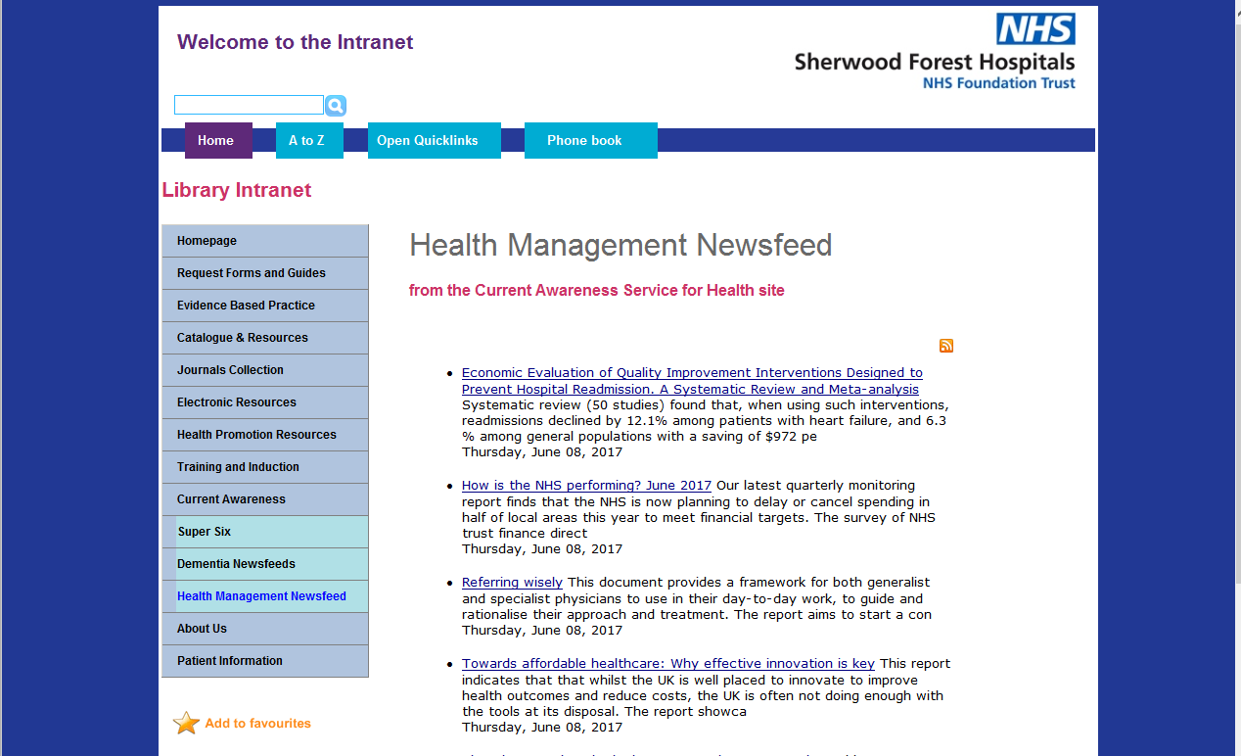
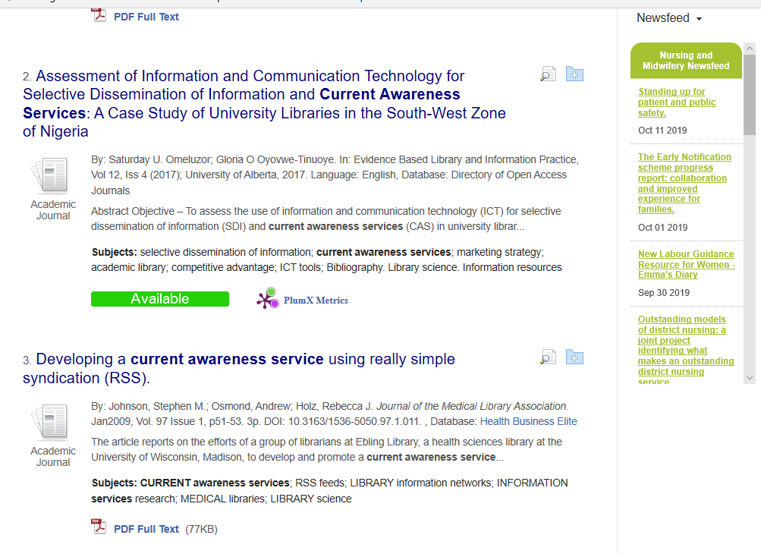
Examples
Notes:
Can embed newsfeed on webpages or Discovery Tools.

Slide 21
CASH development project
Technical development to maximise the functionality on CASH platform
Link tracking
Accessibility
Document summaries
Research and produce case studies to demonstrate the impact on local practices
Time saved
Different team members involved in the process
Training and marketing materials to promote use of and contributions to CASH
Expand the number of active contributors to CASH
Expand the subject coverage for CASH
Source examples of high quality bulletins for key topic areas to be made available for the whole community
Promote the use of CASH as a primary source for themed bulletins and records for locally tailored bulletins

Slide 23
What role do bulletins play in your service offer?

Slide 24
What barriers are there to collaboration?

Slide 25
What needs to change to facilitate collaboration?

Slide 26
Thank you!
Lucy Reid: lucy.reid@hee.nhs.uk
Samantha Gavaghan: samantha.gavaghan@nhs.net

