Slide 1
Library and Knowledge Services Managers North
1st September 2020
Notes:
Good morning everyone.
I hope you’ve had a good Bank Holiday weekend.
17 slides today – this one illustrating the kind of holiday I’m sure we all wish we’d had this year.

Slide 2
Organisational Change
CCGs: Plans to streamline commissioning through a single ICS/STP approach
Formal written applications to merge CCGs on 1 April 2021 need to be submitted by 30 September 2020
Public Health England
Notes:
There are currently 42 STP/ICS in England and around 120 CCGs. It is thought that this change might lead to around 70 ish CCGs
What might this mean for you if you currently deliver services to CCGs?
Are there local partners who you need to work with to maintain and improve your offer into the CCGs?

Slide 3
Funding opportunity: advancing place-based knowledge services
Up to £25,000
Partnership working
Place-based focus
11 September 2020 deadline
See the Blog
Notes:
Related to the CCG changes you will hopefully have seen the opportunity to bid for up to £25,000 non recurrent funding to work with partners to deliver services across the system particularly to underserved areas of healthcare. For full details see the e-mail which has been circulated on the Library Managers England list on 3 August and let us know if you haven't seen it.

Slide 4
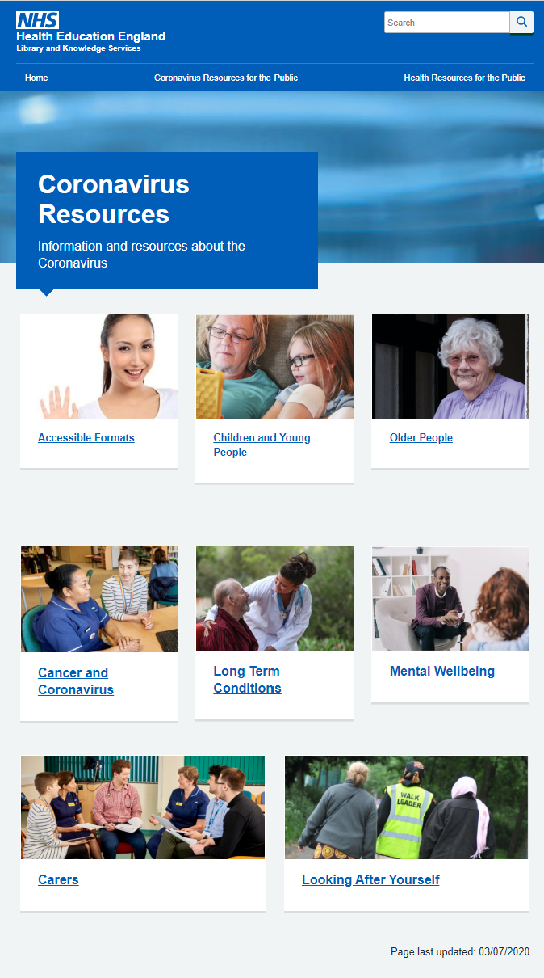
Supporting patients and the public through COVID-19​
Trusted information for patients and the public and in accessible formats
New content added:
Cancer
Mental Health
Carers
Long-term conditions
Wellbeing
https://library.nhs.uk/coronavirus-resources/
Notes:
New content has been added to the covid resources site.
Total page views: 27,201
Most popular section:
Accessible
Children and young people – including new information on returning to school!
Older people
HEE communications team promoted through Trust communications and social media

Slide 5
Supporting LKS teams through COVID-19
COVID-19 search bank
Currently being evaluated
CPD
Facilitating Virtual Meetings
Action Learning Sets
On the horizon
Social distancing posters
HEE policy on library space
LKS induction animation
Notes:
CPD
More sessions for Facilitating Virtual Meetings
Additional cohorts of Action Learning Sets
Social distancing in libraries poster – due for circulation in September
HEE is producing a policy on the role and value of library space – aiming for Executive approval in early October
LKS induction animation – technical problem meant that kick-off was delayed so the animation was not ready in time for August inductions. Work will be completed for general inductions.

Slide 6
E-books via Kortext
Kortext awarded a contract by HEE to provide collaborative e-book purchasing for NHS library services
https://www.kortext.com/nhs-books/
Notes:
A collection of titles are available on the platform. They include some free titles made available as part of the Covid response and some titles which we will likely purchase made available for now as courtesy.
Open Athens authenticated.
Once signed in with Athens, this also becomes your Kortext login for the platform and the app.
Books purchased on a credit model where available
Books are available in perpetuity; there is no annual subscription fee.
A number of credits are available per book which are automatically renewed annually.
A collection of ’core’ books are being purchased for each region by HEE
Trusts can then opt to participate in a further regional collaborative – libraries buy the titles they need and these are made available to everyone involved, building a wider collection.

Slide 7
What next?
NHS Store (admin site for ordering and all aspects of managing the service) and enhanced user platform to be launched in September
HEE is providing some funding for each region to purchase a collection…..
Once purchased, MARC records and Wayfless URLs will be available for integrating the books into LMS and Discovery systems.
Notes:
We will very soon seek your feedback and suggestions for titles across the north

Slide 8
National Discovery Service
June – out to tender
June and July – ‘before action learning’ sessions with LKS managers
August – submissions received and evaluation commences
November – contract award
Summer 2021 – service ready in beta
Notes:
In January 2020, we announced that the HEE Executive had approved this project and that implementation costs would be covered centrally.
Aims –
“…to provide NHS staff with a single, coherent national gateway to their trusted library and knowledge service, connecting them seamlessly to quality resources, services and support tailored to their needs”
Consistent high quality experience for all staff
Reduce money and release time currently spent managing an exponentially increasing number of local discovery services

Slide 9
National Discovery Service
Key messages from ‘before action learning’ sessions with LKS managers
Current user frustrations
The new service must overcome these
Hold the supplier to account
Ensure library services and users are consulted and informed
Reassure library staff
Take into account local IT
Notes:
10 sessions
User frustrations - Too many routes to information, Lack of time, Lack of searching skills, OpenAthens & multiple logins, different wherever you go
The new service must overcome these frustrations
Offer intuitive functionality but not an information hose
Engagement
Reassurance
Could fail if don’t generate enthusiasm and don’t take into account local IT

Slide 10
HDAS and Native Interfaces
Our plans to decommission HDAS at the end of March 2022
National Discovery Service to be launched by October 2021
Expert searching available through native interfaces
Native interface pilot sites identified
Training and support will be offered to all LKS staff
FAQs - https://kfh.libraryservices.nhs.uk/resourcediscovery/frequently-asked-questions-2/
Notes:
The HDAS decision was very difficult. Together with NICE, HEE gave full consideration to feedback, usage data, costs and research findings – as well as the views of colleagues and partner organisations.
The priority now is to mitigate the loss of HDAS – HEE are taking this forward in a range of ways.
The new National Discovery Service will be launched by October 2021 – this should meet the majority of the search needs for the wider workforce
Expert searching will be available through the native interfaces – see next slide. Most expert searching will be done by LKS staff
There were 8 applications from networks of library services who expressed an interest in piloting the move away from HDAS to be early adopters of native interfaces. 4 of these applications were successful, including one from the north. The native interface pilot commences in October.
A comprehensive range of training will be offered to all LKS staff in due course to support the move to native interfaces
A part-time secondee will be employed to support this work.

Slide 11
Native Interfaces now
Notes:
This slide shows the current range of databases and the suppliers that provide the native interfaces

Slide 12
Library Management Systems in the North
LMS projects ongoing in all regions
Lessons learnt will be shared with the North – early planning encouraged!
Funded by HEE and will be compatible with new Discovery Service
Engagement events to be announced shortly
Notes:
We are hoping to get started with this project shortly and our immediate priority is to get LKS staff and services involved and engaged.
Lessons learnt from other regions have identified the benefit of early planning and conversations around the shared LMS. We will shortly arrange preliminary sessions around this if services would like to start thinking about who might represent them in these conversations.
As a reminder, HEE will fund these regional systems, which will help to realise the full potential of the National Discovery Service. We are aiming for 2 systems in the north – one for the North-West and the other for the North-East and Yorkshire/Humber.

Slide 13
Today: impact and staff development survey
Biennial Survey for all library and knowledge services staff
Opening 1 September 2020
Seeking views and feedback on:
The impact of your library service
Learning and development opportunities offered
Reflections on library and knowledge services response to Covid-19

Slide 14
Virtual CPD in the Autumn
Health literacy awareness and train the trainer - October 12th and November 18th
Making Work work – opportunity for teams to have a facilitated conversation to enable you to rediscover your shared sense of purpose - contact Gil Young for more information
Northern NHS/HE Sharing Day – November 9th
Coming soon…
Scanning and synthesis training

Slide 15
Knowledge for Healthcare – refresh 2021 - 2026
Knowledge for Healthcare refresh has reached the editing phase
The general direction and priorities remain unchanged
Aiming for a launch in early 2021

Slide 16
Library Space
We are aware that there are some current pressures on library spaces
Planned HEE policy on library space…but it isn’t here yet
Current LDA requires Trusts to consult HEE on any such changes to the use of educational space
Please keep us informed…
Notes:
Largely due to COVID-19 and pressure on non-clinical spaces, we are aware of some cases of libraries being asked to give up part or all their space for other services to use. This has happened both regionally and nationally.
A clause in the current LDA requires Trusts to consult with HEE if they are planning to change the use of their educational space. HEE is also planning to produce a policy on library space. Although this hasn’t been written yet, it does demonstrate the importance and expectation that HEE place on physical library spaces.
Please do keep us informed if this affects you – now or in the future

Slide 17
Thank you
Any Questions?

