Slide 1
When is a Systematic Review not a Systematic Review? OR How can a library service with a minimal level of staff support systematic reviews (SRs)?
Our experience within Trust Library Services at Northern Lincolnshire and Goole NHS Foundation Trust (NLaG)
By Jo Thomas, Trust Library Services Manager at NLaG

Slide 2
Where we are
Our Trust: Supporting acute and community services in Northern Lincolnshire and the East Riding of Yorkshire (Goole)
Our Library Service: potentially serving 6,500 Trust staff plus placement students.
Our staff: 4.22 wte library staff covering 2 site libraries plus outlying resource room.
2 of the staff are professionally qualified, 2.22 wte are paraprofessionals.

Slide 3
In 2019 and the beginning of 2020 it became noticeable that we were being asked to support systematic reviews (SRs) more than we ever have been in the past.
We were excited about this, but also worried about how to manage the demand.

Slide 4
What is the essential contribution that librarians can make in the systematic review process?
We are knowledgeable searchers :

Slide 5
“Given that librarians are well acquainted with the anatomy of literature, they work from a very algorithmic process of deductive steps…”*
* Thomas, B et al. (2015) Making literature reviews more ethical: a researcher and health sciences librarian collaborative process. Future Science OA, 11 (4), FSO78, p.2
Available at: https://doi.org/10.4155/FSO.15.78 [Accessed on 15 January 2020]
We are happy to assist where we can
It may help to raise the profile of the service
The subject matter can be fascinating to those carrying out the searches.

Slide 6
The Cons of being called upon to carry out an increased level of support for systematic reviews:
The amount of time it takes
Conflicting pulls on Library & Knowledge Service staff (LKS) time inducing stress
Sometimes the pastoral care that is required (can be positive too)

Slide 7
My own Review
Conducted my own brief review of whether my colleagues/the literature reflected an increase in demand for NHS libraries to support SRs; did this in the following way:
I e-mailed a message to Library & Knowledge Service (LKS) Managers in the NHS in England
I carried out a literature search using Library, Information Science and Technology Abstracts (LISTA)
I read the transcript of #UKmedlibs Twitter chat from 17th March 2020 on the subject of Systematic Reviews

Slide 8
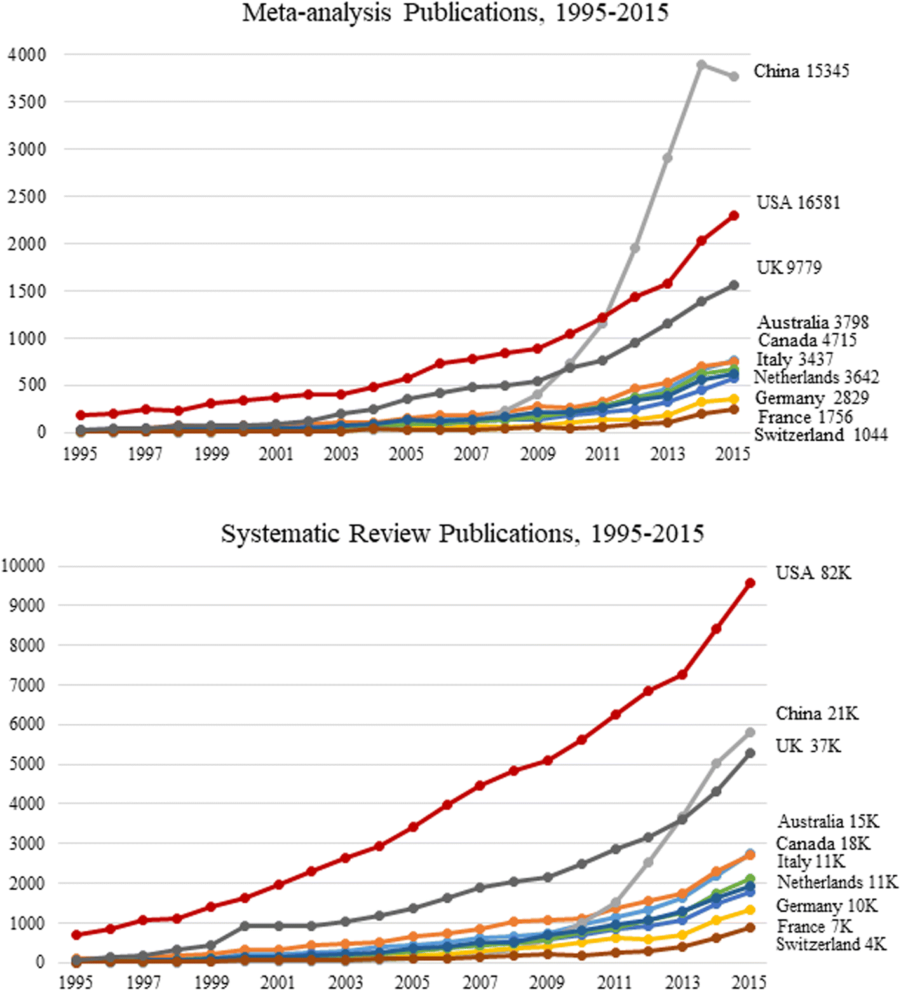
FINDINGS : SRs are increasing:

Slide 9
FURTHER FINDINGS:
University students are carrying out systematic reviews as part of a Master’s Dissertation which may not fit with NHS LKS staff perceptions or expectations of what a systematic review is.
“Systematic reviews seek to collate evidence that fits pre-specified eligibility criteria in order to answer a specific research question. They aim to minimise bias by using explicit, systematic methods documented in advance with a protocol.”*
*Cochrane Handbook for Systematic Reviews of Interventions. Version 6.1, 2020 Series editors: Higgins, J & Thomas, J.

Slide 10
FURTHER FINDINGS:
LKS staff are struggling to support SRs and are considering rationing time:
SRs take a long time to complete at the moment:
“The time required to complete a full systematic review, which is often more than two years following the publication of a protocol, is a barrier both to author teams……and for decision makers…….Methodology for undertaking reviews more rapidly is developing quickly. However, difficult choices are required in the trade-off between rigour and speed.”*
*Available at training.cochrane.org/handbook/current/chapter-I, section-i-2-3
[Accessed on 28.09.2020]

Slide 11
FURTHER FINDINGS:
Health Education England (HEE) established that there is variation in the ratio of qualified LKS staff to support NHS staff in England.
There is a lack of uniformity in the ability to draw down evidence to support the joint HEE and Chartered Institute of Library and Information Professionals (CILIP) initiative of A Million Decisions.*
Health Education England (2019) NHS Library and Knowledge Services in England: Recommendations to improve the staff ratio for the number of qualified library and knowledge specialists per member of NHS workforce. Knowledge for Healthcare Policy Statement.
Available at: https://www.hee.nhs.uk/sites/default/files/documents/HEE%20LKS%20Staff%20Ratio%20Policy%20January%202020.pdf [Accessed : 16 April 2020]

Slide 12
The Support being offered

Slide 13
Documents are being produced to explain the scope of help available.
Some LKS websites define the scope of support offered.
Networks of LKS are developing common policies.
Expert searchers have developed search guidance to help searchers who are supporting systematic reviews.

Slide 14
Helping our users prepare for a systematic review in a way that also helps us to prepare
We have tried to develop a defined and structured service model
Are we are dealing with a ‘full’ systematic review?
Detailing and defining the level at which we are able to assist
Determining how much the researcher has thought through their request

Slide 15
We intend to offer a 3 tiered level of support:
Advisory support
Mediated searches and documentation of the search process
Acquisition of relevant articles

Slide 16
We base the level of support that we are willing to give upon a completed work plan
The questions we ask:
The purpose of the SR
Project timeframe
Has the researcher conducted a SR before?
Registration with PROSPERO
Does a SR or protocol on the same subject already exist?
Has the research question been devised
Have any models been followed to break the research question into searchable components
Limiting factors to be used
Clinical databases to be used
Grey literature databases to be included

Slide 17
Recommendations
Pockets of NHS LKS staff are developing guides/populating websites with SR tools
Some consolidation of advice and tools to help manage demand may be useful?
Otherwise:
Devise a work plan to both assist and manage expectation
The work plan sympathetically reveals whether it is a literature review or systematic review
Revealing the preparatory work the researcher has completed prior to approaching you.

Slide 18
Thank You.

