Slide 1
Regional Library Management Systems

Slide 2
Regional LMS - Background
HEE to fund regional LMS across England
Compatible with the National Discovery Service
Currently being rolled out in some regions
North – much work to do!
Procurement process planned to start summer 2021
Fundamental question – how many systems across the north? 1, 2 or 3...
Notes:
We are wanting services to opt-in to the systems rather than this necessarily being an obligation, but that we hope they will see the benefits in terms of cost efficiencies, reduced administration longer term, and the links through to the Discovery system.

Slide 3
Regional LMS - Engagement
Lots of opportunities to engage
Start the conversation today
Leadership Programme support
Consultation and engagement events to follow
Please share your thoughts with us

Slide 4
LMS Groupwork – Six Thinking Hats
Developed by De Bono
“Six Thinking Hats” helps us to evaluate change from a number of perspectives
As a group spend a few minutes wearing each hat
Note your thoughts/comments on the IdeaBoardz
Blue Hat – Process
White Hat – Facts
Red Hat – Feelings
Green Hat – Creativity
Yellow Hat – Benefits
Black Hat - Cautions

Slide 6
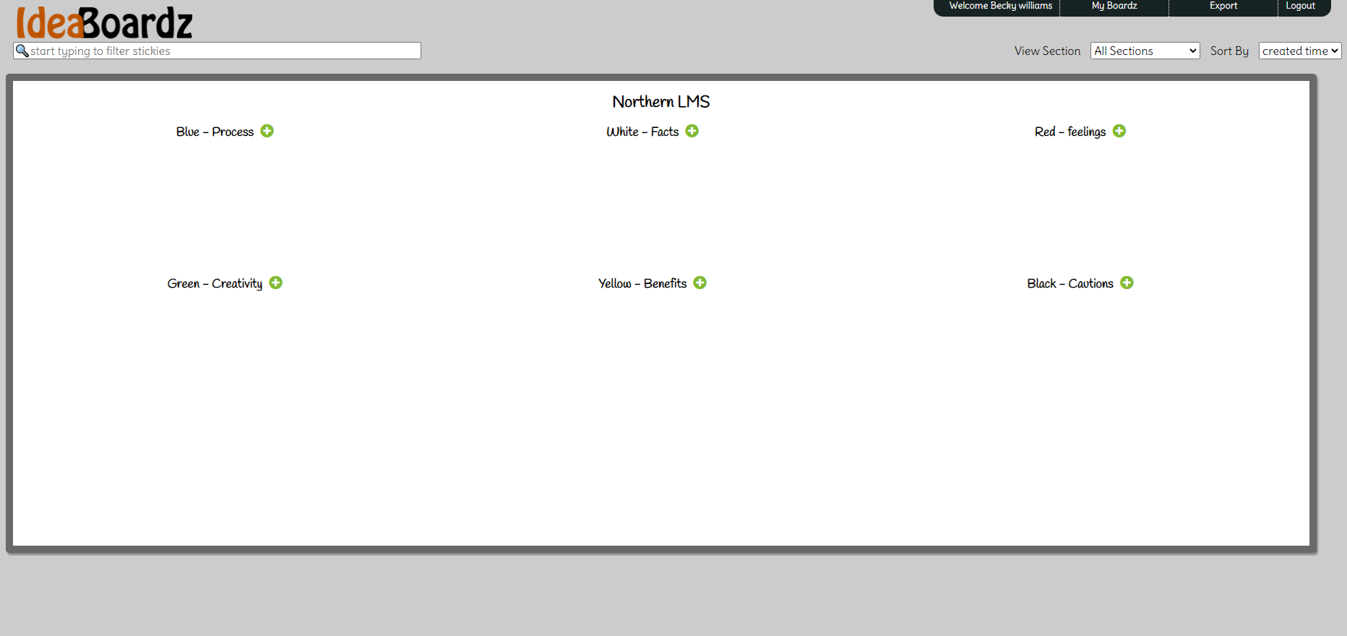
IdeaBoardz
Please leave this meeting at the break and join your group after the break in the group Teams invite
Discuss and add sticky notes for each “hat”
Ensure you leave your group meeting by 12.30 for lunch
Re-join the main meeting by 13.30
Links to the group IdeaBoardz will be provided in the main meeting chat for you to browse over lunchtime. You can “like” comments that you agree with!

