Slide 1
Welcome to STEMClub Collaboration through the pandemic and beyond
Service Transformation through
Evidence Mobilisation
#HealthSTEMclub

Slide 2
Programme
Introduction: About STEMClub: a chance to connect and review the local health landscape led by Mark Lambert
Activity: Reflecting and looking forward: stories from the pandemic
Update and consultation: ‘evaluation eco system’- How can we speed up innovation in Health and Social Care? led by Jody Nichols
Comfort break
Workshop: ‘C-WorKS: a collaborative resource for sharing information about consequences of COVID: what we do and how we can work better together led by Helen Park and Anna Christie
Reflections and next steps

Slide 3
Sharing Stories from the Pandemic

Slide 4
Research & Evidence Team’s COVID-19 response
Helen Martin
Research & Evaluation Co-ordinator
Official
necsu.nhs.uk

Slide 6
Responding to COVID-19
High volumes of research
Hard to navigate
Lots of research repositories being set up
Overwhelming
Focus
Symptoms
Treatments
Spread
What would be valuable to primary care and commissioning?
Official
necsu.nhs.uk

Slide 7
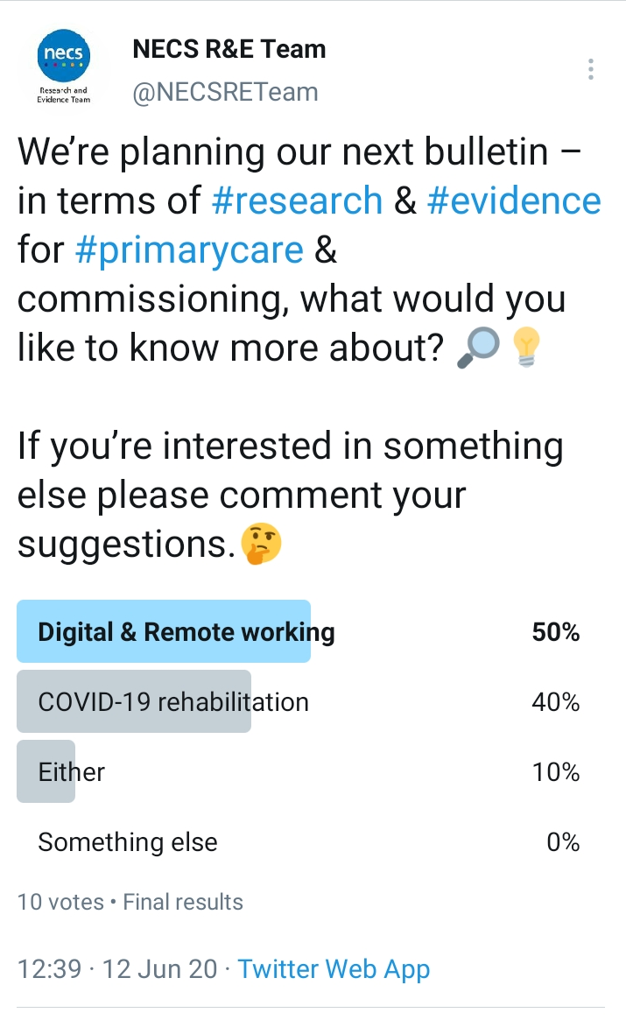
Responding to COVID-19
Periodic bulletins
usually broad, sharing evidence, events, studies to get involved in
Focused, themed bulletins
Link to repositories not repeat
Reviewed and improve style of bulletin to make it more accessible
Asked for topic priorities via Twitter poll
Official
necsu.nhs.uk

Slide 8
Themed bulletins
10 Things to know about COVID-19 research
Digital and remote working at home
Digital and remote working in Primary Care
COVID-19 and mental Health
Official
necsu.nhs.uk

Slide 9
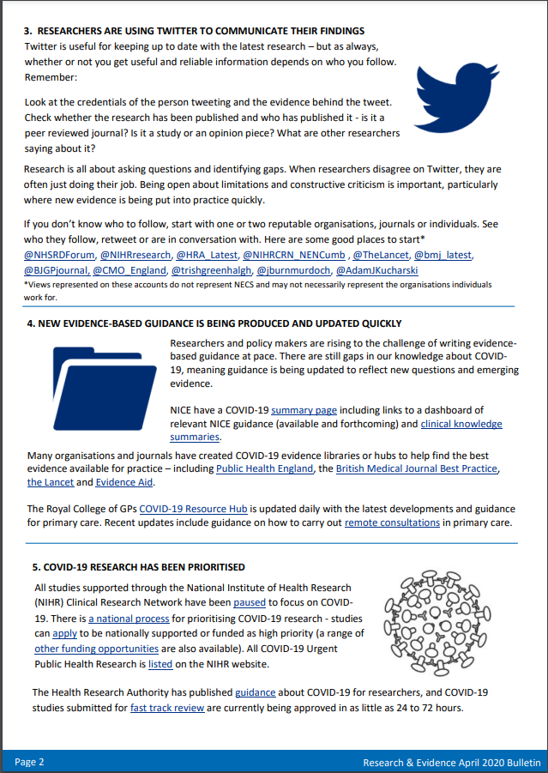
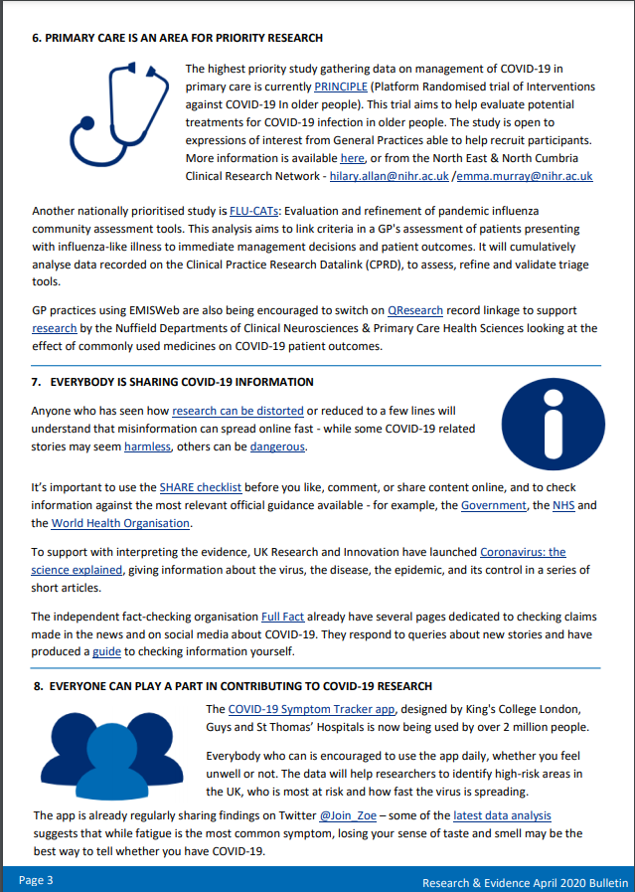
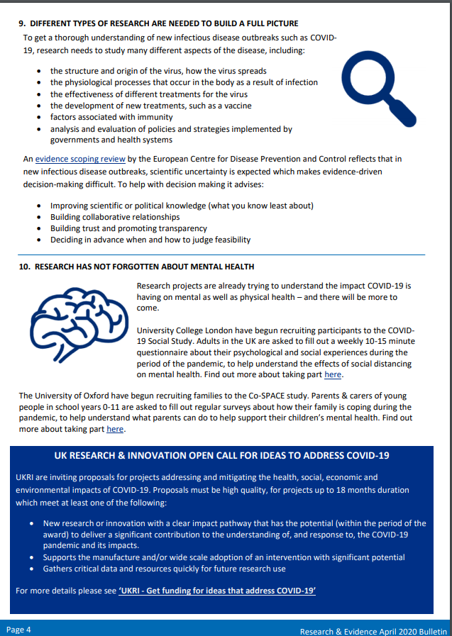
10 things to know about COVID-19 research
Official
necsu.nhs.uk

Slide 10
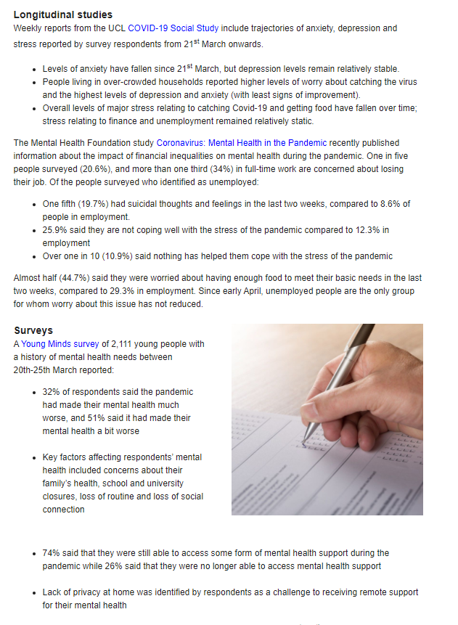
COVID-19 and mental health
Official
necsu.nhs.uk

Slide 11
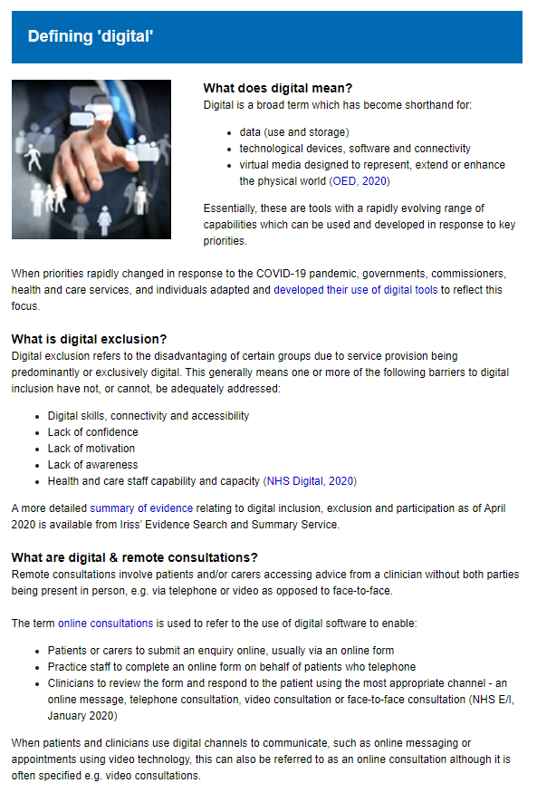
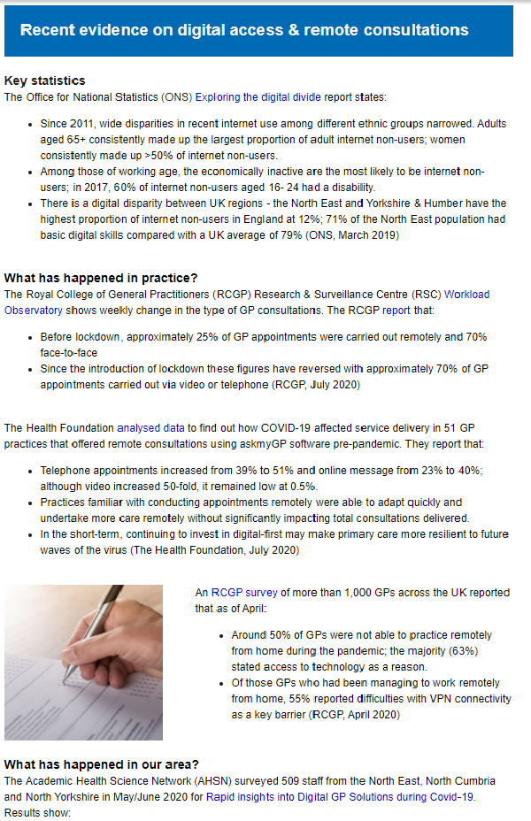
Digital and remote working in primary care
Official
necsu.nhs.uk

Slide 12
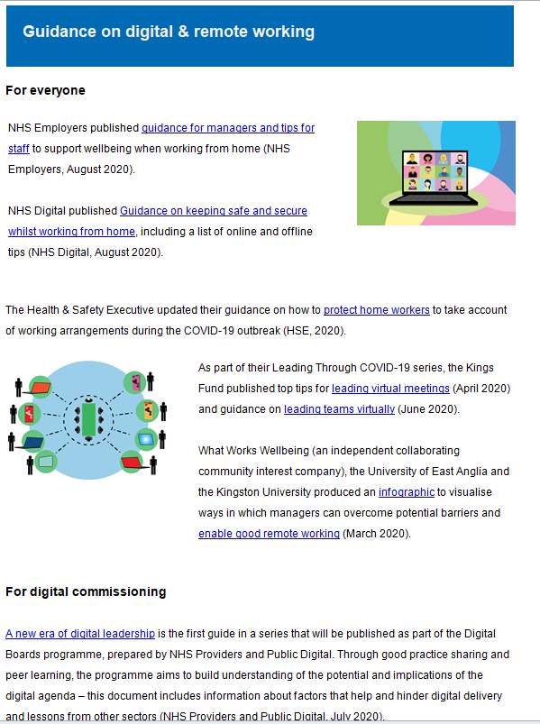
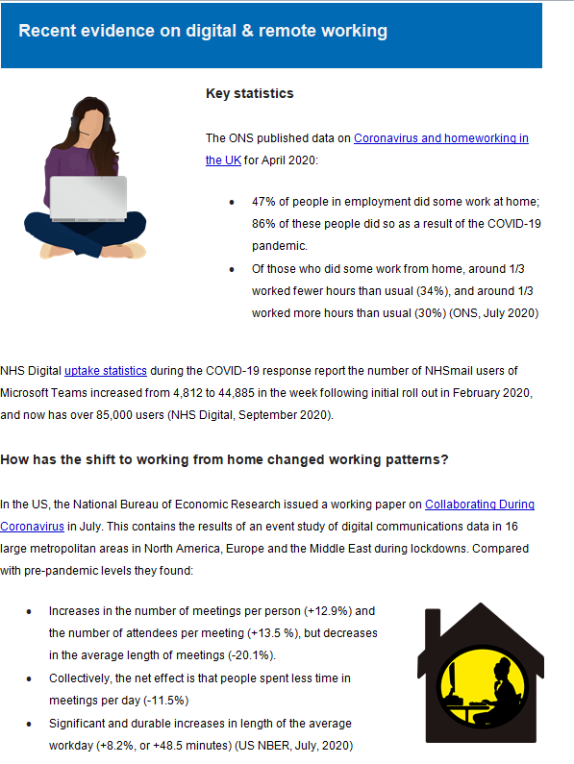
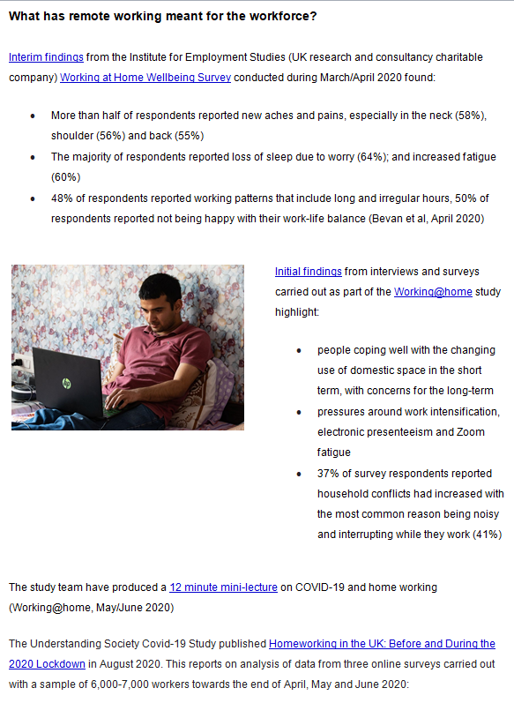
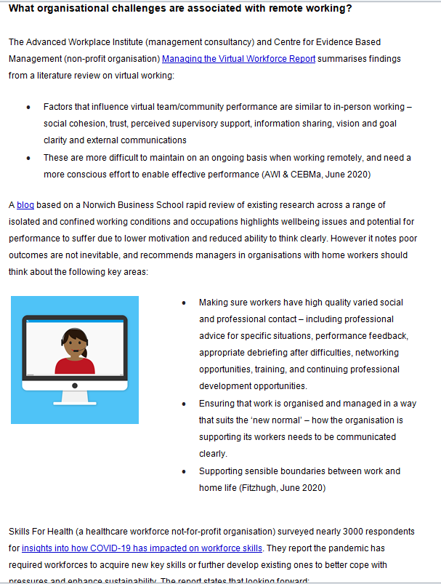
Digital and remote working at home
Official
necsu.nhs.uk

Slide 13
Supporting & advising on C-19 studies
Covid19 - Impact of centralised 24/7 hot hubs
How COVID-19 has affected diabetes care
Retrospective COVID-19 outcome study in patients over 75 who take Vitamin D as a repeat prescription
How has General Practice coped, and what will the new normal working arrangements in County Durham CCG be?
Post COVID recovery - observational follow up study
Why do some healthy people become seriously ill with COVID? (Genomics England)
Psychological impact of COVID19
Official
necsu.nhs.uk

Slide 14
Supporting & advising on C-19 studies
Formulate ideas
Advice and signposting
Grants & funding
Literature review
Governance advice
Resource list
Official
necsu.nhs.uk

Slide 15
#Red4Research
Official
https://www.necsu.nhs.uk/research-evidence/
necsu.reteam@nhs.net

Slide 16
North Cumbria Library & Knowledge Services
Reflections on our experience of the COVID pandemic
www.library@ncumbria.nhs.uk
sheila.marsh@ncic.nhs.uk

Slide 17
Our role during COVID
First wave
Pressure to close
Redeployed coordinating & distributing donations
Setting up virtual service
Latest wave
Maintaining service
Issuing lateral flow kits
Place of refuge
Shared space with vaccination hub
Meet & greet
North Cumbria Library
& Knowledge Services

Slide 18
What was the hardest thing?
No detail or plan
Scope creep
New normal
Picking up new role quickly
Maintain service
Trying to put in some controls!
North Cumbria Library
& Knowledge Services

Slide 19
What was the best thing?
Connecting & getting to know other staff & teams
Witnessing the generosity of people
Recognition for my team shortlisted for Staff Awards
Just Giving total in excess of £50k
Feeling part of the NHS’s fight against the pandemic
Best of all….. the smile on the face of weary staff as you offered them an Easter egg as they finished their shift!
North Cumbria Library
& Knowledge Services

Slide 20
What has it meant for the service?
Making the most of whatever challenge comes your way
Continuing importance for our staff and learners of the physical library space for learning & wellbeing
Opportunity to shine & show how transferable our skills
New opportunities of virtual work environment for our staff, service & profession
Need for us to utilise new virtual tools to connect / share & learn & support our NHS colleagues to do likewise
North Cumbria Library
& Knowledge Services

Slide 21
Thanks you Any questions?
North Cumbria Library
& Knowledge Services
Notes:
Hand over to Shona Haining, Head of Research and Evidence at NECS to talk about future developments at the Integrated Care System level

Slide 22
Notes:
Stretch break
Hand over to Jody Nichols, Health Programme Manager from the Academic Health Science Network who is consulting on an Innovation Pathway.

Slide 23
NENC Evaluation Eco System AHSN NENC
Jody Nichols – NENC AHSN Programme Lead
Russ Watkins – Commercial Director

Slide 24
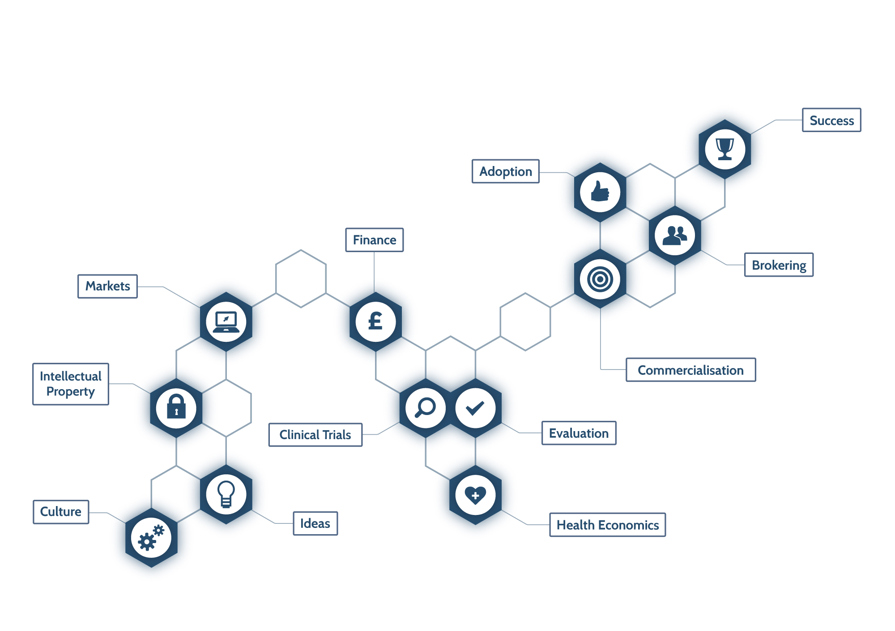
AHSN-NENC – Innovation Pathway
Adoption
Success
Evaluation
Success = patient outcomes & economic growth
Markets
Finance
Facilitate discussions between NHS and innovators to expedite adoption
IP
Facilitate evidence generation & economic argument
Culture
Assistance with funding streams
Business intelligence expertise to assess/ understand market
Expert legal support to help with patent
Innovation scouts help viable idea generation
Notes:
Non linear support service for NHS and industry, include overview notes on each step.

Slide 25
Role of Evaluation and who wants it…..
A means to understand the ‘value’ of something i.e. using data to draw conclusions about whether an intervention or product has had its intended effects….and a means to influence
• Service improvement
• Whether to commission or to continue commissioning
• Whether adaptations are required by the innovators or adopters in the innovation or in how it’s presented
• How or what to spread or scale up
• What is replicable
But we all want something different…..stakeholders, clinicians, providers, commissioners, patient…us

Slide 26
NENC Virtual Evaluation Eco System
AHSN will host a central hub and spoke model that coordinates and brings together rapid evaluation and adoption of innovation across the health and social care landscape in the NE and NC.
Cohesive and joined up ecosystem of collaborative partners and commissioners working in health and social care…were the AHSN can add value by doing the project management / coordination / navigating
Remove some of the obstacles and frustrations that innovators experience whilst in the innovation pathway…NHS / social care are complex

Slide 27
What will the eco system provide?
Job Creation
Attractive NE and NC
Supporting Industry
Clear pathway to evaluation and system
Single point of access and address genuine unmet need and developing solutions to fit
Early Adoption
Securing endorsement at an early stage e.g. commissioners, clinicians
Systematic model that avoids duplication and provides validity
Timely Evaluation and Addressing gaps in structures e.g. commissioning and health economics
Triaging process with a yes or no response
Provide an infrastructure to remove the need to do multiple evaluations
Unique aspects GNCR and our ‘approach’
Post adoption review stage – critical appraisal
Birds eye view of the Eco- System

Slide 28
NENC Evaluation Eco System Structure
Themes
Evidence
Regulation
Evaluation
Digital
Med Tech
Diagnostic
Pharma
Market Setting – placed in system
ACUTE Mental Health PCNS/CCG’s LA
NICE LEPs AHSN Network AAC
Strategic
FT’s
LA
CCG’s
PCNs
DXNE
GNCR
LEP
LCRNs
Med Connect North
Universities
ARC
Health Care Innovation Centre
Med Physics – EAC
RTC
NECS
MIC
CPI
Clinical Trial support
Northern Accelerator Program
Stakeholders
ISN / UKRI

Slide 29
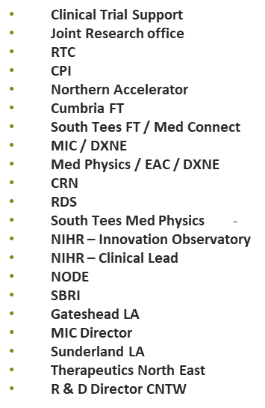
Scoping to date
LCRN / Med Connect
AHSN ‘s
LEP
GNRC
NECS
North Tyne CCG
NG CCG
ARC
Sunderland University
Durham University
Teesside University
Newcastle University
Northumbria University
Cumbria University

Slide 30
Business Engagement
Nick Howard @ Natrox Wound Care (oxygen wound therapy)
David Garrell @ My Way Digital Health
Will Dracup – EDI (early diagnostics institution)
Chris Gordan – Pfizer

Slide 31
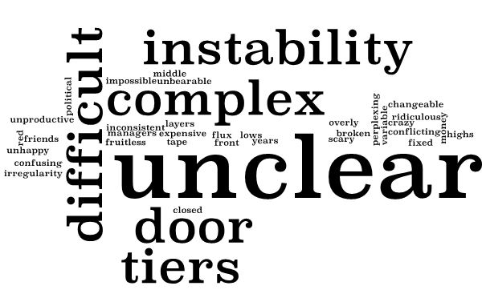
Feedback from Innovators about their journey into the NHS

Slide 32
Already identified (VOICE)
End to end process managed by a Co-ordination Centre led by Programme Manager & team of liaison staff across health and social care
To be identified
Existing solutions that could be adapted
Unmet need identification process
Review and prioritization of unmet needs by Advisory Committee
Unmet need calls
AHSN Comms Department do all unmet need calls - could be expanded to include social care
Advertise calls inviting innovators to submit solutions
SINGLE FRONT DOOR (OMNIA)
Detailed information to be provided by innovator on triage form
The OMNIA online platform is currently being developed by AHSN to co-ordinate the innovation lifecycle. All delivery partners have access. Could be expanded to social care
UNMET NEED ASSESSMENT
EVIDENCE BASE
LEGAL
REGULATORY
Consumer/Clinical need
Market analysis
Competitor Analysis
Critical Data Appraisal
Gap Assessment
Patent check/filing
Licensing status
Co-ordination Centre
Triage Form
MARKET ACCESS
FINANCE
TECHNICAL
Health Economic argument
Funding support available
Technical feasibility
Scalability predictions
LEVEL 1 TRIAGE
DOES IT SATISFY AN UNMET NEED?
DOES IT ADDRESS REGIONAL PRIORITY?
Consumer panel (PPI)
Health & Social Care panel
2/52
YES/NO GO DECISION TO SUPPORT
LEVEL 2 TRIAGE

Slide 33
Panel role –virtual team of expert to advice and guide each promising innovation, allowing each part of the eco system to support and ensure best possible opportunity for the innovation to be commissioned within the NHS/Social Care
Innovator
OMNIA
First Triage
Idea
Pre CE Mark
Post CE Mark
RWE
Adoption and Scale / Scale UP
Value Proposition
Second Triage
MDT virtual panel of experts
Priority, Business Rules, Plan and who's involved at what point
‘Doers’ and ‘expert panel ’
Evaluation Development
Unmet need / Clinical Pull
Evidence generation / RCT
MHRA
NICE programme
Cost Benefit / VP
Spec requirements / Scale up plan
Outputs

Slide 34
Full pathway
The NENC evaluation eco system team will be required to manage all activities along the pathway
Unmet need / Innovator Contact
Data Management / Innovator Feedback / Feedback to stakeholders
EXTERNAL Commissions
Methodologists
Qualitative and Quantitative
Health economists
Project management
Economic Growth Team ensure all requests enter single front door approach
INTERNAL Expertise
NHS networks
Commercial networks
Market research
Legal
Project Management
Evaluation Conducted
EXTERNAL Commissions
Manage delivery contracts
1st Triage – single front door (Triage Form assessing support)
Evaluation Design Developed
Co-ordinate the triage process
Manage Advisory Committee
Evaluation Specialists
Finance
No- alternatives support – EG team
Yes – evaluation support offered
Second triage panel to design evaluation – key ‘stakeholders’ depend on innovation -
Timing is key here
Pathway navigator
EG team
Reposition
Feedback
Co-ordinate the triage process
Manage Advisory Committee

Slide 35
Current Innovation Funnel….
Idea/Pre CE Mark
Post CE Mark
Real World Evaluation
Adoption
Post Market
Surveillance
Sector – Digital, MedTech, DiagnosticsPharma
Clinical Mental health , etc
Limited visibility
Who is working with whom
Limited feedback
Reflection? Critical appraisal?
Do we know how many we have supported to be commissioned and scaled?

Slide 36
Innovation Funnel….after implementation of NE NC Evaluation Ecosystem
Idea/Pre CE Mark
Post CE Mark
Real World Evaluation
Adoption
Post Market
Surveillance
OMNIA
Sector – Digital, MedTech, Diagnostics, Pharma
Clinical Mental health , etc
At any point we can review were any innovator is and who they are working with
- Who is successful and who is not and why
Analysis / grounding in data
Infrastructure unique to the UK
Opportunity to review at any point

Slide 37
Current Position…
LEP LGF – secured grant – top 5 regional priority post covid
3 objectives
Deep dive / focus groups / business case
Funding request from North of Tyne Combined authority to operationalise the system
AHSN NENC is now keen to push forward this work forward and is looking to operationalise for April 21

Slide 39
Notes:
5 minute comfort break
Please stay in the main room for now
You should have an extra Teams invite for a little later.
If you don’t have it, please let me know in chat
Stop sharing so Anna can take over
IdeaBoardz link
https://ideaboardz.com/for/STEMClub%20and%20C-WorKS%20/3682415

Slide 40
C-WorKS: COVID-19 consequences –
Want it? or Know it? Share it!
Workshop: What we do and how we can work with STEMClub
Helen Park and Anna Christie
C-WorKS: COVID-19 consequences
Want it?
Know it?
Share it!

Slide 41
Discussion
What do STEMClub and C-WorKS have in common – where do we overlap?
What are the differences between STEM club and C-WorKS?
How can we best work together?
C-WorKS: COVID-19 consequences
Want it?
Know it?
Share it!

Slide 42
What is C-WorKS?
Regional hub and community of practice which supports joint learning, collation and sharing of knowledge and intelligence across the region about impacts of COVID-19 (and responses to this) on non-COVID related disease and death. We are a community – a platform, newsletter, events – constantly refining and evolving
Rationale behind it: new knowledge and intelligence created in response to COVID-19 in our region or of use to our region is not collated and shared, which hinders learning at system level and developing more effective, efficient and equitable responses to the pandemic
C-WorKS empowers members to add their own resources, post questions and proactively contact others who are working on similar issues
C-WorKS will adapt over time (including working with STEMclub!) to make sure it best serves the needs and wants of its users.
C-WorKS: COVID-19 consequences
Want it?
Know it?
Share it!
Notes:
Sarah

Slide 43
Background
COVID-19, and measures to limit the spread of the virus, have had a huge impact on individuals, communities and care services. C-WorKS provides a regional, system-wide approach to share relevant knowledge and intelligence across the system.
The idea for C-WorKS evolved from a paper scoping the broader impacts of COVID-19 and lockdown. This document is regularly updated and the latest version can be accessed in the Library here (C-WorKS sign up required) or by emailing LKISNorthEastandYorkshire@phe.gov.uk
C-WorKS is hosted via the LKIS NE PHINE Network Khub group. Registration is required to view C-WorKS content. Registration is simple, free and open to all.
C-Works was formally launched on June 1st 2020.
C-WorKS: COVID-19 consequences
Want it?
Know it?
Share it!

Slide 44
Since launch on 1st June 2020 C-WorKS has:
564 members
335 members have visited in the past 6 months (89 in the past month)
179 resources uploaded
Members from organisations including:
Local Authorities
PHE
NHS Trusts
NHS Commissioners and Commissioning support services (mainly NECS)
NHSE/I
Universities (incl. Fuse, CRN, AHSN, ARC)
Note: only users 1st June 2020-11th Nov included in this breakdown
C-WorKS: COVID-19 consequences
Want it?
Know it?
Share it!
Notes:
Sarah
As well as the resources posted and the platform itself other outputs include: presentations at events, monthly newsletter, user activity update reports.

Slide 45
Want it?
Does anyone know of any data showing the impact of COVID on child and adolescent mental health and wellbeing? For example self-harm, self-esteem, referral rates, anxiety, social gradients, patterns etc?
Prof Peter Kelly (Regional Director, North East and Yorkshire region, Public Health England)
C-WorKS: COVID-19 consequences
Want it?
Know it?
Share it!
Notes:
Sarah

Slide 46
Know it?
Rapid literature review on the impacts of COVID-19 on children and young people (undertaken Sept/Oct 2020)
Contact: V.cooling@nhs.net
Study on the impact of Covid-19 on young people aged 13-24 in the UK- preliminary findings by C19PRC. Mental ill-health at age 17 in the UK: Prevalence of and inequalities in psychological distress, self-harm and attempted suicide Contact: UCL
Share it!
Wider Impacts of COVID-19 on Health (WICH) monitoring tool Mental Health and Wellbeing – PHE
Contact: Web link:
WICH tool
How has lockdown and the coronavirus pandemic affected young people?
Contact: Contact: steph.scott@ncl.ac.uk
North East and North Cumbria child Health and Well-being Network
COVID-19: mental health and wellbeing surveillance report – Chapter 7 Children and Young People
Yorkshire and Humber Children and Young People Community of Improvement
Contact:
Khub group
Co-SPACE study - University of Oxford
Mental Health of Children and Young People in England, 2020: Wave 1 follow up to the 2017 survey - NHS Digital
C-WorKS: COVID-19 consequences
Want it?
Know it?
Share it!
Notes:
Sarah

Slide 47
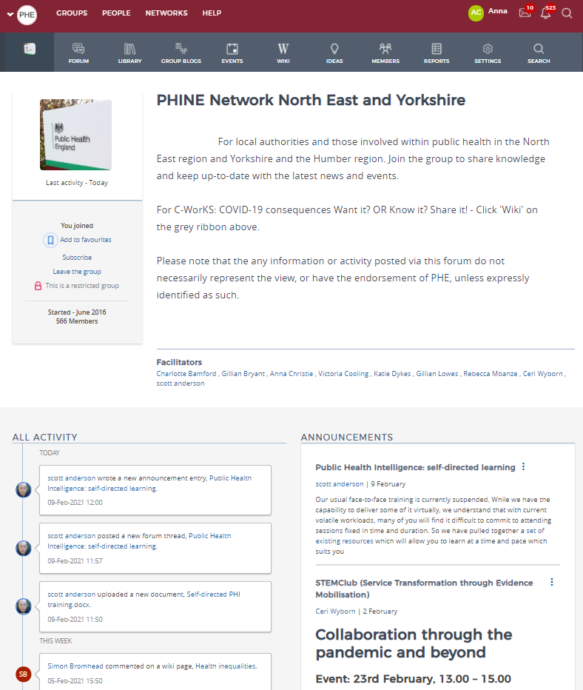
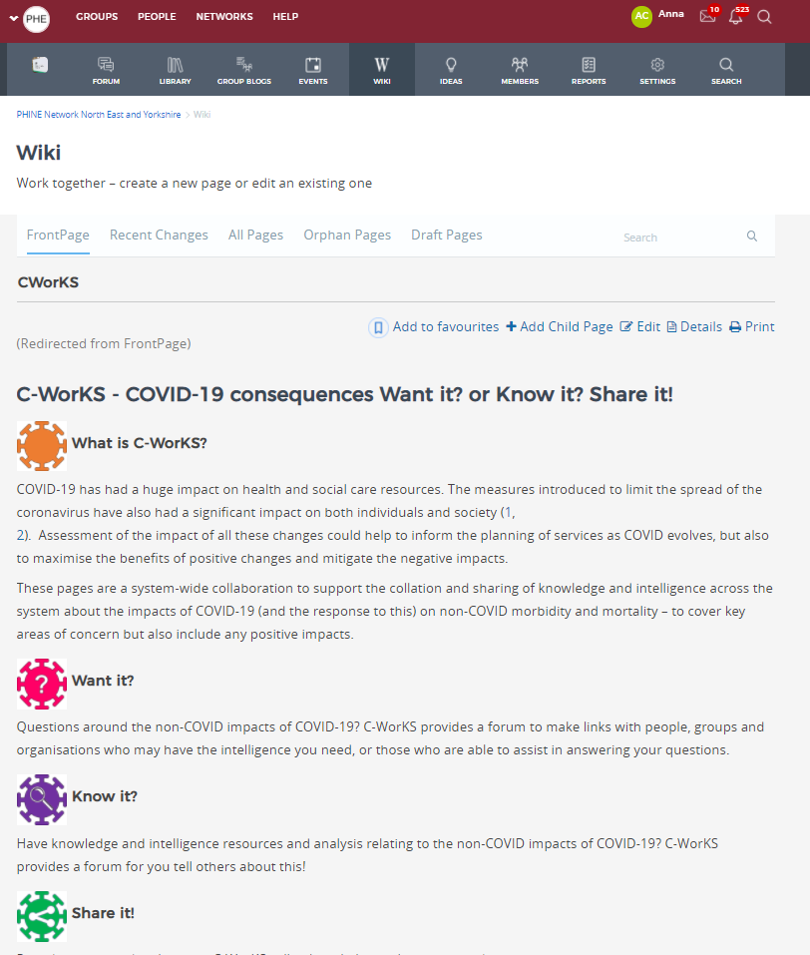
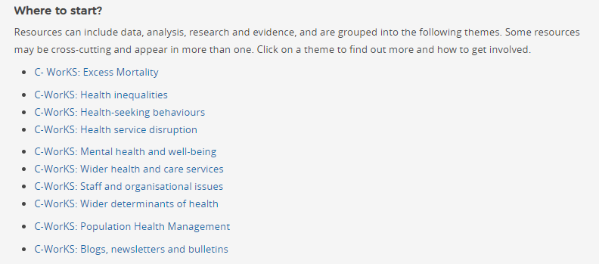

Slide 48
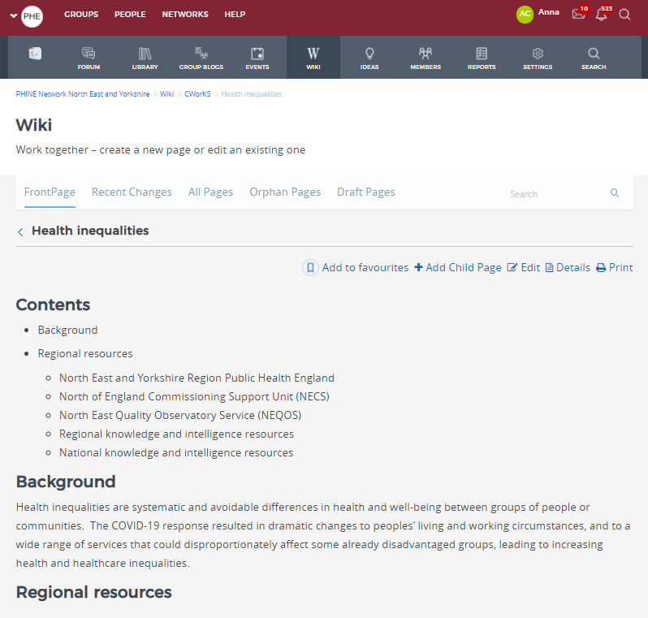
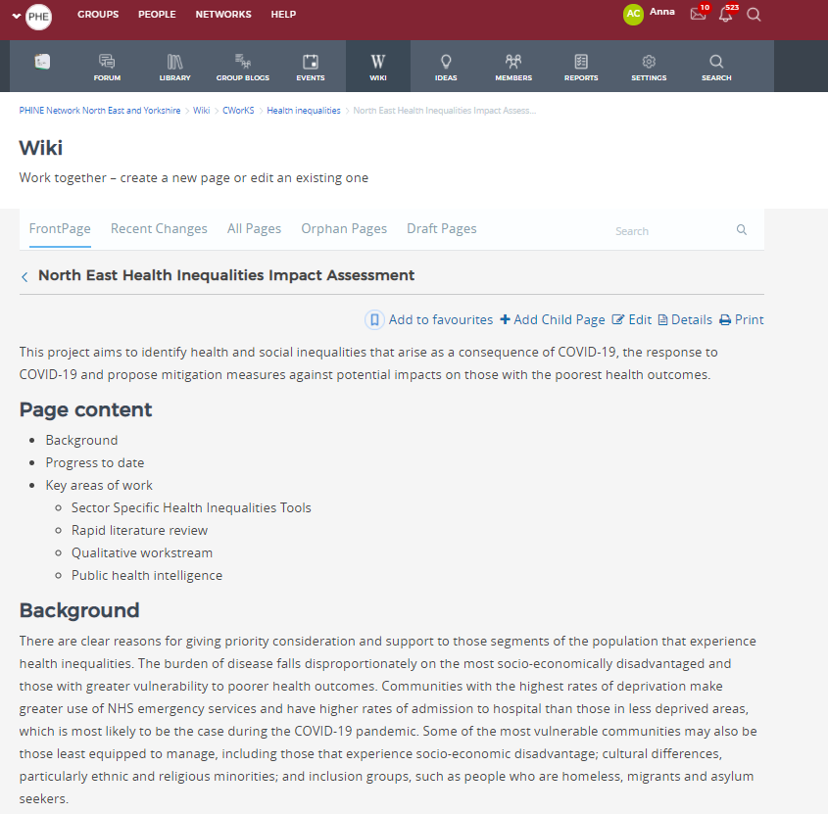

Slide 49
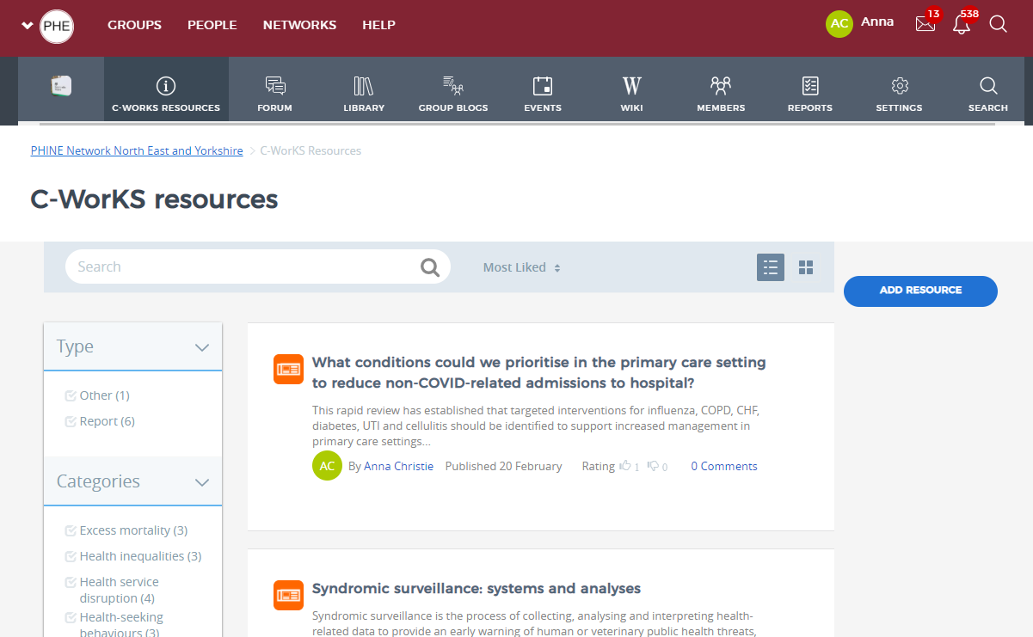

Slide 50
Discussion
What do STEMClub and C-WorKS have in common – where do we overlap?
What are the differences between STEM club and C-WorKS?
How can we best work together?
C-WorKS: COVID-19 consequences
Want it?
Know it?
Share it!

Slide 51
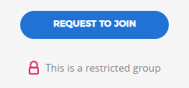
How to register
1: In order to access the C Works Knowledge Hub you will first need to register on Khub if you haven’t already. Please click here to set up your account.
2. Once your account has been created please navigate to the PHINE Network North East and Yorkshire Group. This is a restricted group for those working within a public health remit, so you need to request access to join. Request access by clicking the ‘request to join’ button on the left-hand side of the front page.
3. Once access to PHINE Network North East and Yorkshire has been granted please access the C-WorKS Knowledge hub via the landing page here or by clicking on the ‘wiki’ tab found across the top of the front page
C-WorKS: COVID-19 consequences
Want it?
Know it?
Share it!

Slide 52
Contact Us
If you need anything at all, contact one of the team at C-WorKS
Helen.park@phe.gov.uk
Mia.Moilanen@phe.gov.uk (Mia is our new project manager)
sarah-jane.raymond@nhs.net (Sarah is a librarian at CDDFT and understands issues facing librarians and knowledge managers)
Anna.Christie@phe.gov.uk (Anna understands all things technical)
Ceri.Wyborn@phe.gov.uk (Ceri is involved in all things operational for C-WorKS and undertakes our intelligence updates and newsletter).
C-WorKS: COVID-19 consequences
Want it?
Know it?
Share it!

Slide 53
Thank you and keep in touch
STEMClub
Joanne Naughton
Joanne.naughton@hee.nhs.uk
CWoRKS
Helen Park
Helen.Park@phe.gov.uk
Mia Moilanen
Mia.Moilanen@phe.gov.uk

Slide 54
Reflections and Next steps
What are the next steps?
What would help?
Notes:
- Any thoughts on how we grow the Network?
How we work across Regions?
- Any asks from the planning group?
- Any next steps for you?

