Slide 1
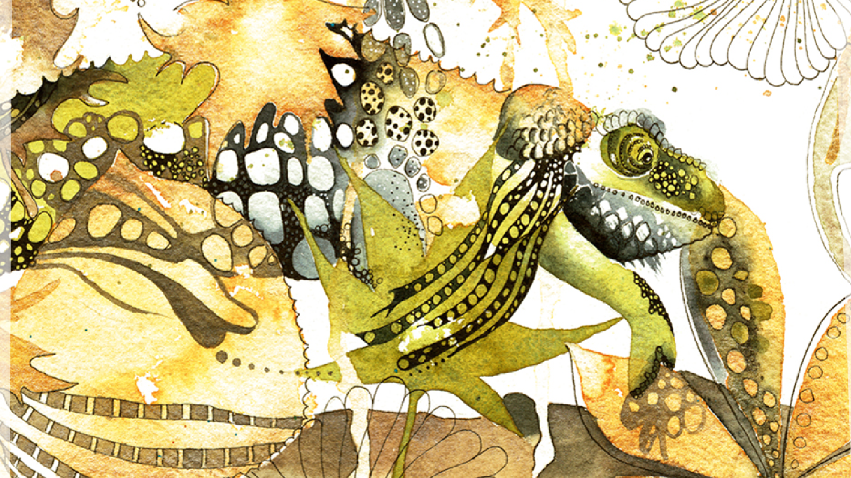
Cheshire and Merseyside Librarians
It has been an exciting year in Cheshire & Mersey getting the gang back together again. We have reformed with members from NHS, HE, 3rd Sector and public libraries.
The focus is show and tell around monthly themes and emerging work from the ICS. We invited Alan Fricker and Becky Williams to discuss Health Literacy from a Hub and shared practice perspective.
People can also ask for help, which has led to a project developing a resource for Getting Research Published. This resource is now live and all feedback welcome to susan.smith2@mcht.nhs.uk
https://library.hee.nhs.uk/learning-academy/learning-zone

Slide 2
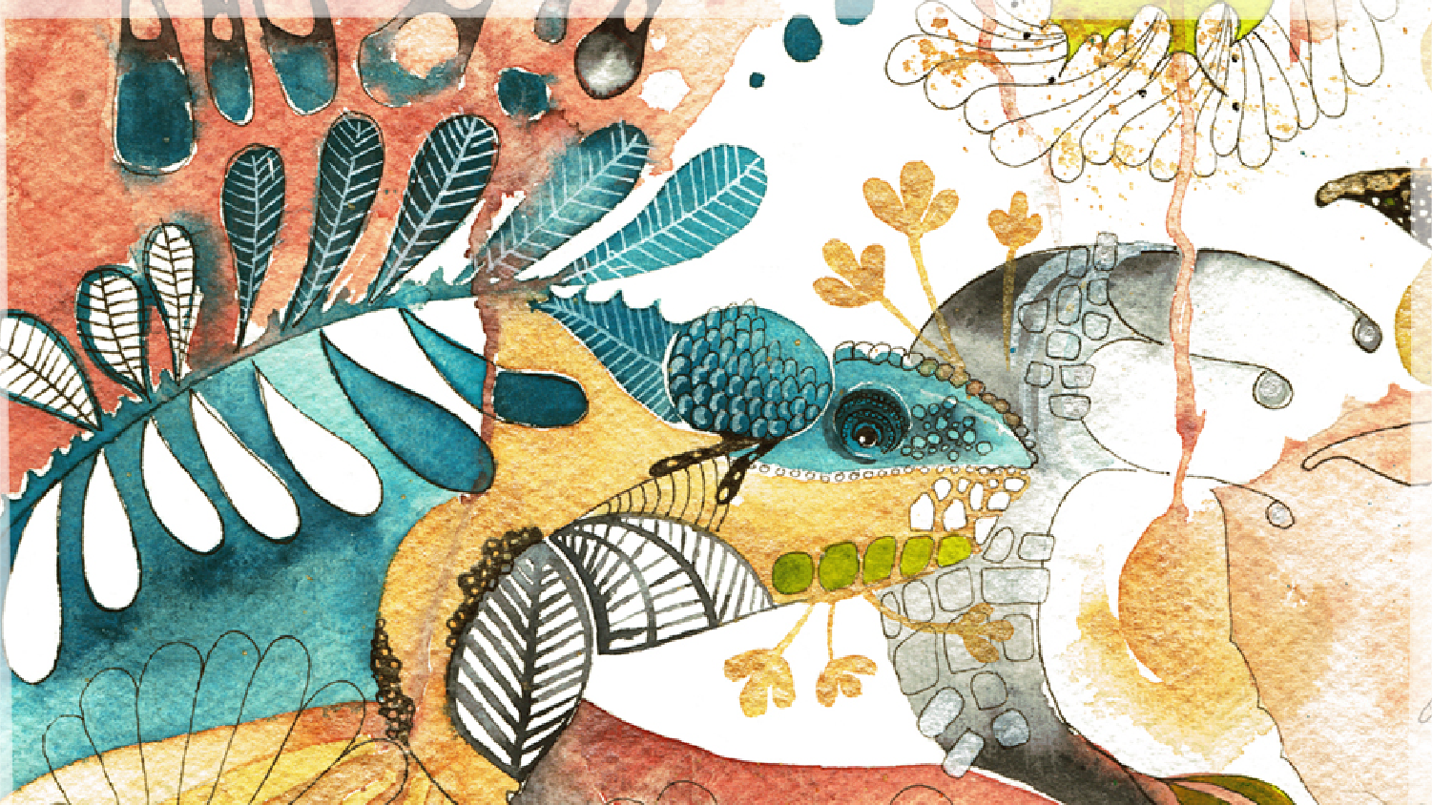
Northern Lights Editorial Group
Northern Lights seeks to share learning and experience throughout the North. In 2022 we published 4 issues of Northern Lights.
We are currently looking to recruit new members to the editorial board. If you are interested in finding out more, then please contact Andrew.Craig@lthtr.nhs.uk.
You can subscribe to Northern Lights by going to https://www.lksnorth.nhs.uk/newsletters/.
If you have any ideas that you would like to share, then please email northernlights@knowledgeforhealthcare.nhs.uk

Slide 3
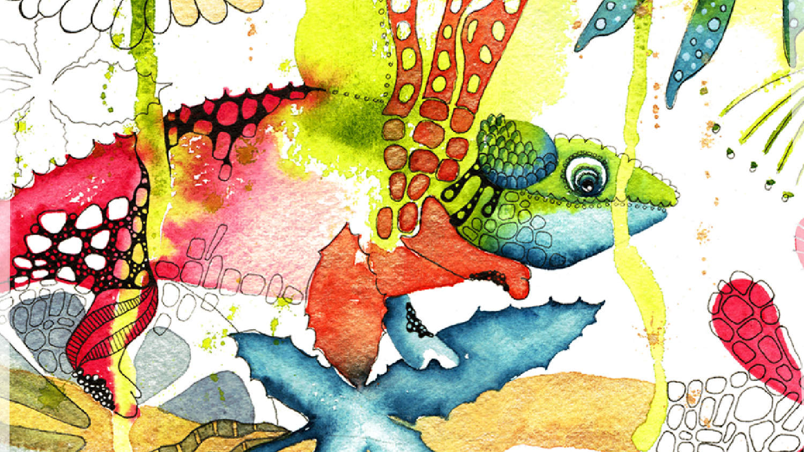
Clinical Librarians, Trainers and Searchers Group
The group has been meeting via Teams every two or three months to discuss issues like training, specifically Critical Appraisal, as well as topics pertaining to promoting and marketing library resources and services.
We occasionally have guest speakers discussing their own services and expertise such as Steve Glover who spoke on Open Access journals and Jon Brassford who will be speaking about the Trip database at the upcoming meeting in July.

Slide 4
Mental Health Librarians
The group has been meeting via Teams every two or three months and have discussed topics like training, as well as issues relating to native interface searching, the KLS Hub and RefWorks.
The next meeting booked for 27th June

Slide 5
Greater Manchester Librarians
We have new managers in post at Bolton Hospitals, Stockport & Tameside
GM EBook consortium has continued to grow following the rescue by VLe eBooks after the Dawsonera collapse
Continue to focus on peer to peer support
Will be rotating the Chair at our next meeting.

